Slide 1
Camera Geometry
Notes:
Lecture Recording
Please see Panopto.

Slide 2
Announcements
HW 2 Written due on Thursday, 10:30 AM
Broader impact discussion right after class today

Slide 3
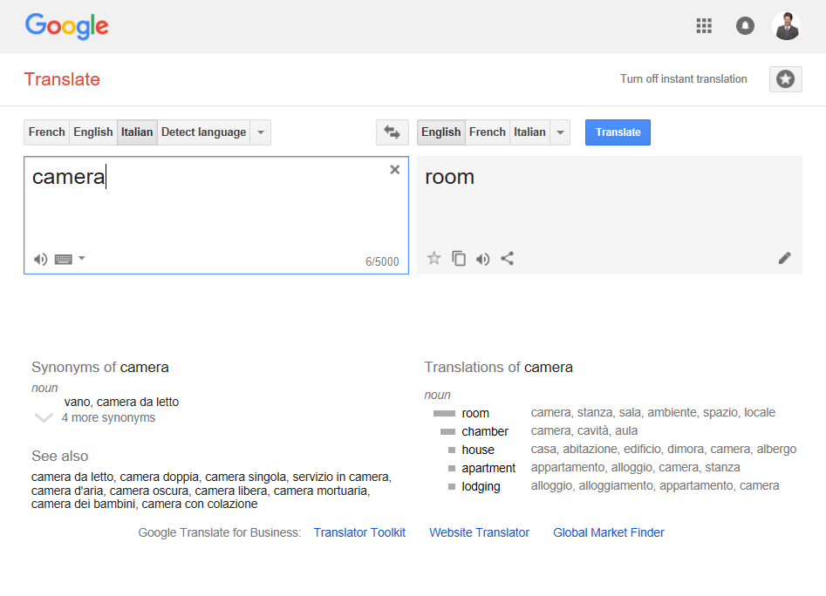

Slide 4
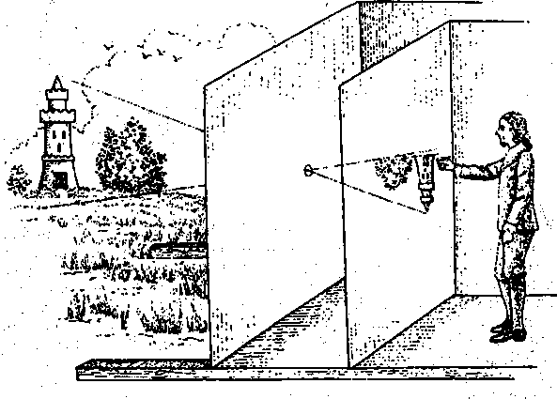
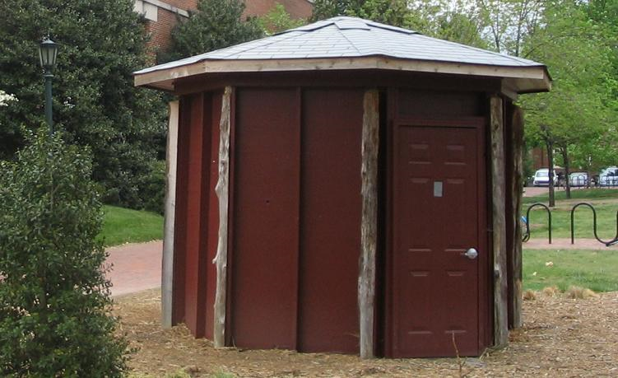
Camera Obscura: dark room
Known during classical period in China and Greece (e.g., Mo-Ti, China, 470BC to 390BC)
Illustration of Camera Obscura
Freestanding camera obscura at UNC Chapel Hill
Photo by Seth Ilys
James Hays
Notes:
In these very early ‘cameras’, light from a scene passed through a small opening (pinhole) and was projected onto a wall on the inside

Slide 5
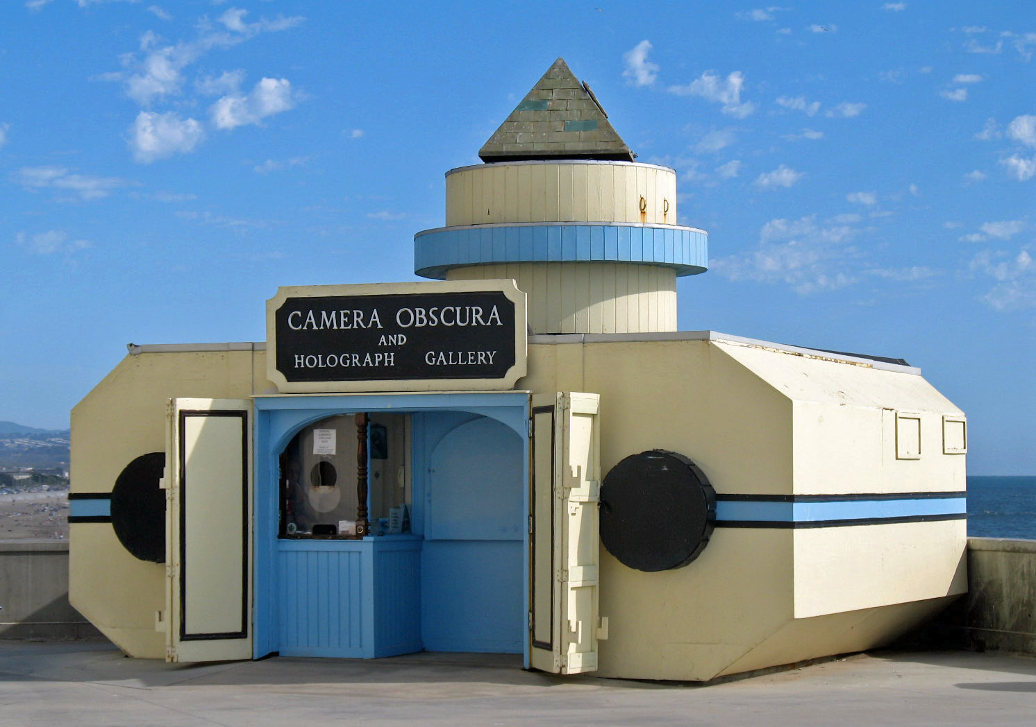
Camera Obscura, San Francisco. Wikipedia

Slide 6
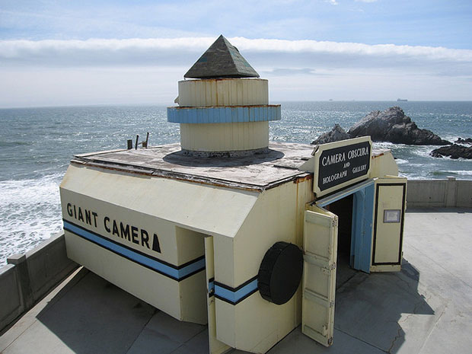
Petapixel

Slide 7
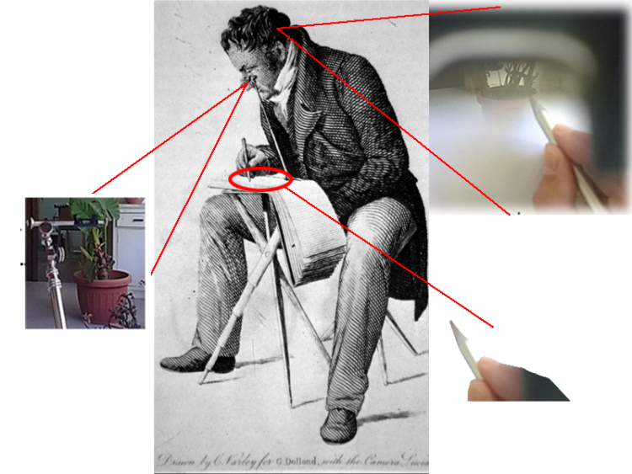
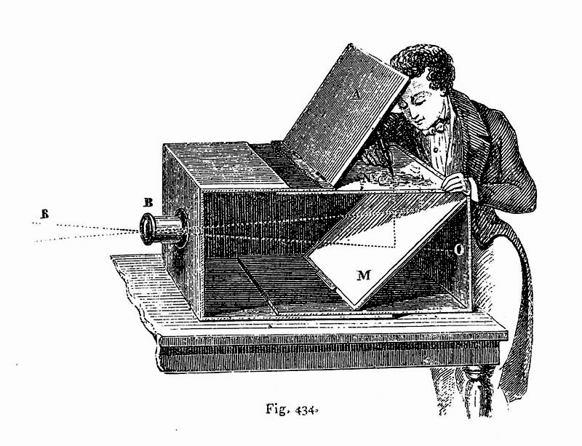
Camera Lucida
Lens Based Camera Lucida, 1568
drawingchamber.wordpress.com
Notes:
https://drawingchamber.wordpress.com/about-me/about/camera-obscura-claude-glass-and-camera-lucida/

Slide 8

Vermeer
Vermeer, The Music Lesson, 1665
Notes:
Trailer: http://www.imdb.com/title/tt3089388/videoplayer/vi4167804953?ref_=tt_ov_vi
Tim Jenison – NewTek company.
Chromatic aberration, lens curvature distortion visible.
Hockney – 2001 book -

Slide 9

Tim’s Vermeer
Vermeer, The Music Lesson, 1665
Tim Jenison (Lightwave 3D, Video Toaster)
Notes:
Trailer: http://www.imdb.com/title/tt3089388/videoplayer/vi4167804953?ref_=tt_ov_vi
Tim Jenison – NewTek company.
Chromatic aberration, lens curvature distortion visible.
Hockney – 2001 book -

Slide 10
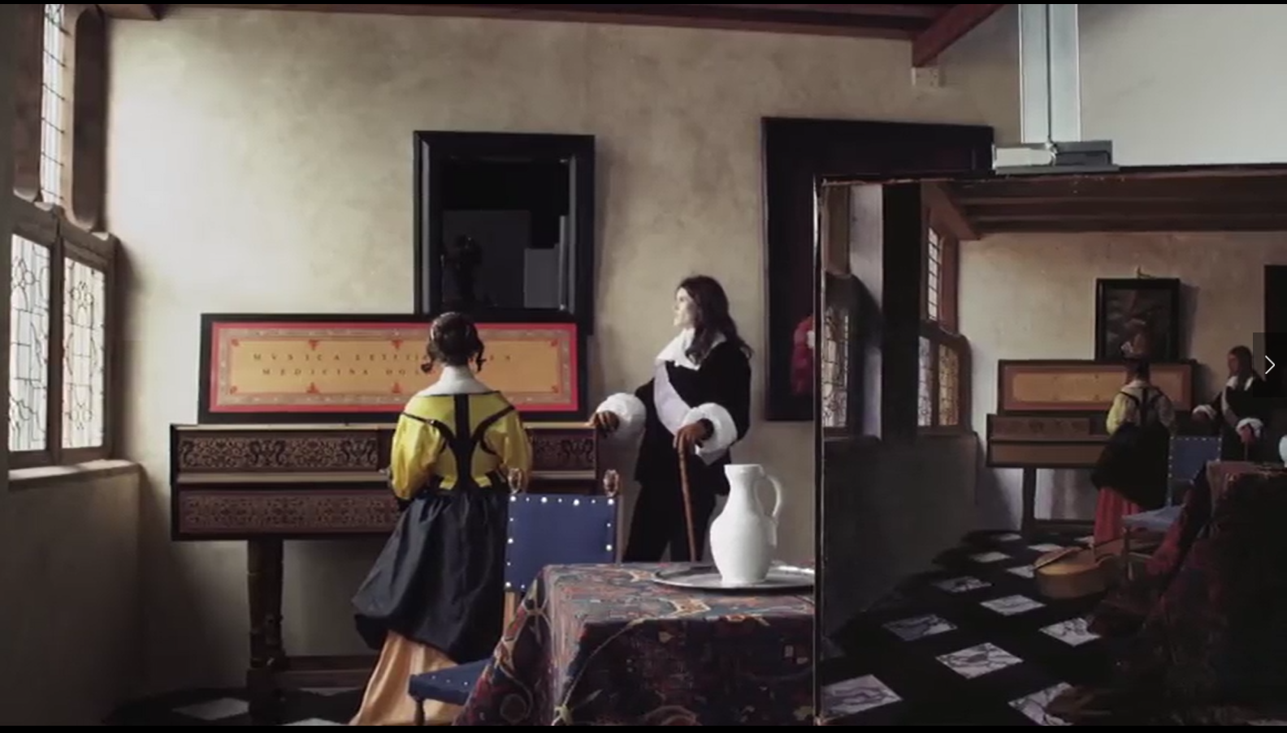
Tim’s Vermeer – video still
Notes:
Tim Jenison built a replica of the room depicted in Vermeer’s painting, then attempted to paint it using the same techniques.
We see (in the background) the replica room, plus in the foreground to the right Tim’s painting.

Slide 11
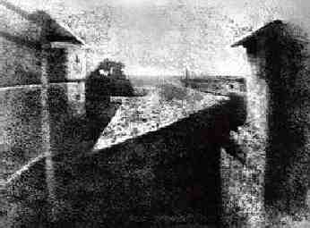
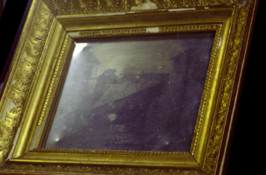
First Photograph
Oldest surviving photograph
  Took 8 hours on pewter plate (with some reports claiming it was several days)
Joseph Niepce, 1826
Stored at UT Austin
Notes:
Instead of using paper or film, Niépce utilized a 16.2 cm × 20.2 cm pewter plate as his backing. He coated the metal with a thin layer of Bitumen of Judea (a light-sensitive natural asphalt) and placed it inside a camera obscura pointed out his workroom window
The Development: He washed the plate with a mixture of oil of lavender and white petroleum. This dissolved away the soft bitumen that had been in the shadows, leaving behind a permanent image made of hardened light areas and bare, dark pewter.
Niépce called this innovative process heliography (literally "sun drawing"). The original, historic pewter plate survives to this day and is preserved in a specialized, oxygen-free display case at the Harry Ransom Center at the University of Texas at Austin.

Slide 12
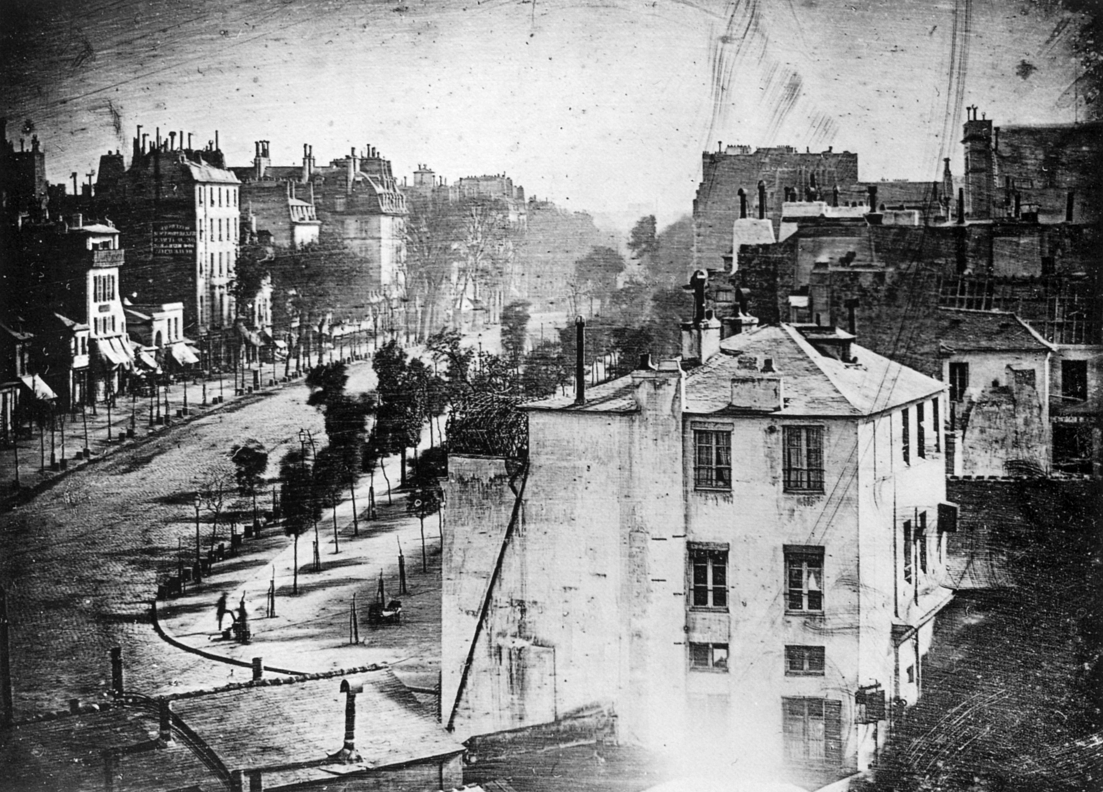
First Photograph with People
Boulevard du Temple, Louis Daguerre, 1838. Wikipedia.
Notes:
The Boulevard du Temple, a daguerreotype made by Louis Daguerre in 1838, is generally accepted as the earliest photograph to include people. It is a view of a busy street, but because the exposure lasted for several minutes the moving traffic left no trace. Only the two men near the bottom left corner, one of them apparently having his boots polished by the other, remained in one place long enough to be visible.

Slide 13
Dimensionality Reduction Machine (3D to 2D)
3D world
2D image
Figures © Stephen E. Palmer, 2002
Notes:
You can think of a camera as a machine that projects 3D scenes from a certain point of observation into 2D images

Slide 14
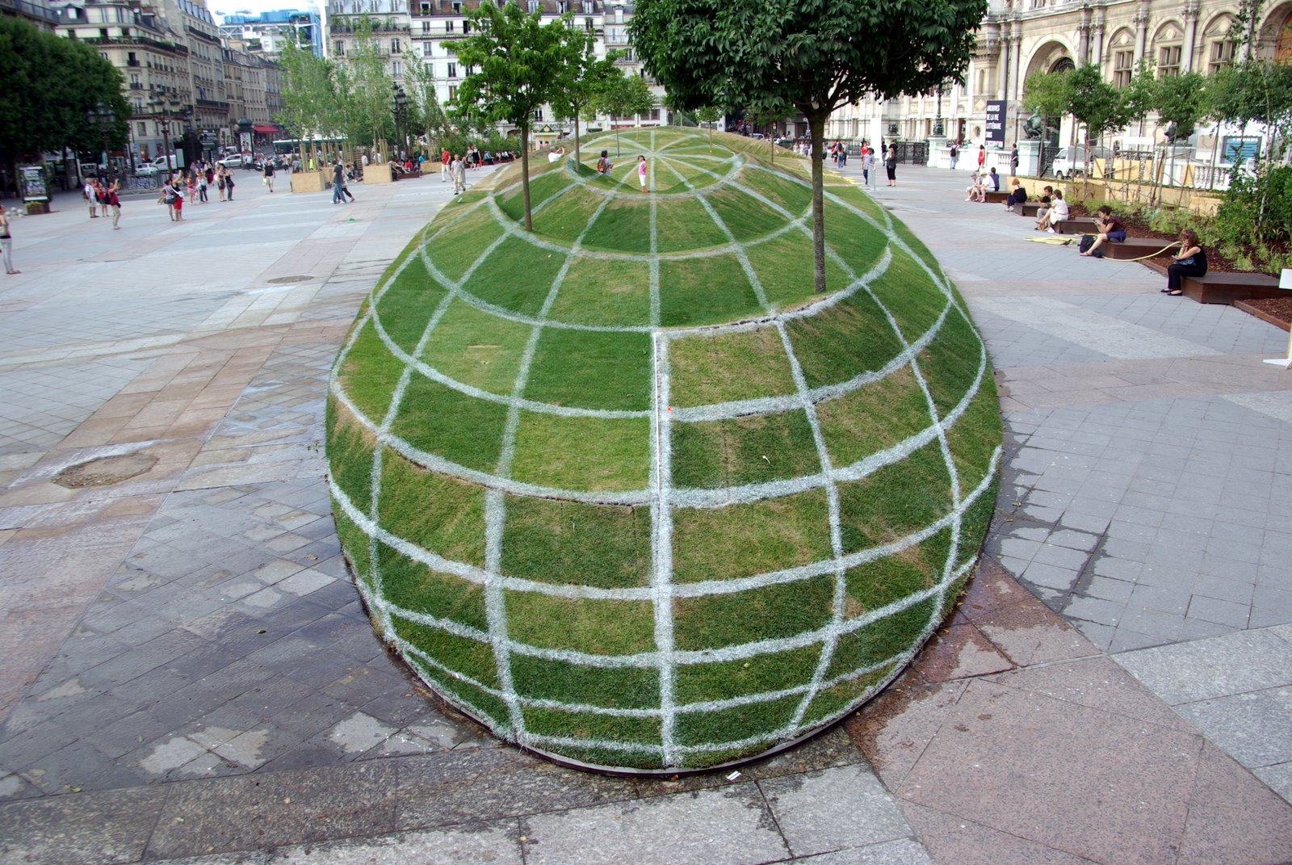
Notes:
Paris town hall
“Anamorphosis” - a distorted projection or perspective requiring the viewer to use special devices or occupy a specific vantage point (or both) to reconstitute the image.

Slide 15
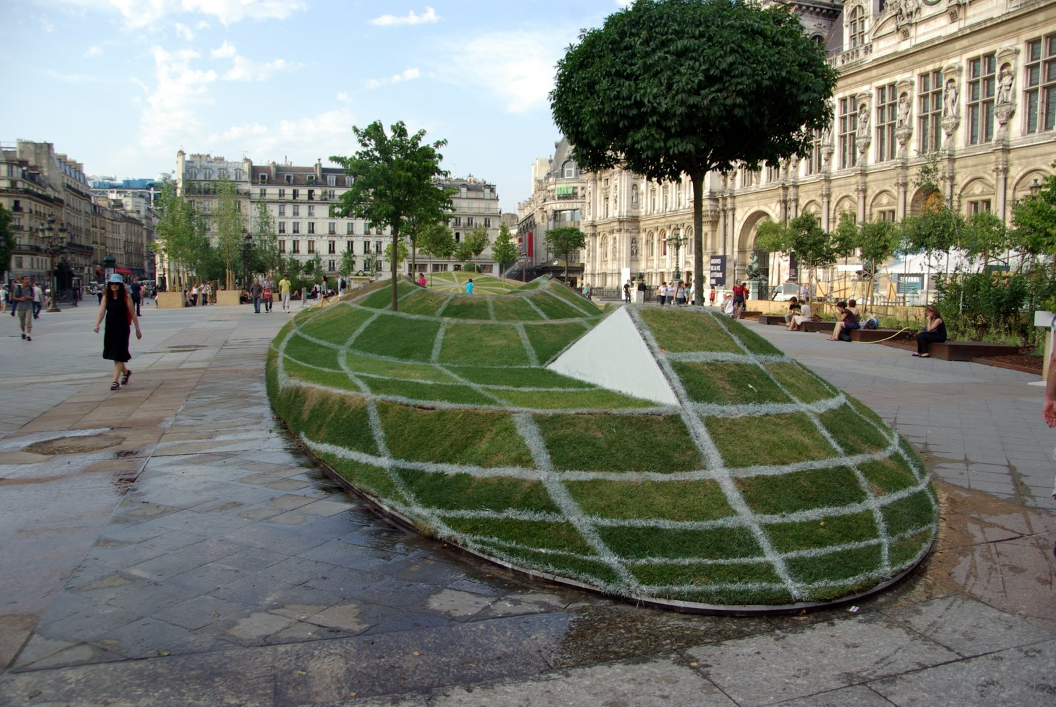

Slide 16
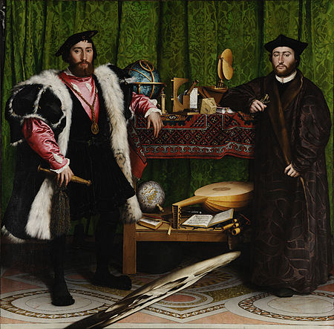
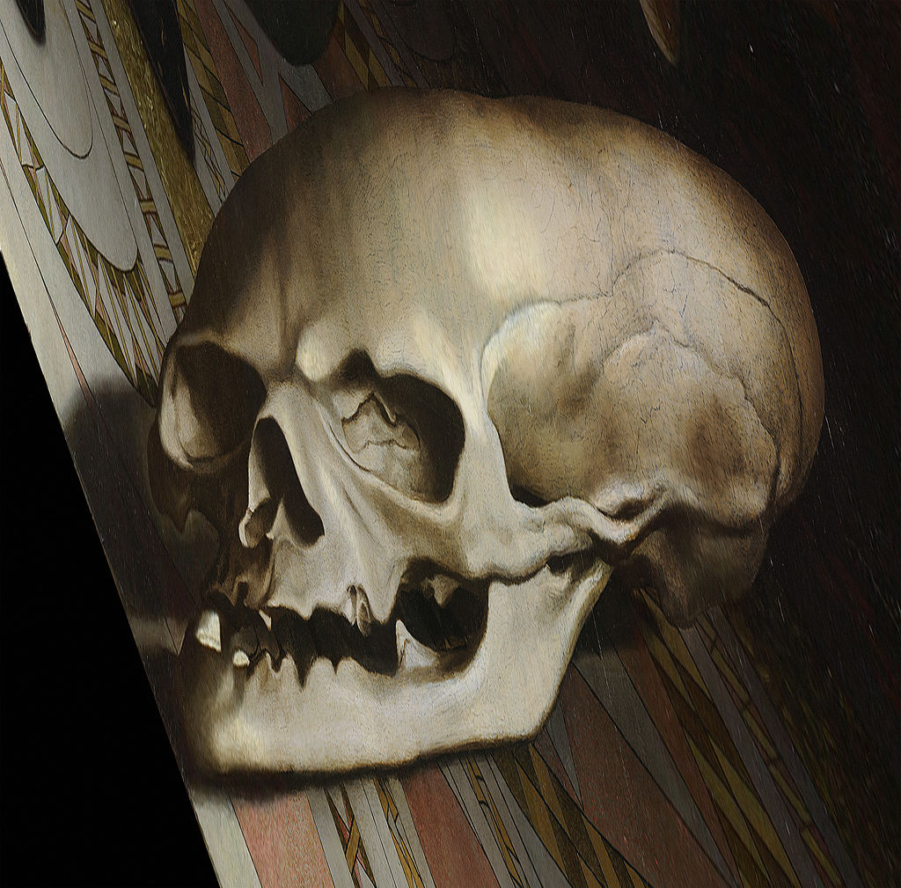
Holbein’s The Ambassadors - 1533
Memento Mori
Notes:
Anarmorphosis

Slide 17
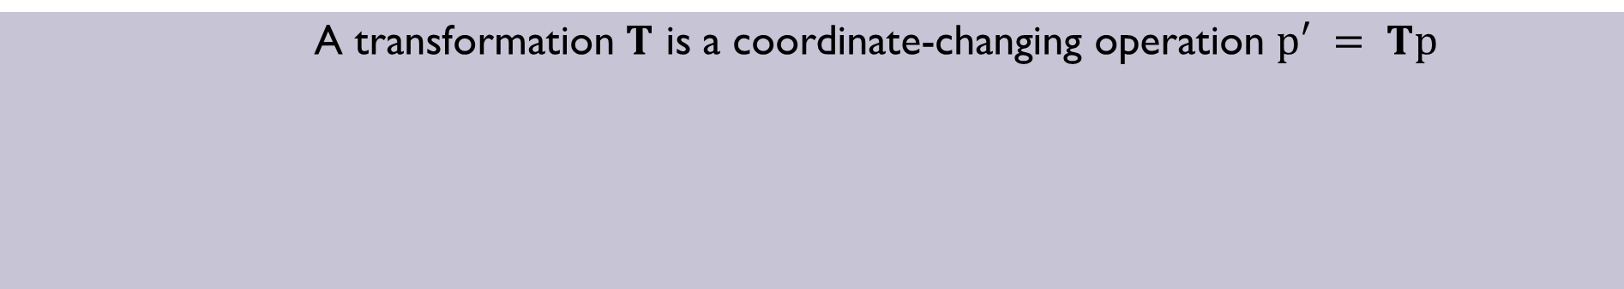




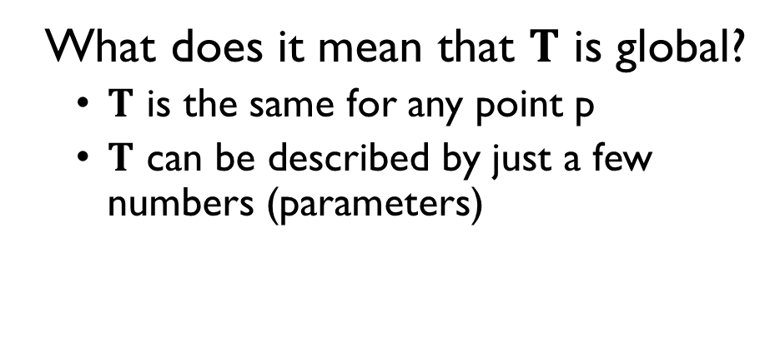
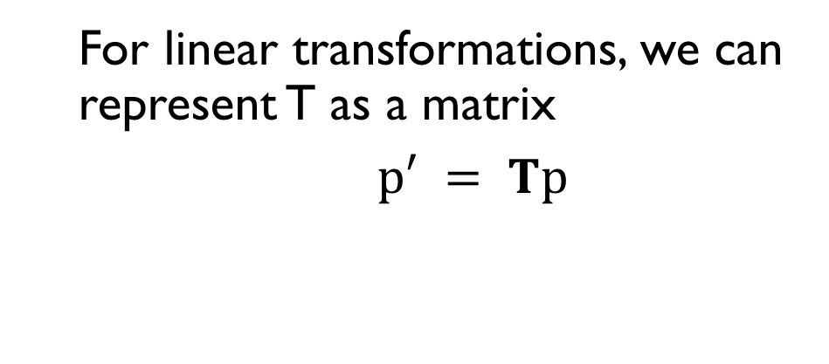
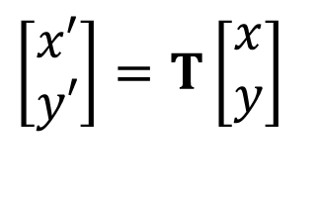
Parametric (Global) Transformations
Notes:
In other words, a transformation takes in a point in space and returns a modified point. A linear transformation is a special type of transformation where the output point (vector) can be expressed as the product of a matrix and the input point.

Slide 18
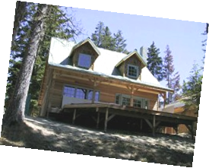
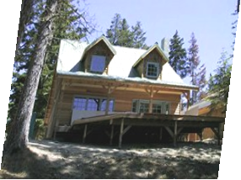
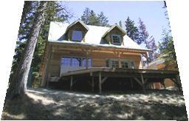
Common Transformations
Original
Transformed
Translation
Rotation
Scaling
Affine
Perspective
Slide credit (next few slides): A. Efros and/or S. Seitz

Slide 19
Scaling
Scaling a coordinate means multiplying each of its components by a scalar.
Uniform scaling means this scalar is the same for all components.
× 2

Slide 20
Scaling
Non-uniform scaling: different scalars per component.
X × 2,
Y × 0.5
Notes:
This results in the final image content looking stretched out more in some directions than in others.

Slide 21
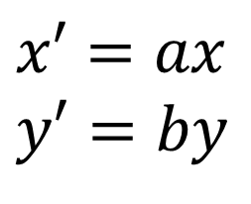
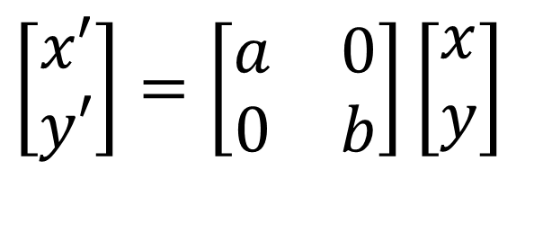
Scaling
Scaling operation:
Or, in matrix form:
scaling matrix S
Notes:
Here, a and b are fixed scalars (constants) that determine how much we want to shrink or stretch the image content in the x and y directions respectively.

Slide 22
2D Rotation
y
(x’, y’)
(x, y)
x’ = x cos(θ) - y sin(θ)
y’ = x sin(θ) + y cos(θ)
θ
x
Notes:
See the next slide for a derivation

Slide 23
Additional Slide: 2D Rotation
Polar coordinates…
x = r cos (f)
y = r sin (f)
x’ = r cos (f + θ)
y’ = r sin (f + θ)
Trig Identity…
x’ = r cos(f) cos(θ) – r sin(f) sin(θ)
y’ = r sin(f) cos(θ) + r cos(f) sin(θ)
Substitute…
x’ = x cos(θ) - y sin(θ)
y’ = x sin(θ) + y cos(θ)
(x’, y’)
(x, y)
θ
f

Slide 24
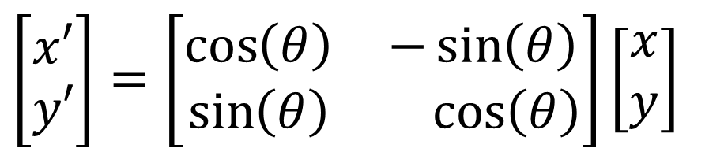
2D Rotation
This is easy to capture in matrix form:
Even though sin(θ) and cos(θ) are nonlinear functions of θ,
x’ is a linear combination of x and y
y’ is a linear combination of x and y
What is the inverse transformation?
Rotation by –θ
For rotation matrices
R
Notes:
To see why the inverse of a rotation matrix is simply its transpose, substitute –(theta) into R and notice that the result is simply R transposed. More formally, R is an orthogonal matrix because its columns form an orthonormal basis (since rotation keeps the columns orthogonal and does not change their unit length). So R*R^T = I, which implies that the inverse of R is R^T.

Slide 25
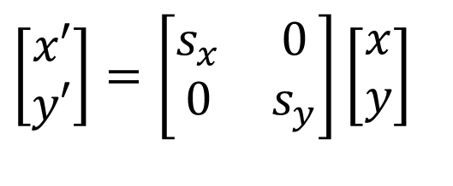
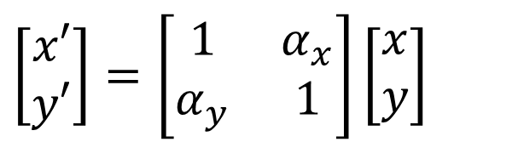
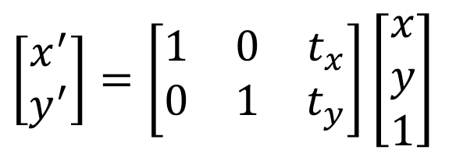
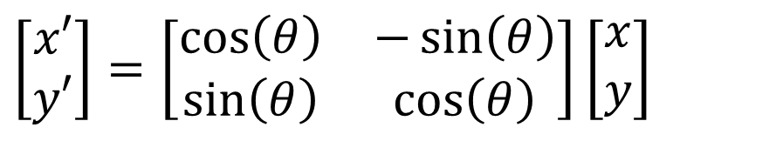
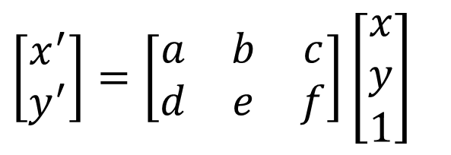
Basic 2D Transformations
Scale
Shear
Rotation
Translation
Affine is any combination of translation, scale, rotation, and shear
Affine
Notes:
Note that it is impossible to represent translation as a linear transformation in 2D because we cannot express the result of translation as a product of a 2x2 matrix and a 2-dimensional vector. More on this soon.

Slide 26
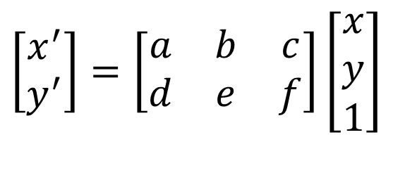
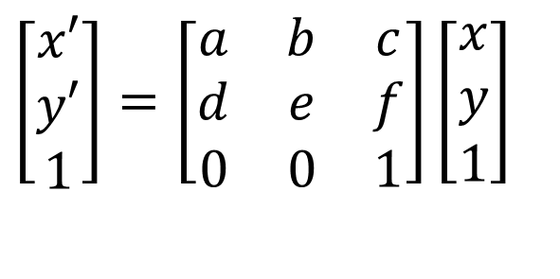
Affine Transformations
Affine transformations are combinations of
  Linear transformations, and
  Translations
Properties of affine transformations:
  Origin (0,0) may move
  Lines map to lines
  Parallel lines remain parallel
  Ratios are preserved
  Closed under composition
or
Sugih Jamin
Notes:
Ratios of distances along straight lines are preserved, e.g. the relative length of two collinear line segments

Slide 27
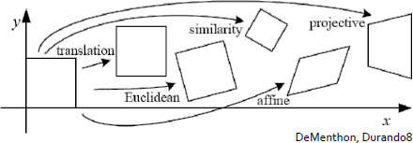
2D Transformations: Properties Preserved
Transformations can be classified based on the properties they preserve:
Rigid Body
  angles, lengths, areas
Similarity
  angles, length ratios
Linear
  linear combination
Affine
  parallel lines, length ratios, area ratios
Perspective
  collinearity, cross-ratio
…
Affine
Perspective
Similarity
Rigid Body
Translation
Linear
Rotation
Scaling
Shear
Reflection
Sugih Jamin

Slide 28
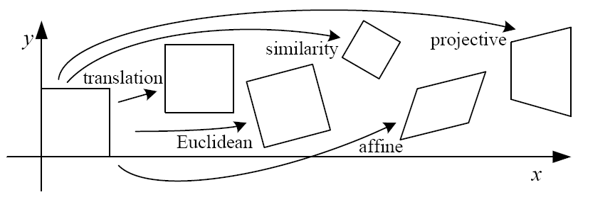
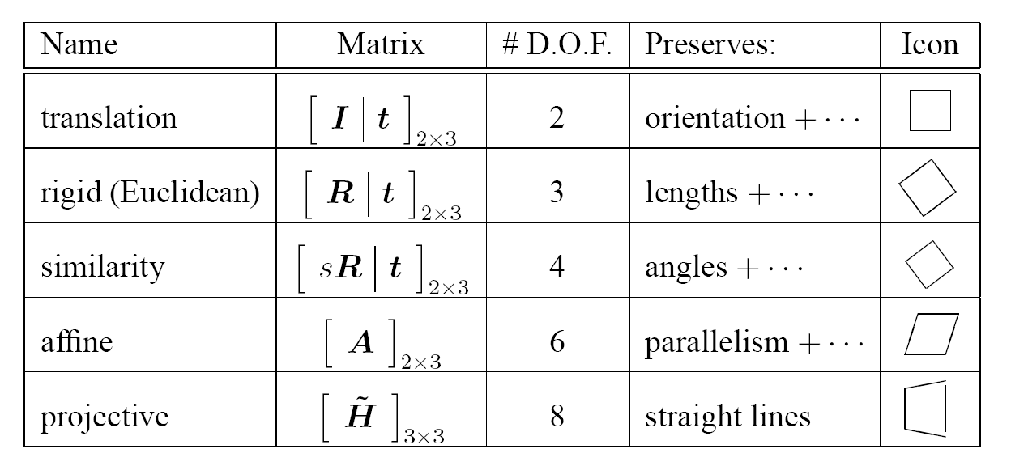
2D Transformations
‘Homography’
Szeliski 2.1
Notes:
https://en.wikipedia.org/wiki/Homography_(computer_vision)

Slide 29
Cameras are Projective Transformation Machines
Projective Transformation
3D world
2D image
Figures © Stephen E. Palmer, 2002

Slide 30
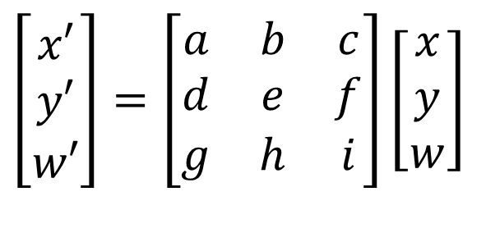
Projective Transformations
Projective transformations are combos of
  Affine transformations, and
  Projective warps
Properties of projective transformations:
  Origin (0,0) may move
  Lines map to lines
  Parallel lines do not necessarily remain parallel
  Ratios are not preserved
  Closed under composition
  Projective matrix is defined up to a scale (8 degrees of freedom)
Sugih Jamin

Slide 31

Notes:
The Mandalorian

Slide 32
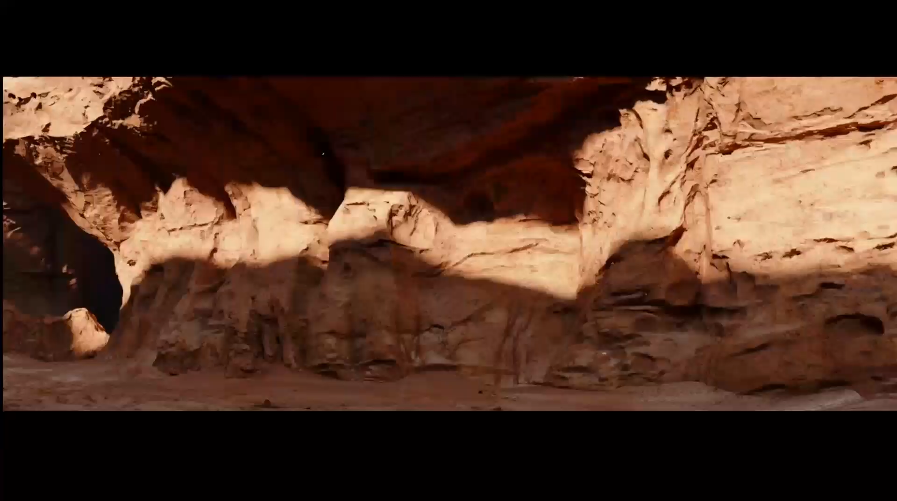
Notes:
The Mandalorian

Slide 33
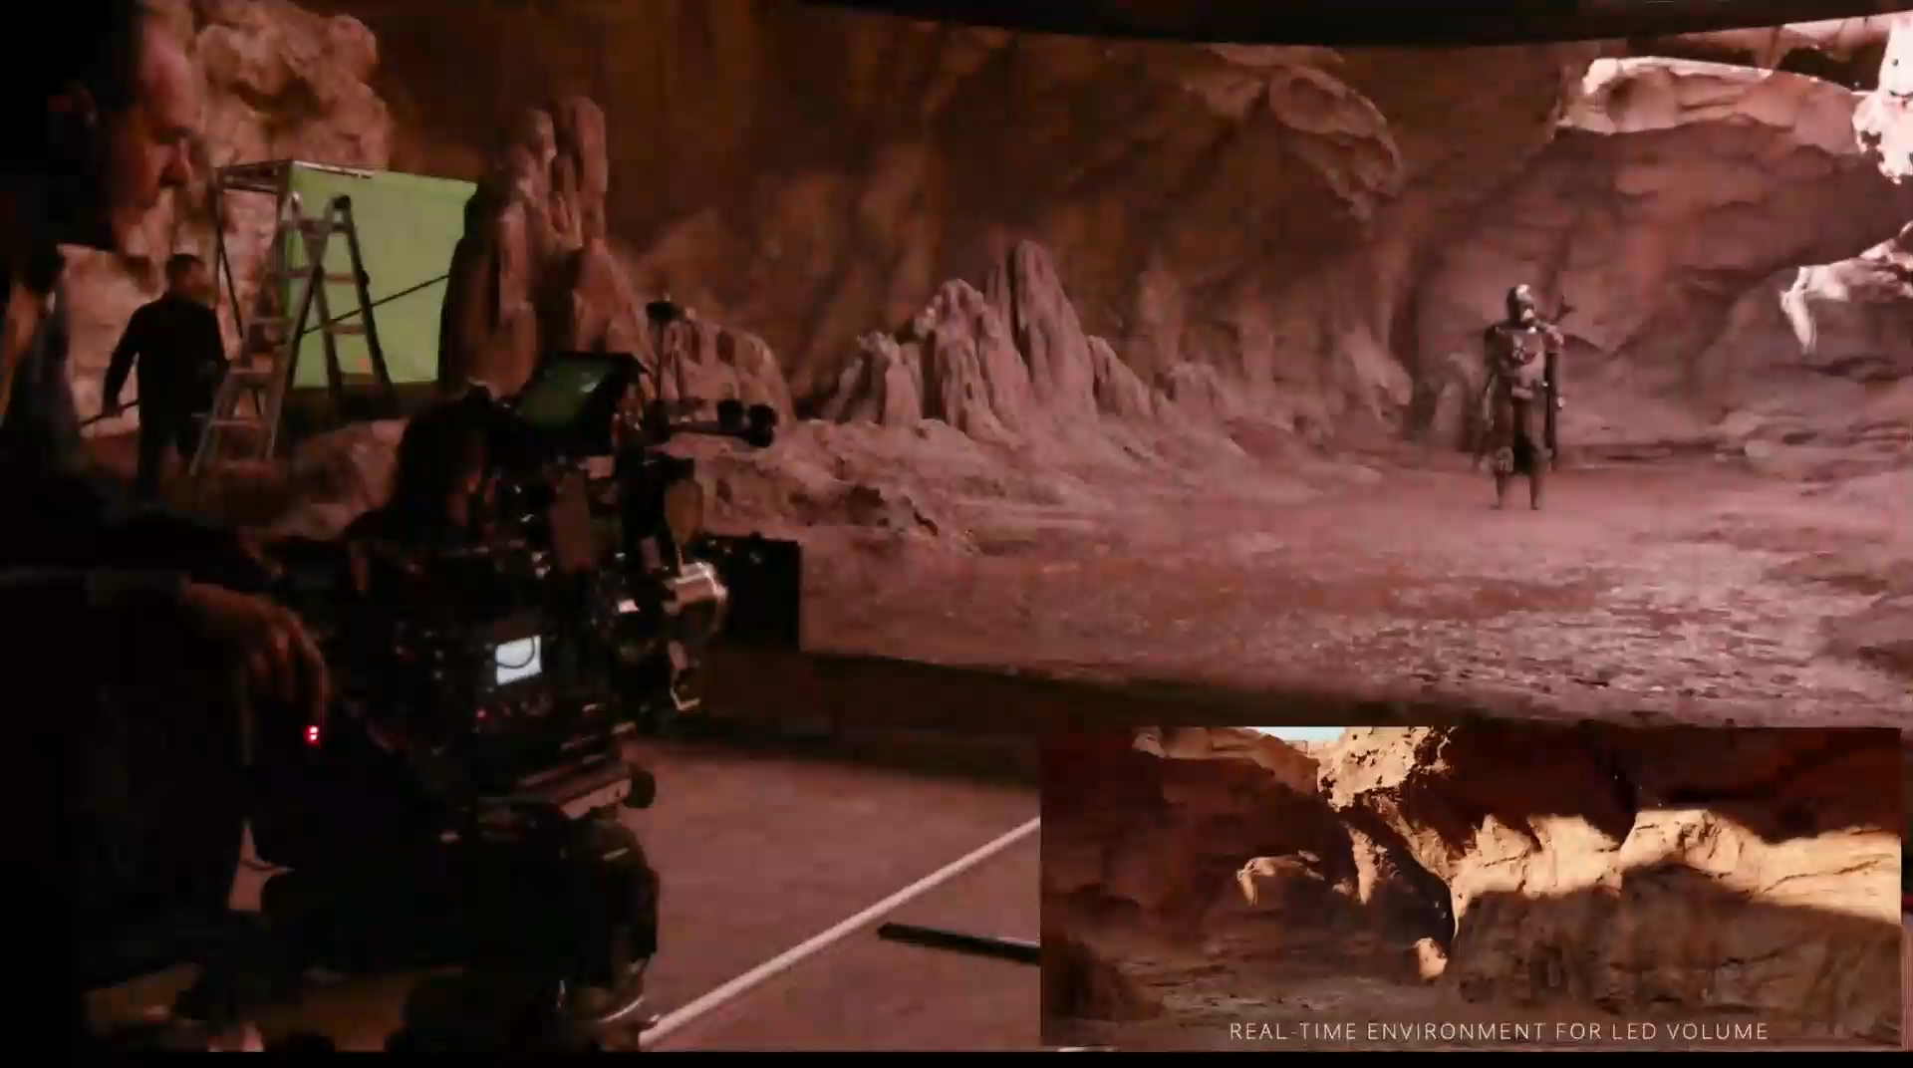
Notes:
The Mandalorian

Slide 34
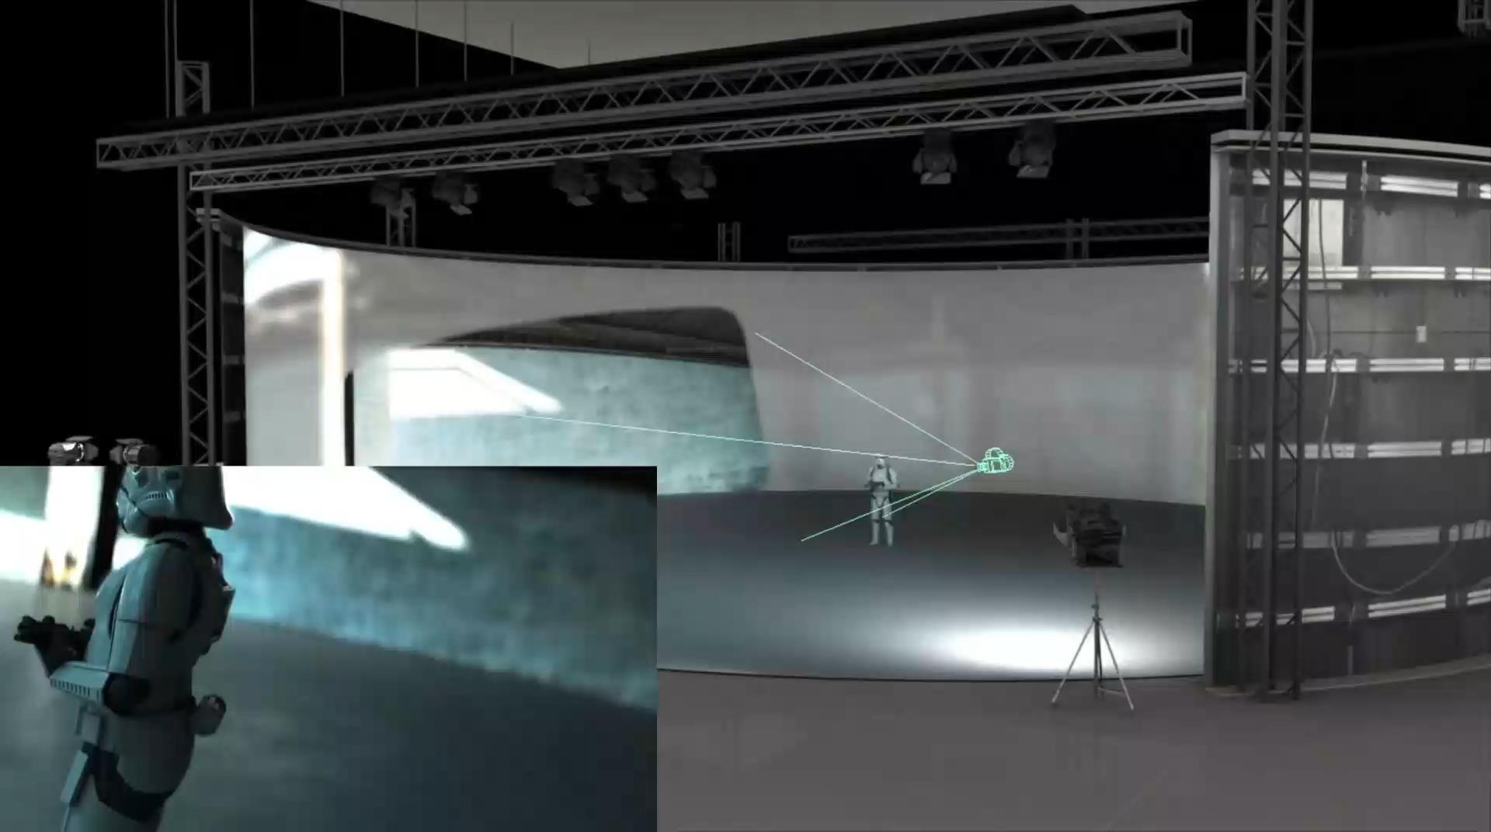
Notes:
The Mandalorian

Slide 35
Design a Camera
Idea 1: Put a sensor in front of an object
Do we get a reasonable image?
sensor
Steve Seitz
Notes:
The problem with this naïve approach is that light rays from every point in the 3D world hit every point on the sensor, which results in a blurry image

Slide 36
Design a Camera
Idea 2: Add a barrier to block most rays
  Pinhole in barrier
  Only sense light from one direction.
    Reduces blurring.
  In most cameras, this aperture can vary in size.
sensor
Steve Seitz
Notes:
To ensure that every point in the scene is captured by only one point on the sensor, we can put a barrier between the scene and the sensor that theoretically only lets in one ray of light for every sensor point. This is known as a pinhole camera.
Q: How does this transform the image? A: It gets inverted (upside down)

Slide 37
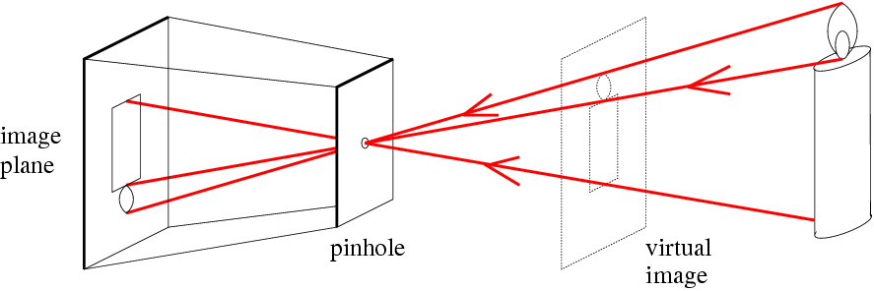
Pinhole Camera Model
f
c
Real object
f = Focal length
c = Optical center of the camera
David Forsyth
Notes:
This is the most commonly used camera model in computer vision and is conceptually the same as the old camera obscuras.
In this diagram we visualize a ‘virtual image’ which is the right side up counterpart of the image plane, and is the same distance f from the pinhole. Note that this virtual image does not actually exist; it’s there for mathematical convenience.

Slide 38
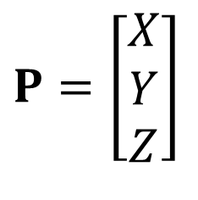
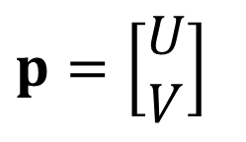
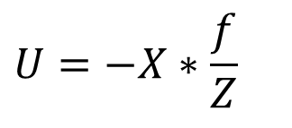
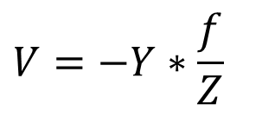
Camera Projection
.
Image center (u₀, v₀)
.
.
f
Z
Y
.
V
Camera Center (0, 0, 0)
U
f = distance from image center
What is the effect if f and Z are equal?
Notes:
P is a 3D vector representing the position of a point in the scene, and p is projection of P onto the image plane. Like before, the focal length f is the distance from the camera center to the image center. Z is the orthogonal distance of the scene point P to the camera center.
Notice how U and V (the coordinates of the projection p relative to the image center) are related to X and Y (the initial coordinates of the scene point P relative to the camera center) by a proportionality factor f/Z. This is true because of basic triangle similarity.
The negative sign is necessary because the projection through the pinhole inverts the image, so points higher up in the 3D scene are projected to points lower down in the 2D image relative to the image center.
With these equations, we can now determine where any 3D point in the scene is sensed in the image.
The effect of f and Z being equal is that we measure real-world units in pixels; that is, objects are of equal size in their world space form and in their projected form on the image plane.

Slide 39
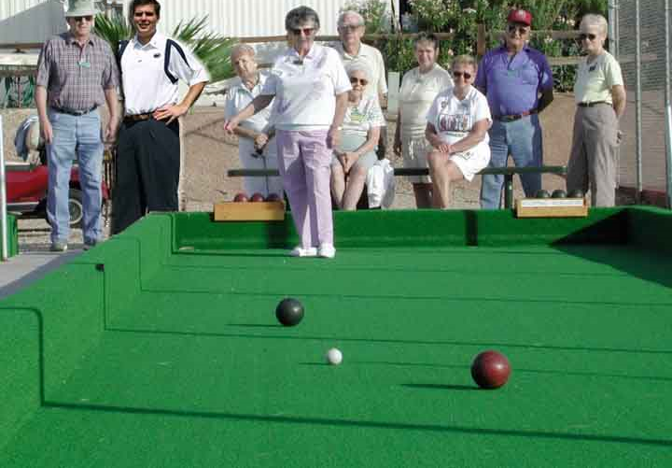
Projective Geometry
Length (and so area) is lost.
Who is taller?
Which is closer?
Notes:
Notice how the height of the person on the left is the same as that of the person in the center if we measure the pixel distances in the projected 2D image.

Slide 40
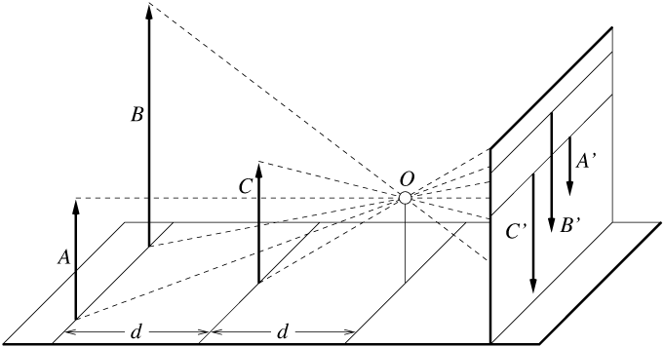
Projective Geometry
A’
C’
B’
Figure by David Forsyth
Notes:
In this diagram, A, B, and C are 3D points and A’, B’, C’ are their respective image projections. Because lengths are not preserved by projective transformations, C’ appears to have roughly the same height as B’ in the image, but this is clearly not true in the real scene. This occurs because C is closer to the pinhole than B.

Slide 41
Projective Geometry
Angles are lost.
Parallel?
Perpendicular?
Notes:
Parellel lines are no longer parallel and perpendicular ones are no longer perpendicular.

Slide 42
Projective Geometry
What is preserved?
Straight lines are still straight.

Slide 43
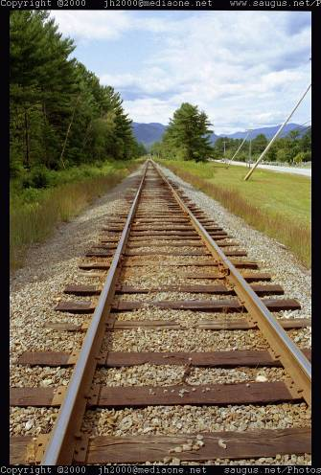
Vanishing Points and Lines
Parallel lines in the world intersect in the projected image at a
“vanishing point”.
Parallel lines on the same plane in the world converge to vanishing points on a “vanishing line”.
e.g., the horizon.
Vanishing Point
Vanishing Point
Vanishing Line
Notes:
Various properties of vanishing points/lines.
Parallel lines intersect at a point
The intersection of red lines and blue lines form a parallelogram
Sets of parallel lines on the same plane form a vanishing line
Sets of parallel planes form a vanishing line
Not all lines that intersect are parallel

Slide 44
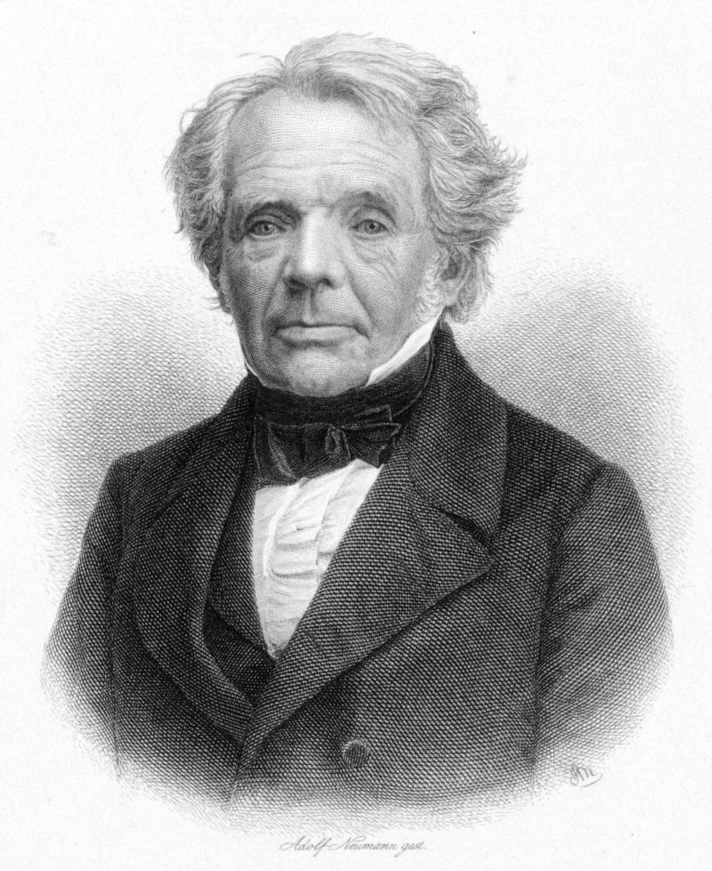
Homogeneous Coordinates
Introduced by August Ferdinand Möbius
An alternative coordinate system for projective geometry
  Compare to Cartesian coordinates
Simplify formulas
  Make translation a linear transformation
  Facilitate matrix-vector formulas
Wikipedia

Slide 45
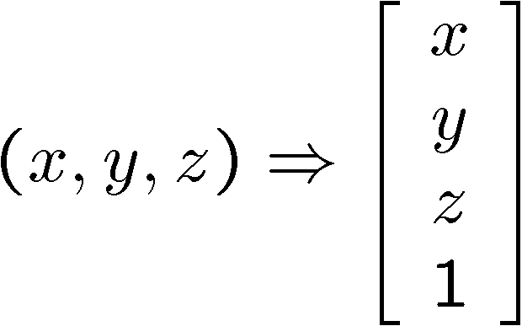
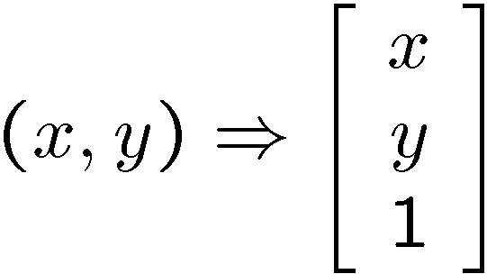


Homogeneous Coordinates
Converting to homogeneous coordinates
2D (image) coordinates
3D (scene) coordinates
Converting from homogeneous coordinates
2D (image) coordinates
3D (scene) coordinates
Notes:
To convert to homogeneous coordinates, we append a new coordinate with value 1 after the final real coordinate. To reverse this, we divide each real coordinate by the final coordinate w and discard the final coordinate.
This is simply convention: these rules may seem somewhat arbitrary, but they exist simply to help us express matrix/vector quantities we care about in a more convenient way as you’ll see in later slides.

Slide 46

Homogeneous Coordinates
Scale invariance in projection space
Scale invariance in projection space
Homogeneous Coordinates
Cartesian Coordinates
e.g., we can uniformly scale the projective space, and it will still produce the same image -> scale ambiguity
Notes:
This means that no matter how we scale the projection space (i.e. the homogeneous coordinate representation), we do not change the underlying image represented by the coordinates (i.e. the Carteisan x/y/z representation).
This is because we divide through by the additional coordinate in the homogeneous representation when converting to Cartesian coordinates, which cancels out the effect of scaling in the projection space.
Because scaling the homogenous coordinates has no effect on the cartesian image coordinates, we say that there is ‘scale ambiguity’.
Q: Suppose we have a point in Cartesian coordinates. What is that in homogeneous coordinates? A: a ray

Slide 47

Homogeneous Coordinates
Projective
Point becomes a line
To homogeneous
From homogeneous
Song Ho Ahn
Notes:
This is a visualization of scale ambiguity. Each horizontal plane represents an image plane at a certain distance w from the image origin in homogeneous coordinates (we get a different image plane for each w). If we connect the scaled versions of a single point (1,2,1) at different scales (k=1, k=2, k=3), we get a straight line cutting through the planes.
The key takeaway is that, for any of the scaled homogeneous points of (1,2,1), we’re conceptually representing exactly the same cartesian point (1,2) when we scale up the homogeneous coordinate (1,2,1), .
An intuitive example is how a point on an object twice as large in an image twice as large really represents the same point in the unenlarged image.
http://www.songho.ca/math/homogeneous/homogeneous.html

Slide 48

Projective geometry
2D point in cartesian = (x,y) coordinates
2D point in projective = (x,y,w) coordinates
Y
Projector
X
Idea from www.tomdalling.com
Notes:
http://www.tomdalling.com/blog/modern-opengl/explaining-homogenous-coordinates-and-projective-geometry/

Slide 49
Projective geometry
2D point in cartesian = (x,y) coordinates
2D point in projective = (x,y,w) coordinates
Y
Projector
W
X
Idea from www.tomdalling.com
Notes:
http://www.tomdalling.com/blog/modern-opengl/explaining-homogenous-coordinates-and-projective-geometry/

Slide 50


Varying w
w₁
w₂ < w₁
Y
Y
Projector
Projector
X
X
Projected image becomes smaller.

Slide 51
Projective geometry
2D point in projective = (x,y,w) coordinates
  w defines the scale of the projected image.
  Each x,y point becomes a ray!
Y
Projector
W
X

Slide 52
Homogeneous Coordinates
Cartesian: (Inf, Inf)
Homogeneous: (1, 1, 0)
Cartesian: (Inf, Inf)
Homogeneous: (1, 2, 0)
Intersection of parallel lines
Notes:
Parallel lines intersect at different infinities.
We can represent the intersection points in homogeneous coordinates using non-infinite x/y but with w=0, which is equivalent to cartesian points at infinity because of the division by 0. This is useful because we can differentiate different vanishing points from each other.

Slide 53
Basic 2D Transformations
Scale
Shear
Rotation
Translation
Affine is any combination of translation, scale, rotation, and shear
Affine
Notes:
Previously, we could not represent translation as a linear transformation in 2D. But now we can represent a translation as a linear transformation in 3D using homogeneous coordinates.
What does this mean? It means that translation in 2D is actually a kind of shear transform in homogeneous coordinates within a 3D space.

Slide 54

Advanced Reading

Slide 55


Lenses: The Need
Steve Seitz
Notes:
Pinhole cameras are limited by the geometry of the aperture. No control is possible without changing aperture.
Lenses allow making compact cameras
Increased ability to focus on parts of scene and map it to parts of the image

Slide 56
Focus and Defocus
A lens focuses light onto the film
  There is a specific distance at which objects are “in focus”
    other points project to a “circle of confusion” in the image
  Changing the shape of the lens changes this distance
world
lens
sensor
“circle of
confusion”
or coma
Steve Seitz

Slide 57

Lenses in Practice
Operation
[Matthew Farrell, Michelle Pang, Michael Tom]

Slide 59
Dall-E Time!
Give me prompts…
Btw, Dall-E is now available to everyone.

Slide 60
Cameras are Projective Transformation Machines
Projective Transformation
3D world
2D image
Figures © Stephen E. Palmer, 2002

Slide 61





Fundamental Equations of Computer Vision
Image Filtering
Camera Geometry
Machine Learning
Optical Flow

Slide 62


Camera (Projection) Matrix
Slide Credit: Savarese
R,t
World space
j_{w}
Image space
X
k_{w}
O_{w}
x
Camera
space
i_{w}
x: Image Coordinates: (u,v,1)
K: Intrinsic Matrix (3x3)
R: Rotation (3x3)
t: Translation (3x1)
X: World Coordinates: (X,Y,Z,1)
Extrinsic Matrix
Notes:
We want to find out where a 3D point X in the scene will be located in the 2D image, and this diagram visualizes that process.
The objects in the world/scene use a coordinate system (i.e. frame of reference) O_w that is different from the coordinate system of the camera. These two coordinate systems are related by an “extrinsic matrix” which encodes a rotation and translation.
The extrinsic matrix is simply the concatenation of the rotation matrix and translation vector that transforms world coordinates to the camera coordinates. In other words, applying this transformation [R t] effectively aligns the basis vectors of the coordinate systems, so that we can now represent points in the scene relative to the coordinate system of the camera. We then apply a different matrix K (more later) to go from the 3D representation of X with respect to the camera’s coordinate system to a 2D point on the image plane.
We can use homogeneous coordinates to write ‘camera matrix’ in linear form.

Slide 63


Projection Matrix
X
(0,0,0)
x
Intrinsic Assumptions
Unit aspect ratio
Optical center at (0,0)
No skew
Extrinsic Assumptions
No rotation
Camera at (0,0,0)
K
Silvio Savarese
Notes:
Here we assume that the world coordinate system is already aligned with the camera coordinate system (i.e. we apply no rotation and no translation to go from the world space to the camera space), so R is the identity matrix and t is the zero vector.
We’ve also converted the input 3D world point X and the 2D output image point x into their homogeneous representations by appending an additional 1 coordinate.
We define K as the 3x3 submatrix of the 3x4 matrix applied to the homogenous representation of X = <x,y,z,1>. f denotes the focal length of the camera (same meaning as before)

Slide 64
Projection
.
Image center (u₀, v₀)
.
.
f
Z
Y
.
V
Camera Center (0, 0, 0)
U
p = distance from image center
Notes:
If you write out the previous matrix-vector product and convert the output x back to 2D Cartesian coordinates, you’ll get the same equations for U and V that we previously saw for projection through a pinhole camera!

Slide 65


Remove assumption: known optical center
Intrinsic Assumptions
Unit aspect ratio
No skew
Extrinsic Assumptions
No rotation
Camera at (0,0,0)
K
James Hays
Notes:
Here we no longer assume that the image center on the image plane is at (0,0) but instead at a general point (u0, v0). You can verify that placing u0 and v0 at these entries results in an offset in the final 2D coordinates by carrying out the multiplication and converting back to 2D Cartesian coordinates.

Slide 66

Remove assumption: equal aspect ratio
Intrinsic Assumptions
No skew
Extrinsic Assumptions
No rotation
Camera at (0,0,0)
James Hays
Notes:
Here we assume that the focal length in the x direction is not necessarily the same as that in the y direction. An example of where this is relevant is in camera manufacturing; it’s difficult to get the focal length in both directions to match perfectly.

Slide 67

Remove assumption: non-skewed pixels
Intrinsic Assumptions
Extrinsic Assumptions
No rotation
Camera at (0,0,0)
Note: different books use different notation for parameters
James Hays
Notes:
Here we assume that pixels on the image plane are not necessarily square by adding a ‘skew’ factor s.
This final red submatrix is known as the intrinsic matrix, since it contains information about the intrinsics of the camera that are independent of the world/scene.

Slide 68
Oriented and Translated Camera
R
j_{w}
X
t
k_{w}
O_{w}
x
i_{w}
James Hays
Notes:
Now we consider the extrinsics of the camera defined by its rotation and translation relative to a world coordinate system.

Slide 69


Allow camera translation
Intrinsic Assumptions
Extrinsic Assumptions
No rotation
James Hays
Notes:
Here we assume that the camera’s coordinate system is different from the world’s coordinate system only by translation. That is, we can represent a world point in the camera’s coordinate system by just translating that point from its original world coordinate system. t is a nonzero vector.

Slide 70

3D Rotation of Points
Slide Credit: Saverese
Rotation around the coordinate axes, counter-clockwise:
p’
γ
y
p
x
z
Notes:
Don’t freak out: there’s no need to memorize these. This simply says that we can express any rotation by composing (multiplying) the rotations about the x/y/z axes.

Slide 71


Allow camera rotation
James Hays
Notes:
Now, if we assume that the camera’s coordinate system is different from the world’s by both translation and rotation, we get the general expression for the extrinsic matrix! The rotation matrix is placed in the left 3x3 submatrix of the extrinsic matrix.

Slide 72


Camera Matrix
Slide Credit: Savarese
R,t
j_{w}
World space
Image space
X
k_{w}
O_{w}
Camera
space
i_{w}
x
x: Image Coordinates: (u,v,1)
K: Intrinsic Matrix (3x3)
R: Rotation (3x3)
t: Translation (3x1)
X: World Coordinates: (X,Y,Z,1)
Extrinsic Matrix
Notes:
This is what the cameras we use on a daily basis are doing conceptually.

Slide 73


Degrees of Freedom (DoF)
5
6
James Hays
Notes:
Degrees of freedom refer to the number of parameters required to uniquely define each transformation/matrix. Notice how there are 5 unknowns in the intrinsic matrix. However, in the extrinsic matrix, we only have 6 degrees of freedom despite having 12 matrix entries. This is because the 12 entries are dependent: we can uniquely encode a rotation using just three angles (one around each coordinate axis) and three translation components (one relative to each axis), which requires only 6 in total.
How many known points are needed to estimate this?
11 degrees of freedom
6 points

Slide 74

HW3 Written

Slide 75
Demo – Kyle Simek
“Dissecting the Camera Matrix”
Three-part blog series
http://ksimek.github.io/2012/08/14/decompose/
http://ksimek.github.io/2012/08/22/extrinsic/
http://ksimek.github.io/2013/08/13/intrinsic/
“Perspective toy”
http://ksimek.github.io/perspective_camera_toy.html

Slide 76

Additional Slide: Orthographic Projection
Special case of perspective projection
  Distance from the center of projection
  to the image plane is infinite
  Also called “parallel projection”
  What’s the projection matrix?
Image
World
Steve Seitz

Slide 77

Scaled Orthographic Projection
Special case of perspective projection
  Object dimensions are small compared to distance to camera
  Also called “weak perspective”
  What’s the projection matrix?
Image
World
Slide by Steve Seitz

Slide 78




Vanishing Point = Projection from Infinity
James Hays

Slide 79


Recap
Vertical vanishing
point
(at infinity)
Projection loses length, area, angle, but straight lines remain straight.
Pinhole camera model and camera projection matrix.
Homogeneous coordinates.
Vanishing
line
Vanishing
point
Vanishing
point
James Hays

Slide 80

Calibration
Stereo

