Slide 1
Edge Detection

Slide 2
Announcements
HW 1 Questions due this Thursday,10:30 AM
Broader Impact Discussion
  Immediately after class today
Workshop
  Location: CIT 101
Lecture notes
  Scribe volunteers

Slide 3
Fourier Series and Transform
Fourier Transform Properties
Convolution Theorem

Slide 4
Edge Detection

Slide 5

Edge Detection
https://towardsdatascience.com/edge-detection-in-python-a3c263a13e03
Notes:
The white lines in the edge image on the right side correspond to edges in the original image

Slide 6
Edge Detection
The process of identifying parts of a digital image with sharp changes (discontinuities) in image intensity.
Beginning to extract information.
Helpful to
  Recognize objects
  Reconstruct scenes
  Edit images (artistically)
Notes:
Sharp changes in image intensity correspond visually to regions where there is a sudden change in the color/brightness of an image (an edge!).
Edges are fundamental for recognition, reconstruction, and reorganization.

Slide 7
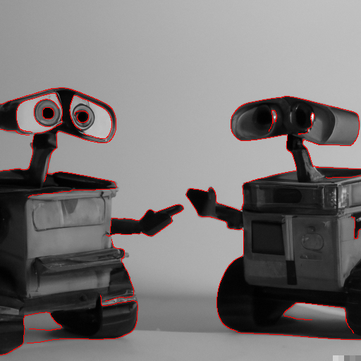
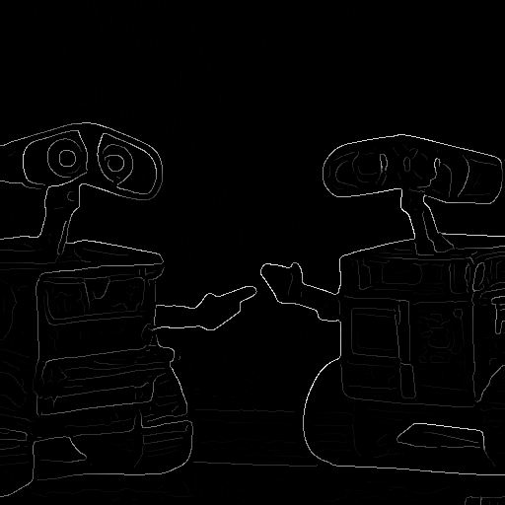
Question:
What natural phenomena produce image edges?
Dall-E: “wall-e having a discussion with another wall-e”. http://bigwww.epfl.ch/demo/ip/demos/edgeDetector

Slide 8
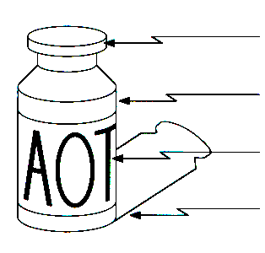
Causes of Edges
Edges are caused by a variety of factors
surface orientation discontinuity
depth discontinuity
surface color discontinuity
illumination discontinuity
Notes:
Surface orientation discontinuity: caused by physical edges in the 3D object in question
Depth discontinuity: caused when the foreground becomes the background (as viewed from a certain perspective)
Surface color discontinuity: caused by differences in colors between
Illumination discontinuity: caused by lighting/shadows

Slide 9
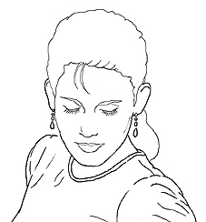
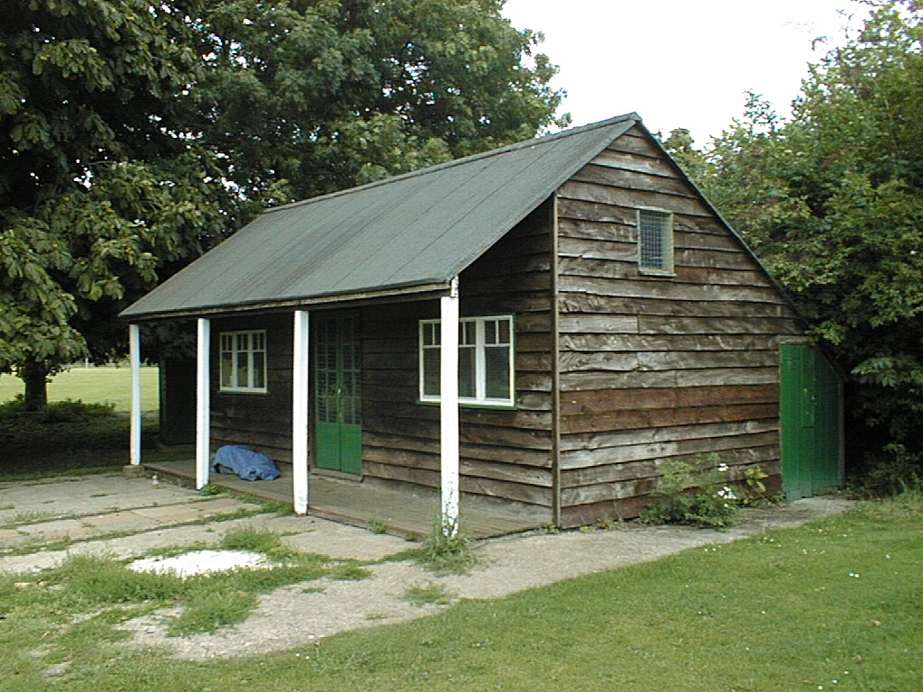
Use of Edges
Extract information
  Recognize objects
  Reconstruct scenes
Help recover geometry
and viewpoint
Edit images directly
  Artistic effects
Vertical vanishing
point
(at infinity)
Vanishing
line
Vanishing
point
Vanishing
point

Slide 10
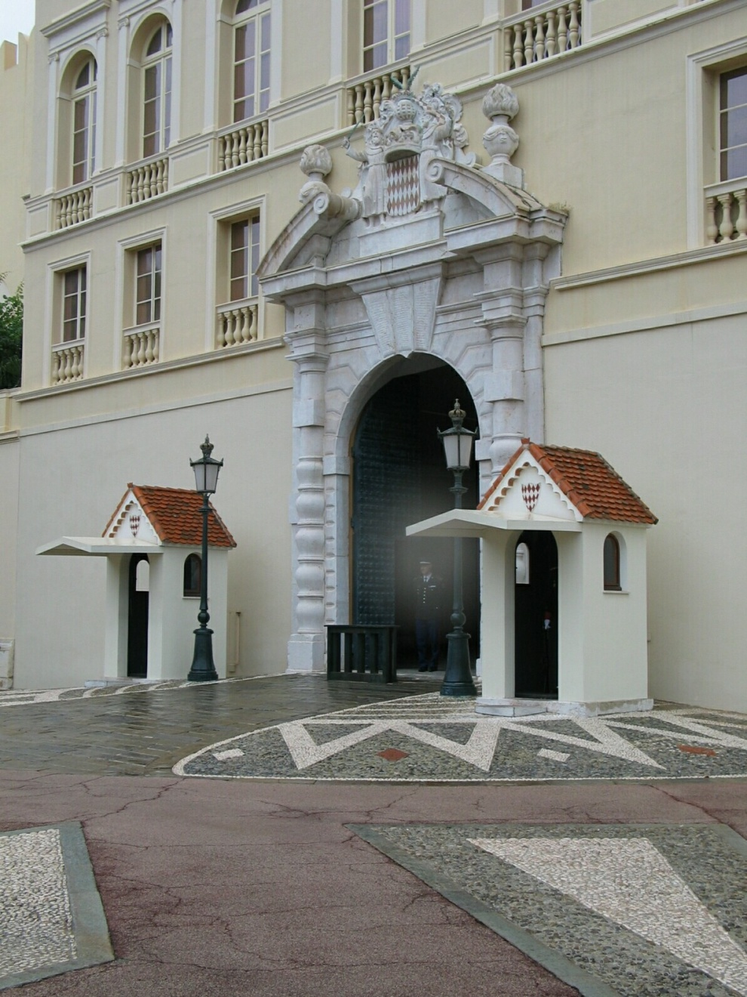
Closer Look at Edges

Slide 11
Closer Look at Edges
Notes:
We can zoom into a small patch in the image. We interpret the changes between the vertical bars as edges; think about what type of discontinuity each is caused by.

Slide 12
Closer Look at Edges

Slide 13
Closer Look at Edges

Slide 14

Characterizing Edges
An edge is a place of sharp change (discontinuity) in the image intensity function. Simple algorithm for edge detection: find gradient.
intensity function
(along horizontal scanline)
image
first derivative
edges correspond to
extrema of derivative
Notes:
The first derivative is strongest (i.e. has the highest magnitude) where the intensity changes most rapidly. The sign of the derivative depends on whether the intensity falls from high to low or rises from low to high.

Slide 15
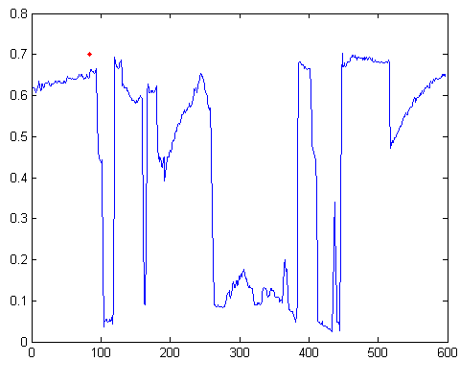
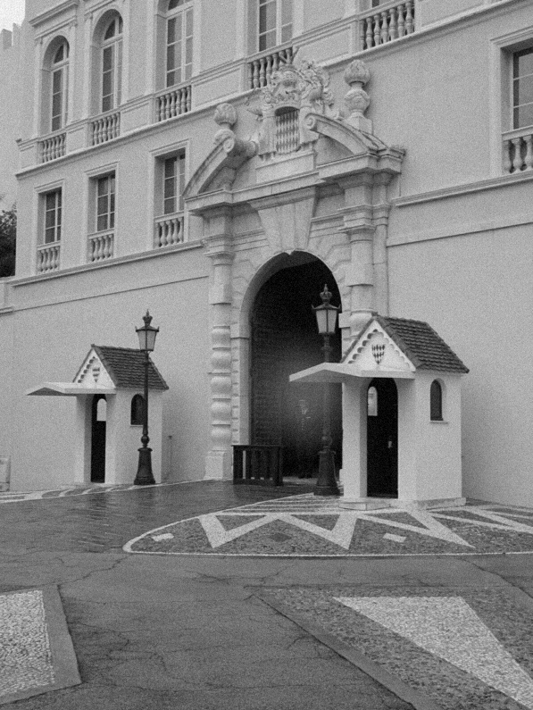
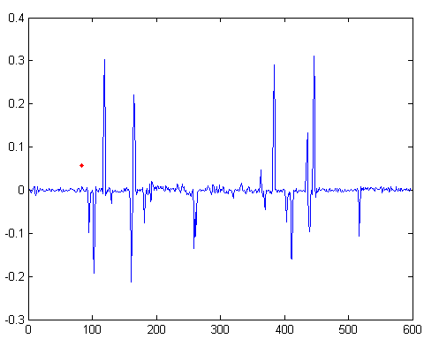
Intensity Profile
Intensity
Intensity derivative
x
Notes:
Consider a single row of pixels (a ‘scan line’) from the image. Notice how the spikes in the derivative function correspond to the regions of most rapid change in the intensity function.

Slide 16
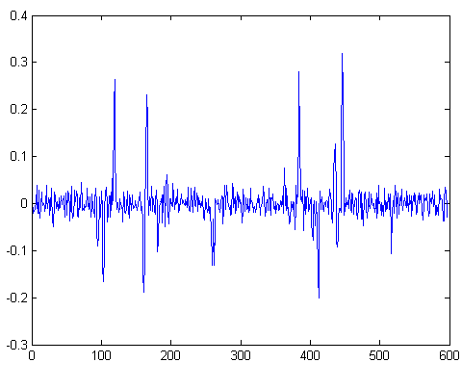
Adding Gaussian noise
Intensity derivative
x
Notes:
But, again, real images are noisy, which results in lots of noise in the first derivative and starts to overwhelm the peaks.

Slide 17
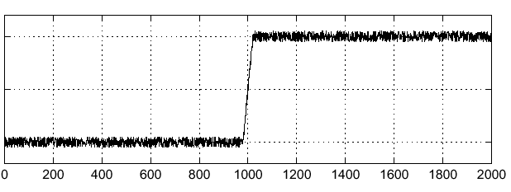

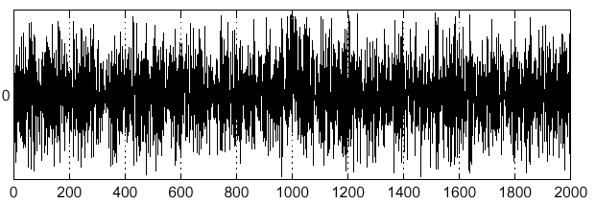
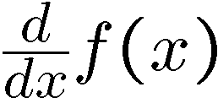
Effects of Noise
Consider a noisy signal
  Here’s how the derivative looks like
Notes:
Hmm… it would be almost impossible to detect where the edge occurred by inspecting the derivative graph with all that noise.

Slide 18
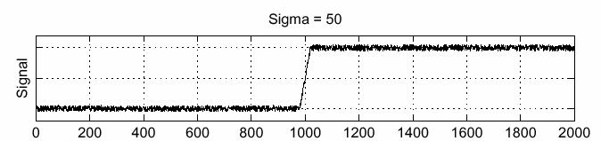
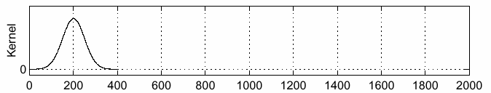
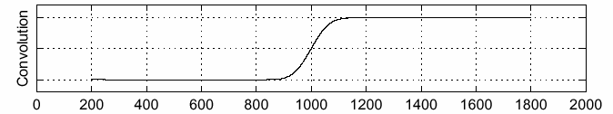
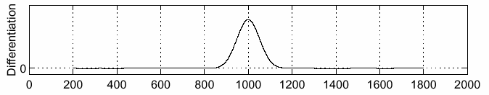
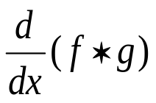

Solution: Smoothing Filter
f
g
f * g
To find edges, look for peaks in
Steve Seitz
Notes:
We can fix this by filtering the signal (image) first to smooth out the noise BEFORE computing the derivative! A gaussian filter is common.

Slide 19
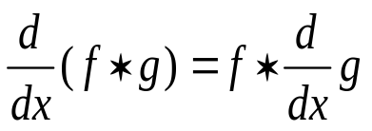
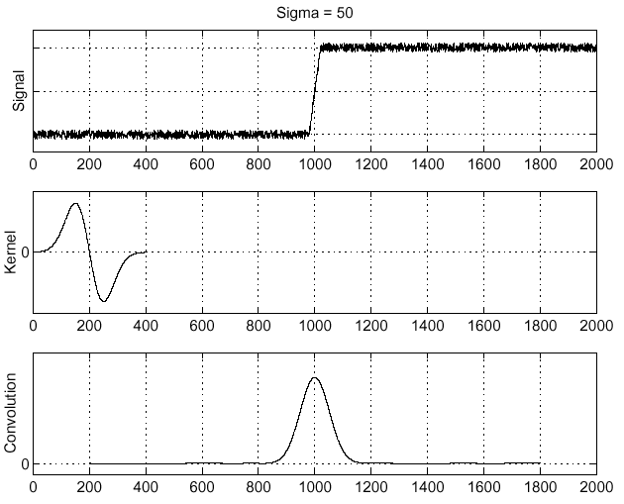
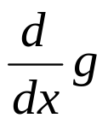
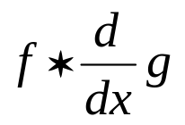
Derivative Theorem of Convolution
Convolution is differentiable:
f
Steve Seitz
Notes:
This means that we can compute the derivative just on the filter g and convolve the image by the differentiated filter to get the same result as on the previous slide.
Useful because instead of convolving the image twice – once to denoise and once to compute the derivative – we only need to convolve once.
-------
One student question: “Why don’t we have to apply the chain rule?”
We have d/dx ( f * g ) where f and g are functions, and * is convolution. This represents the continuous case in 1D.
We see this identity:
d/dx (f * g) = f * dg/fx
Due to the commutativity of convolution, this is also true:
d/dx (g * f) = f * dg/fx
Or equally:
d/dx (f * g) = df/fx * g
The derivative of a convolution of two functions is equal to the derivative of either of the functions convolved with the other function.
This also holds for partial derivatives (for 2D convolution).
Let's look at the 1D continuous convolution case again. We didn't define it in lecture, but let's do it now. Convolution is a definite integral (our product in the discrete case):
(f * g)(x) = INT( f(k)g(x-k) )dk | k=-inf to k=inf
where x is our domain, and k is our dummy variable that slides f over g. Loosely, g would be our image, and f our filter.
So, when we want d/dx, we're differentiating an integral.
d/dx (f * g)(x) = d/dx INT( f(k)g(x-k)dk ) | k=-inf to k=inf
By the Liebniz rule (differentiation under the integral), as our kernel doesn't depend on x, we can bring the (now partial) derivative inside the integrand.
d/dx (f * g)(x) = INT( f(k) ∂/∂x g(x-k)dk ) | k=-inf to k=inf
Which is f * dg/dx.
The proof for the discrete case with the finite difference operator D can be found similarly (as in Section D.2.4 below), along with proofs of many of the other properties of convolutions.
http://web.eecs.utk.edu/~roberts/WebAppendices/D-ConvProperties.pdf
Thanks to Prof. Michael Roberts at UTK for this document.
Note that Prof. Roberts is in EECS, and is used to convolving time series, so x is usually t.

Slide 20
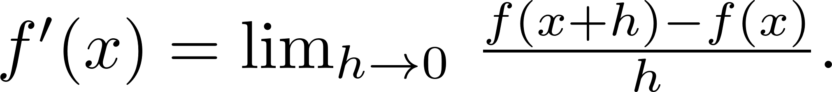
Derivatives in Practice
Digital images are discrete signals
Derivative
We approximate the true derivative with finite differences.
The smallest sampled ‘h’ in images is 1 (one pixel).
Symmetric form produces derivative estimate at x exactly, rather than at the border between (x+1) and x as above.
Notes:
We approximate the derivative by assuming h=1 (because 1 pixel in an image is the smallest step you can take). In other words, our approximation is just the difference between intensity of a neighboring pixel and that of the current pixel.
There are other ways to approximate the derivate such as the symmetric form, which process an estimate at the center of pixel f(x). Each has different behavior.

Slide 21
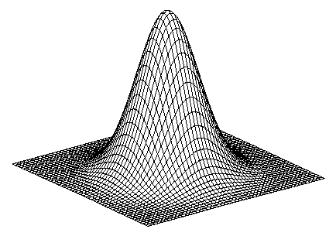
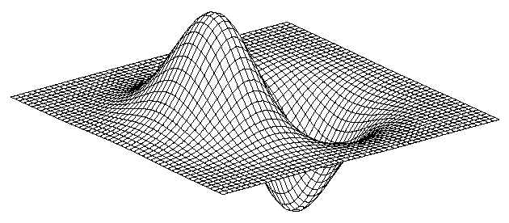
Derivative of 2D Gaussian Filter
* [1 -1] =
g
James Hays

Slide 22
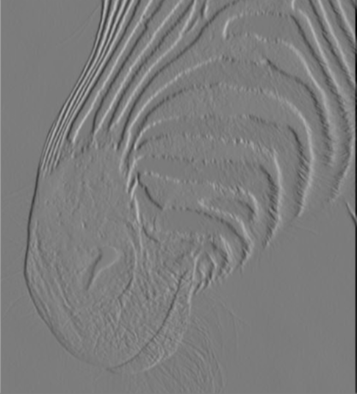
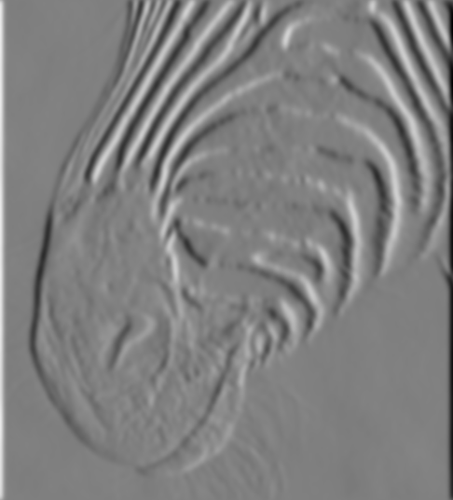
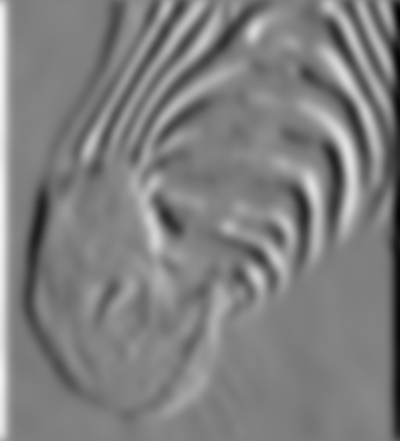
Smoothing-Localization Tradeoff
Smoothed derivative removes noise, but blurs edge.
Also finds edges at different frequencies.
1 pixel
3 pixels
7 pixels
David Forsyth
Notes:
The bigger the kernel, the more smoothed out the edges of the image are since we start killing off lower frequencies.

Slide 23
Designing an Edge Detector
Criteria for a good edge detector:
  Good detection: the optimal detector should find all real edges, ignoring noise or other artifacts
  Good localization
    the edges detected must be as close as possible to the true edges
    the detector must return one point only for each true edge point
Cues of edge detection
  Differences in color, intensity, or texture across the boundary
  Continuity and closure
  High-level knowledge
Fei-Fei Li

Slide 24

Designing an Edge Detector
“All real edges”
  We can aim to differentiate later which edges are ‘useful’ for our applications.
  Our perceptual system can complete shapes even when no edge exists.
  No correct answer
“Edges are imposed, not detected.”
- Koenderink
Marr’s famous Vision book!
Notes:
Jan Johan Koenderink (b. 1943)
See Svetlana Lazenbik’s course on Computer Vision: Looking Back to Look Forward
David Marr (b. 1945, d.1980) – neuroscientist investigating vision @ MIT. His book was published posthumously after his early death due to ill health.
Computer vision’s prize for best paper at ICCV (International Conference on Computer Vision) is named after him.
Foreword:
https://en.wikipedia.org/wiki/David_Marr_%28neuroscientist%29

Slide 25
Closer Look at Edges
Derek Hoiem

Slide 26
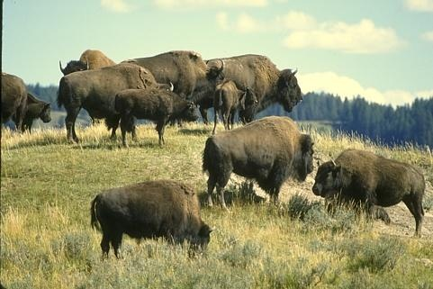
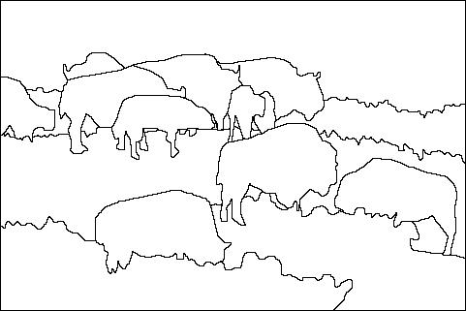
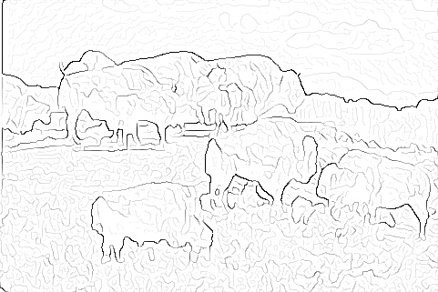

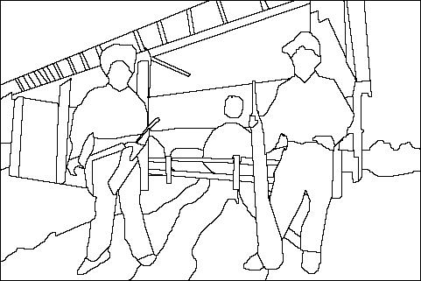
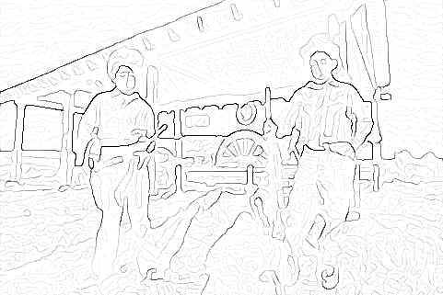
Where do humans see boundaries?
image
human segmentation
gradient magnitude
James Hays. http://www.eecs.berkeley.edu/Research/Projects/CS/vision/grouping/segbench/

Slide 27
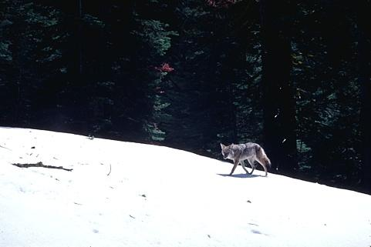
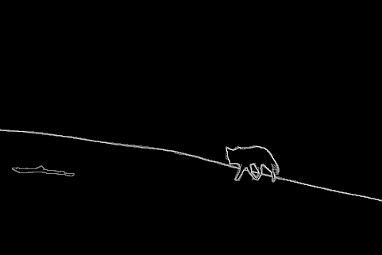
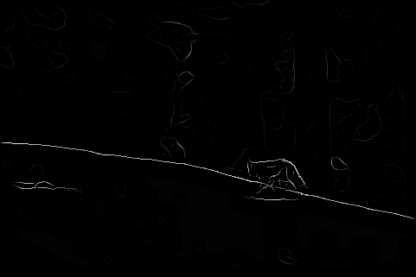
pB Boundary Detector vs. Humans
Score = confidence of edge.
For humans, this is averaged across multiple participants.
Human (0.95)
Pb (0.88)
http://www.eecs.berkeley.edu/Research/Projects/CS/vision/grouping/papers/mfm-pami-boundary.pdf
Notes:
Brighter edges are edges with higher confidence

Slide 28
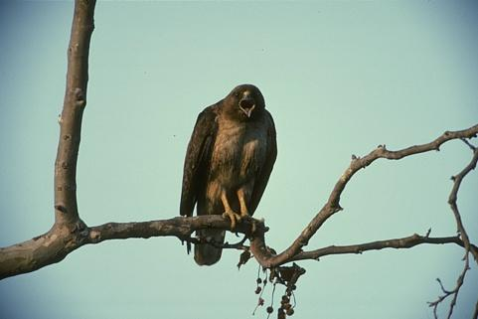
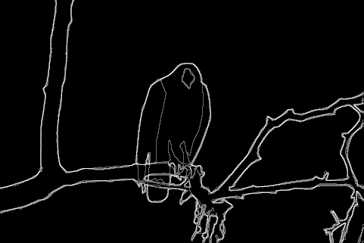
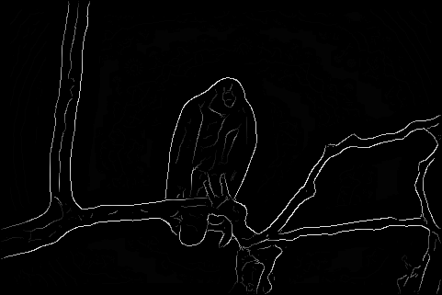
pB Boundary Detector vs. Humans
Pb
Score = confidence of edge.
For humans, this is averaged across multiple participants.
Global Pb
Human
Human (0.96)
Pb (0.88)
http://www.eecs.berkeley.edu/Research/Projects/CS/vision/grouping/papers/mfm-pami-boundary.pdf
Notes:
Humans tend to group objects into fewer contiguous regions.

Slide 29
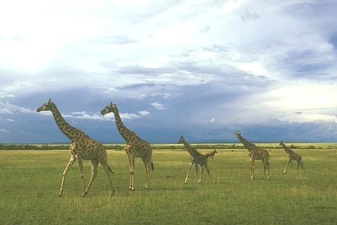
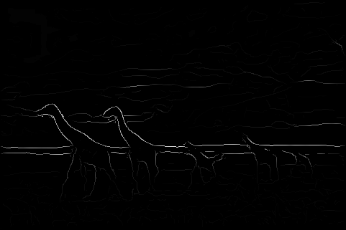
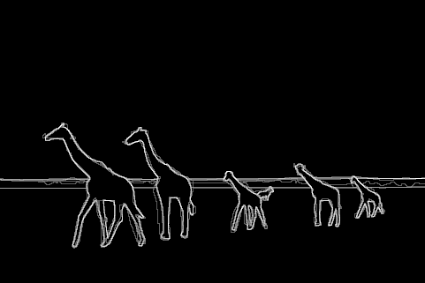
Score = confidence of edge.
For humans, this is averaged across multiple participants.
Pb (0.63)
Human (0.95)

Slide 30
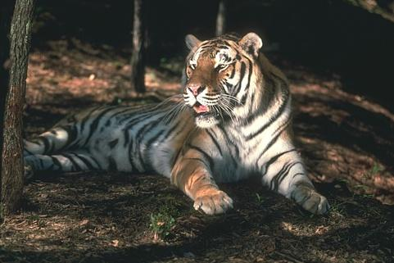
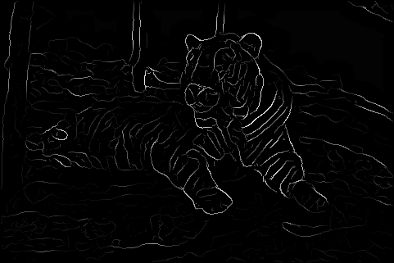
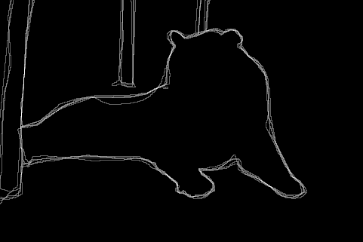
Score = confidence of edge.
For humans, this is averaged across multiple participants.
Pb (0.35)
Human (0.90)
For more: http://www.eecs.berkeley.edu/Research/Projects/CS/vision/bsds/bench/html/108082-color.html

Slide 31
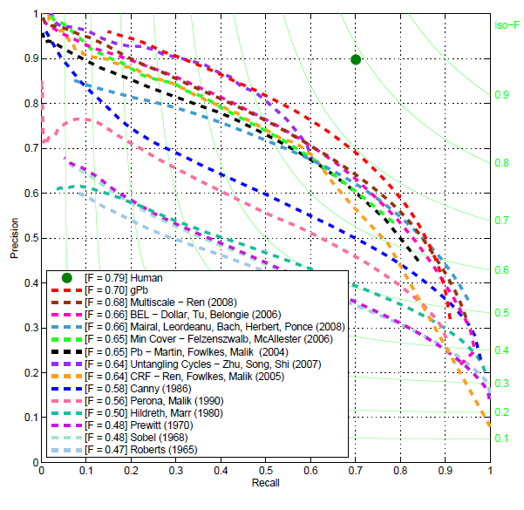
45 Years of Boundary Detection*
* Pre-deep learning
Arbelaez, Maire, Fowlkes, and Malik, TPAMI 2011.

Slide 32
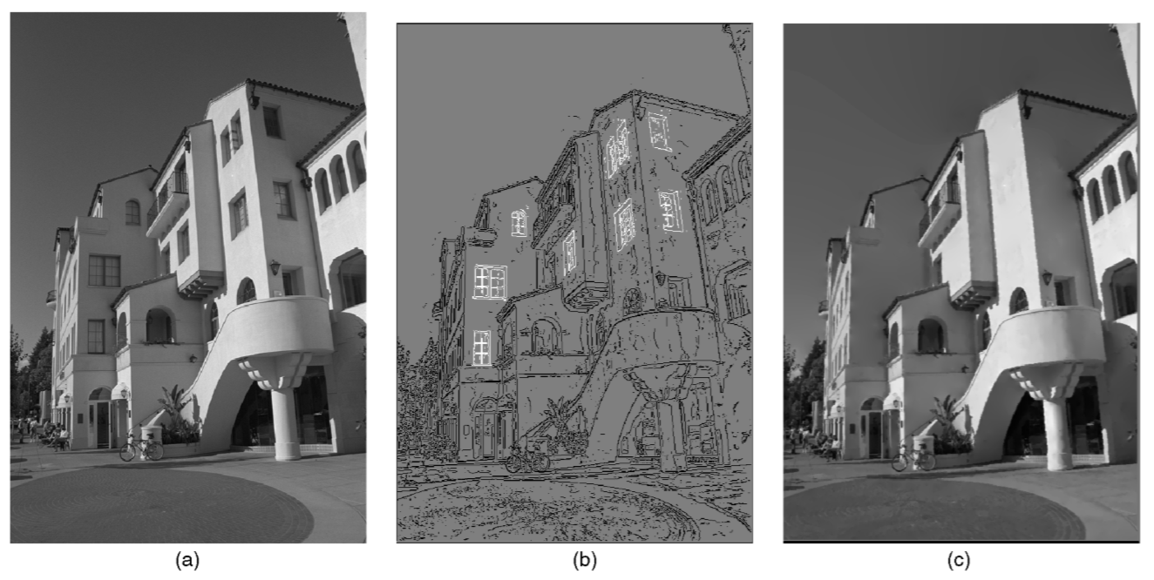
Image Editing
Image Editing in the Contour Domain, TPAMI 2001.
Notes:
Defenestration!
Reconstruction: PDE problem

Slide 33
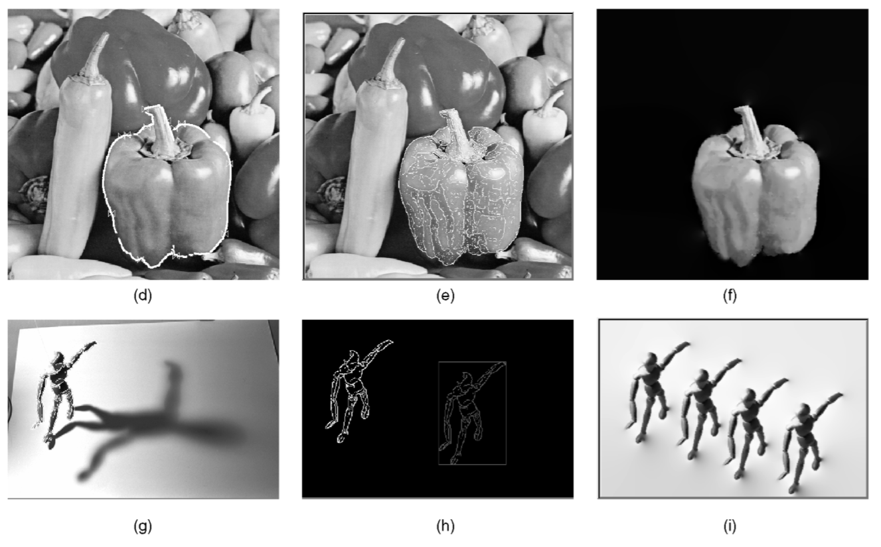
Image Editing
Image Editing in the Contour Domain, TPAMI 2001.

Slide 34
State of Edge Detection
Local edge detection works well
  ‘False positives’ from illumination and texture edges (depends on our application).
Some methods to consider longer contours
Modern methods that “learn” from data.
Poor use of object and high-level information.

Slide 35
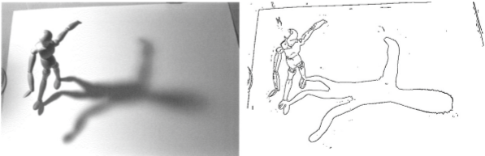
Summary
Edge detection to identify
sharp changes in image intensity
Edges help with three Rs
Derivative of Gaussian
and linear combination
of convolutions
Properties of good edges
f

Slide 36
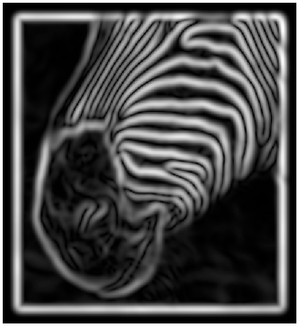
A Better Edge Detector
The gradient magnitude is large along a thick “trail” or “ridge,” so how do we identify the actual edge points?
How do we link the edge points to form curves?
David Forsyth
Notes:
Figures show gradient magnitude of zebra at two different scales

Slide 37

Canny Edge Detector
Probably the most widely used edge detector in computer vision.
J. Canny, A Computational Approach To Edge Detection, IEEE Trans. Pattern Analysis and Machine Intelligence, 8:679-714, 1986.
40,530 citations!
Fei-Fei Li

Slide 38


Demonstrator Image
rgb2gray(‘img.png’)
Notes:
“Asian Business Woman 2” by Bold Content is licensed under CC BY 2.0

Slide 39
Canny Edge Detector
Filter image with x, y derivatives of Gaussian
David Lowe, Fei-Fei Li
Notes:
Again, to remove noise

Slide 40


Derivative of Gaussian filter
x-direction
y-direction
Notes:
Find the derivatives (kernels) along the x- and y-directions

Slide 41



Compute Gradients
X’ Derivative of Gaussian
Y Derivative of Gaussian
(x2 + 0.5 for visualization)
Notes:
We can see more vertical edges in the X derivative version

Slide 42
Canny Edge Detector
Filter image with x, y derivatives of Gaussian
Find magnitude and orientation of gradient
David Lowe, Fei-Fei Li

Slide 43

Compute Gradient Magnitude
sqrt( XDerivOfGaussian .^2 + YDerivOfGaussian .^2 ) = gradient magnitude
(x4 for visualization)

Slide 44


Compute Gradient Orientation
Threshold magnitude at minimum level
Get orientation via
Unthresholded:
theta = atan2(yDeriv, xDeriv)
Notes:
Here we visualize the orientation using colors that vary in [-pi, pi]

Slide 45
Canny Edge Detector
Filter image with x, y derivatives of Gaussian
Find magnitude and orientation of gradient (or can just use sobel)
Non-maximum suppression:
  Thin multi-pixel wide “ridges” to single pixel width
David Lowe, Fei-Fei Li
Notes:
Intuitively, we want to find the peaks in the gradient that correspond to edges in the image, and we want the detected edges to be thin.

Slide 46


Non-Maximum Suppression for Each Orientation
At pixel q:
We have a maximum if the value is larger than those at both p and at r.
Interpolate along gradient direction to get these values.
David Forsyth

Slide 47



Additional Slide: Interpolation Options
e.g., skimage.transform.rescale( I, 2, order=x )
x == 0 -> ‘nearest neighbor’
  Copy value from nearest known
  Very fast but creates blocky edges
x == 1 -> ‘bilinear’ (default)
  Weighted average from four nearest known pixels
  Fast and reasonable results
x == 3 => ‘bicubic’
  Fit cubic spline to pixel intensities
  Non-linear interpolation over larger area (4x4)
  Slower, visually appealing, may create negative pixel values in cubic function fitting
Examples from http://en.wikipedia.org/wiki/Bicubic_interpolation

Slide 48

Before Non-max Suppression
Gradient magnitude (x4 for visualization)

Slide 49

After Non-max Suppression
Gradient magnitude (x4 for visualization)
Notes:
Notice how the edges are less smoothed out; the edges are thinner boundaries.

Slide 50
Canny Edge Detector
Filter image with x, y derivatives of Gaussian
Find magnitude and orientation of gradient
Non-maximum suppression:
  Thin multi-pixel wide “ridges” to single pixel width
‘Hysteresis’ Thresholding
David Lowe, Fei-Fei Li
Notes:
Hysteresis is the dependence of the state of a system on its history -> system is _along the edge_.
A little odd of a word to use in this sense (comes from engineering). As if ‘history’ is the spatial extent of the edge.

Slide 51
‘Hysteresis’ Thresholding
Two thresholds – high and low
Grad. mag. > high threshold? = strong edge
Grad. mag. < low threshold? noise
In between = weak edge
Edge linking: ‘Follow’ edges starting from strong edge pixels
Continue them into weak edges
    Connected components (Szeliski 3.3.4)
Steve Seitz
Notes:
At a high level, we want the final edges to be contiguous without abrupt ends and starts. This process ranks the edges as strong (confident of edge), weak (less confident), or noise (definitely not an edge), and then connects the strong & weak edges as described above.

Slide 52
Additional Slide: Edge Linking
Assume the marked point is an edge point. Then we construct the tangent to the edge curve (which is normal to the gradient at that point) and use this to predict the next points (here either r or s).
Source: D. Forsyth

Slide 53


Final Canny Edges
$$σ=\sqrt{2}, t_{low}=0.05,t_{high}=0.1$$
Steve Seitz

Slide 54




Effect of σ (Gaussian kernel spread/size)
Original
$$σ=\sqrt{2}$$
$$σ=4\sqrt{2}$$
The choice of σ depends on desired behavior
  large σ detects large scale edges
  small σ detects fine features
Steve Seitz

Slide 55
Canny Edge Detector
Filter image with x, y derivatives of Gaussian
Find magnitude and orientation of gradient
Non-maximum suppression:
  Thin multi-pixel wide “ridges” to single pixel width
‘Hysteresis’ Thresholding:
  Define two thresholds: low and high
  Use the high threshold to start edge curves and the low threshold to continue them
  ‘Follow’ edges starting from strong edge pixels
    Connected components (Szeliski 3.3.4)
David Lowe, Fei-Fei Li

