Slide 1
Filtering
Filtering properties
Correlation & convolution
Sampling & aliasing
Modified by Hong Xu, mostly taken from slides by Betsy Sanders, in turn modified from James Tompkin’s class.
Image credit: Pixar animation studios

Slide 2
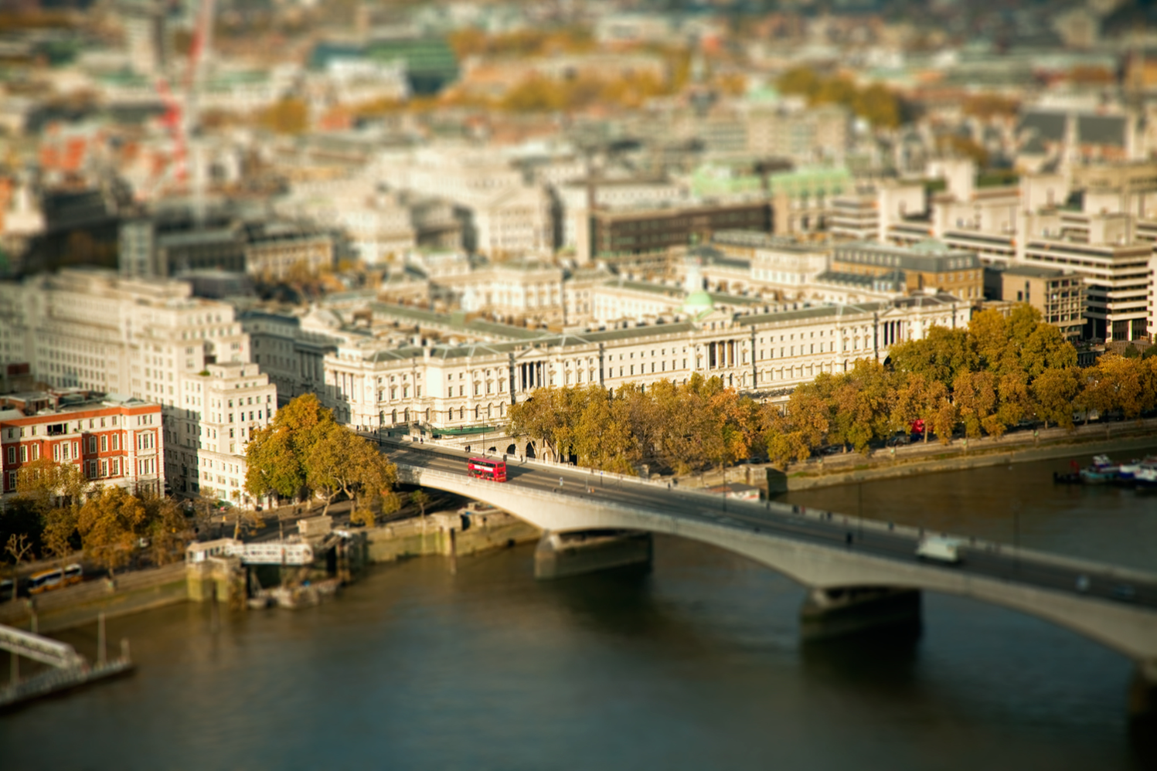
Ben Thomas
Notes:
http://benthomas.net.au/cityshrinker/eilz24txaul9s1hx5prqr0ta5y8nvl
Somerset house in London, next to Waterloo Bridge. James Tompkin’s undergraduate alma mater --- King’s College London --- is just on the left there.
What do you notice about this image?

Slide 3
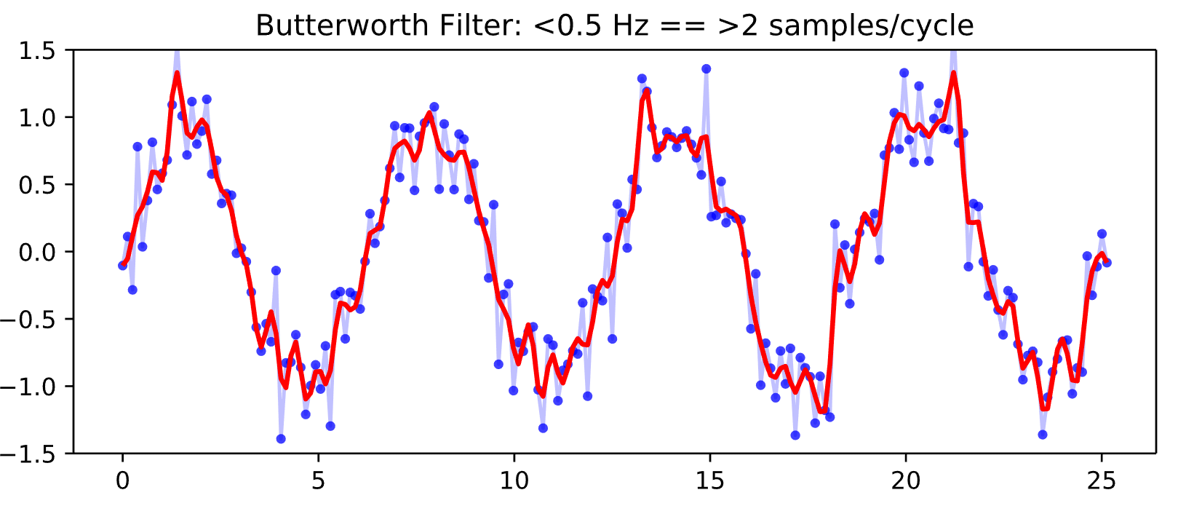
Filtering
An operation that modifies a (measured) signal.
https://ggbaker.ca/data-science/media/butter4.svg
Notes:
A signal is just some natural phenomenon that often varies across space and/or time (e.g. light, gravitational waves, etc.). We are interested in measured or discrete signals because that is what we get from hardware such as sensors.

Slide 4
Filtering
An operation that modifies a (measured) signal.
Modifications include
  Removing undesirable components
  Transforming signal in a desirable way
  Extract specific components of a signal
https://ggbaker.ca/data-science/media/butter4.svg
Notes:
A signal is just some natural phenomenon that often varies across space and/or time (e.g. light, gravitational waves, etc.). We are interested in measured or discrete signals because that is what we get from hardware such as sensors.

Slide 5
Filtering
An operation that modifies a (measured) signal.
Modifications include
  Removing undesirable components
  Transforming signal in a desirable way
  Extract specific components of a signal
Typically, discrete measured signals
https://ggbaker.ca/data-science/media/butter4.svg
Notes:
A signal is just some natural phenomenon that often varies across space and/or time (e.g. light, gravitational waves, etc.). We are interested in measured or discrete signals because that is what we get from hardware such as sensors.

Slide 6
Filtering
An operation that modifies a (measured) signal.
Modifications include
  Removing undesirable components
  Transforming signal in a desirable way
  Extract specific components of a signal
Typically, discrete measured signals
Can be in any dimension
https://ggbaker.ca/data-science/media/butter4.svg
Notes:
A signal is just some natural phenomenon that often varies across space and/or time (e.g. light, gravitational waves, etc.). We are interested in measured or discrete signals because that is what we get from hardware such as sensors.

Slide 7
1D Filtering: Moving Average
https://en.wikipedia.org/wiki/Moving_average
Notes:
“I” is the signal and we can represent it as a vector of size mx1, where m is the number of samples we take of the signal, and each sample is a single scalar value. The moving average h[n] at the point n is the average value of the signal over the k most recent samples. In other words, we move a window of size k across the signal. h[n] is a 1D filter and results in the red curve when applied to the original noisy blue curve.
The second equation is just another way of expressing the first equation using matrix multiplication (in this case it equivalent to the dot product). I[n-k+1:n] uses numpy notation to represent the window of k values centered at n.
k/2 – k must be even, we also need to consider boundaries.

Slide 8
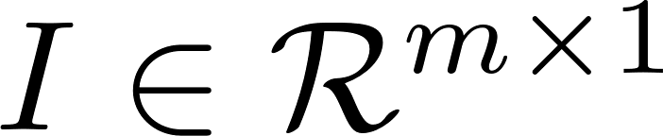
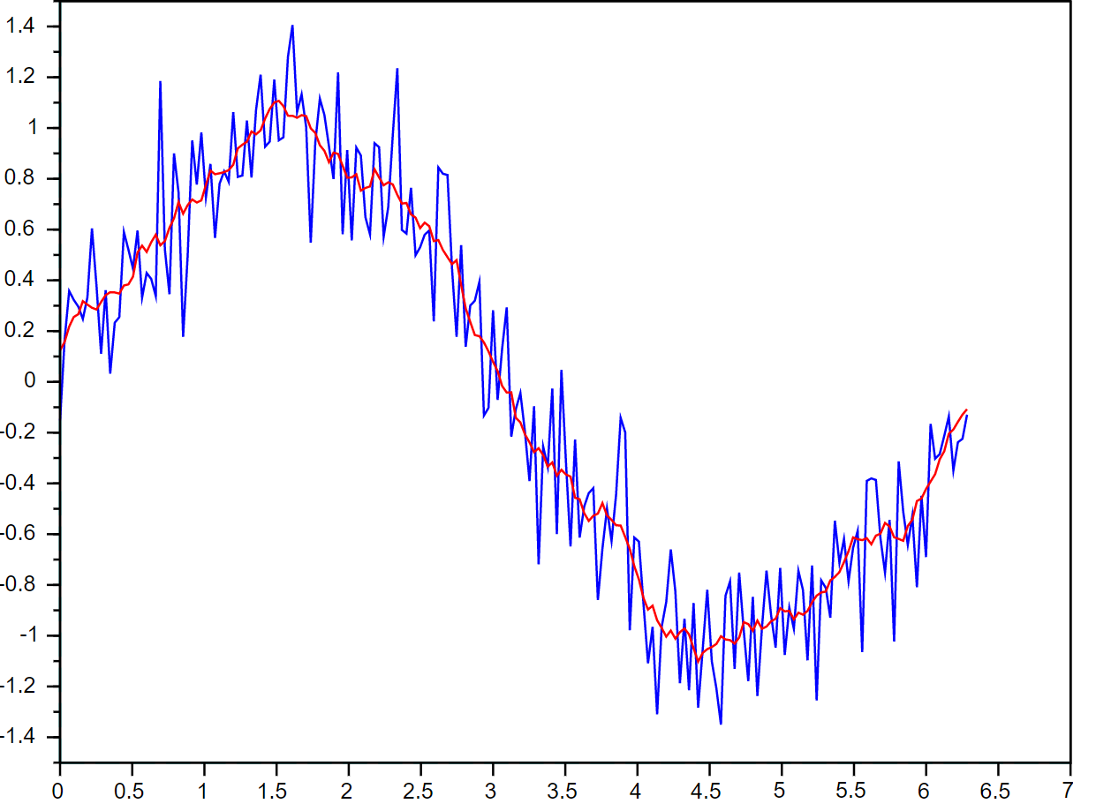
1D Filtering: Moving Average
https://en.wikipedia.org/wiki/Moving_average
Notes:
“I” is the signal and we can represent it as a vector of size mx1, where m is the number of samples we take of the signal, and each sample is a single scalar value. The moving average h[n] at the point n is the average value of the signal over the k most recent samples. In other words, we move a window of size k across the signal. h[n] is a 1D filter and results in the red curve when applied to the original noisy blue curve.
The second equation is just another way of expressing the first equation using matrix multiplication (in this case it equivalent to the dot product). I[n-k+1:n] uses numpy notation to represent the window of k values centered at n.
k/2 – k must be even, we also need to consider boundaries.

Slide 9
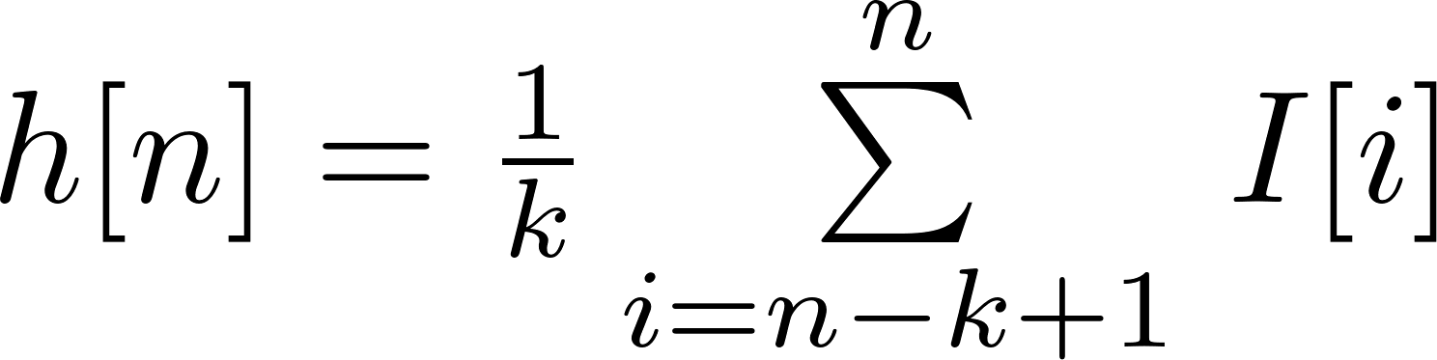
1D Filtering: Moving Average
Window size ‘k’
https://en.wikipedia.org/wiki/Moving_average
Notes:
“I” is the signal and we can represent it as a vector of size mx1, where m is the number of samples we take of the signal, and each sample is a single scalar value. The moving average h[n] at the point n is the average value of the signal over the k most recent samples. In other words, we move a window of size k across the signal. h[n] is a 1D filter and results in the red curve when applied to the original noisy blue curve.
The second equation is just another way of expressing the first equation using matrix multiplication (in this case it equivalent to the dot product). I[n-k+1:n] uses numpy notation to represent the window of k values centered at n.
k/2 – k must be even, we also need to consider boundaries.

Slide 10
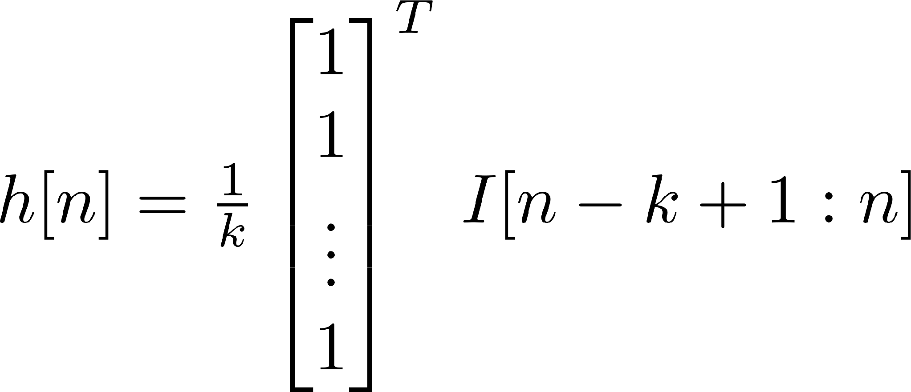
1D Filtering: Moving Average
Window size ‘k’
https://en.wikipedia.org/wiki/Moving_average
Notes:
“I” is the signal and we can represent it as a vector of size mx1, where m is the number of samples we take of the signal, and each sample is a single scalar value. The moving average h[n] at the point n is the average value of the signal over the k most recent samples. In other words, we move a window of size k across the signal. h[n] is a 1D filter and results in the red curve when applied to the original noisy blue curve.
The second equation is just another way of expressing the first equation using matrix multiplication (in this case it equivalent to the dot product). I[n-k+1:n] uses numpy notation to represent the window of k values centered at n.
k/2 – k must be even, we also need to consider boundaries.

Slide 11
1D Filtering: Moving Average
Window size ‘k’
https://en.wikipedia.org/wiki/Moving_average
Notes:
“I” is the signal and we can represent it as a vector of size mx1, where m is the number of samples we take of the signal, and each sample is a single scalar value. The moving average h[n] at the point n is the average value of the signal over the k most recent samples. In other words, we move a window of size k across the signal. h[n] is a 1D filter and results in the red curve when applied to the original noisy blue curve.
The second equation is just another way of expressing the first equation using matrix multiplication (in this case it equivalent to the dot product). I[n-k+1:n] uses numpy notation to represent the window of k values centered at n.
k/2 – k must be even, we also need to consider boundaries.

Slide 12

1D Filtering: Moving Average
Identity filter
Window size ‘k’
https://en.wikipedia.org/wiki/Moving_average
Notes:
“I” is the signal and we can represent it as a vector of size mx1, where m is the number of samples we take of the signal, and each sample is a single scalar value. The moving average h[n] at the point n is the average value of the signal over the k most recent samples. In other words, we move a window of size k across the signal. h[n] is a 1D filter and results in the red curve when applied to the original noisy blue curve.
The second equation is just another way of expressing the first equation using matrix multiplication (in this case it equivalent to the dot product). I[n-k+1:n] uses numpy notation to represent the window of k values centered at n.
k/2 – k must be even, we also need to consider boundaries.

Slide 13
1D Filtering: Moving Average
Identity filter
Window size ‘k’
https://en.wikipedia.org/wiki/Moving_average
Notes:
“I” is the signal and we can represent it as a vector of size mx1, where m is the number of samples we take of the signal, and each sample is a single scalar value. The moving average h[n] at the point n is the average value of the signal over the k most recent samples. In other words, we move a window of size k across the signal. h[n] is a 1D filter and results in the red curve when applied to the original noisy blue curve.
The second equation is just another way of expressing the first equation using matrix multiplication (in this case it equivalent to the dot product). I[n-k+1:n] uses numpy notation to represent the window of k values centered at n.
k/2 – k must be even, we also need to consider boundaries.

Slide 14
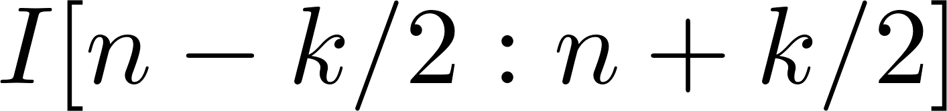
1D Filtering: Moving Average
Identity filter
Window size ‘k’
Different window
https://en.wikipedia.org/wiki/Moving_average
Notes:
“I” is the signal and we can represent it as a vector of size mx1, where m is the number of samples we take of the signal, and each sample is a single scalar value. The moving average h[n] at the point n is the average value of the signal over the k most recent samples. In other words, we move a window of size k across the signal. h[n] is a 1D filter and results in the red curve when applied to the original noisy blue curve.
The second equation is just another way of expressing the first equation using matrix multiplication (in this case it equivalent to the dot product). I[n-k+1:n] uses numpy notation to represent the window of k values centered at n.
k/2 – k must be even, we also need to consider boundaries.

Slide 15
Filtering Demo
https://cristal.univ-lille.fr/~casiez/1euro/InteractiveDemo/

Slide 16
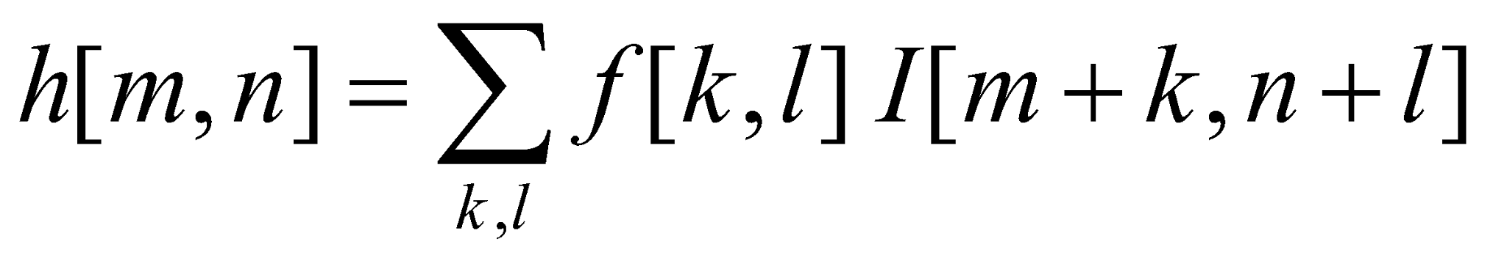
2D Filtering
  Compute function of local neighborhood
  at each position:
Window size ‘k’ and ‘l’
James Hays
Notes:
For images, we’re interested in filtering along two spatial axes (x and y) rather than a single one. The equation says that the filtered value at a location (m,n) is the sum over products of the filtering function f and the image I in a local neighborhood.
The size of the neighborhood (‘window’) is determined by k and L.

Slide 17
2D Filtering
  Compute function of local neighborhood
  at each position:
h=output
f=filter
I=image
2d coords=k,l
2d coords=m,n
[ ]
[ ]
[ ]
Note: Filter is often
called the ‘kernel’
James Hays
Notes:
Like before, it’s useful to think of our equations in terms of matrices. The size of the brackets above shows the (typical) relative sizes of the matrices h, f, and I.

Slide 18
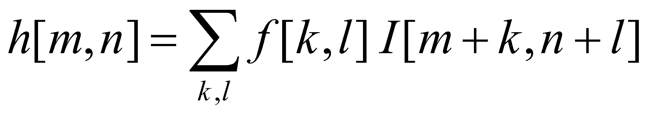
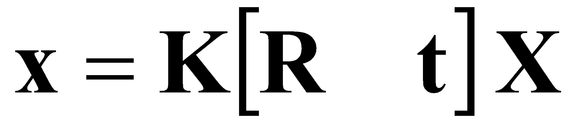

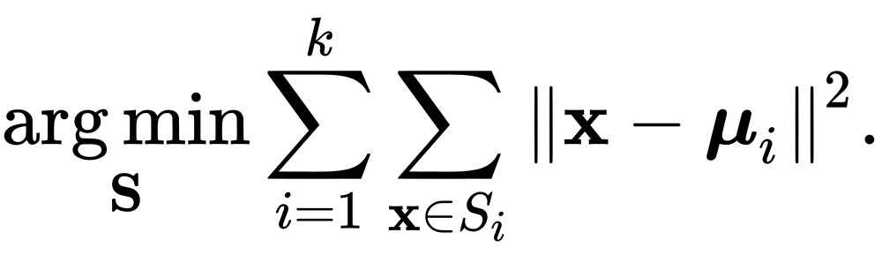

Fundamental Equations of Computer Vision
Image Filtering
Camera Geometry
Machine Learning
Optical Flow

Slide 19

Fundamental Equations of Computer Vision
Image Filtering
Camera Geometry
Machine Learning
Optical Flow

Slide 20
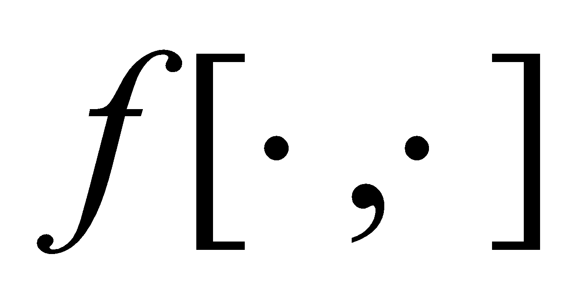

Example: Box Filter
1
1
1
1
1
1
1
1
1
David Lowe
Notes:
f is our filtering function and is a 3x3 matrix

Slide 21
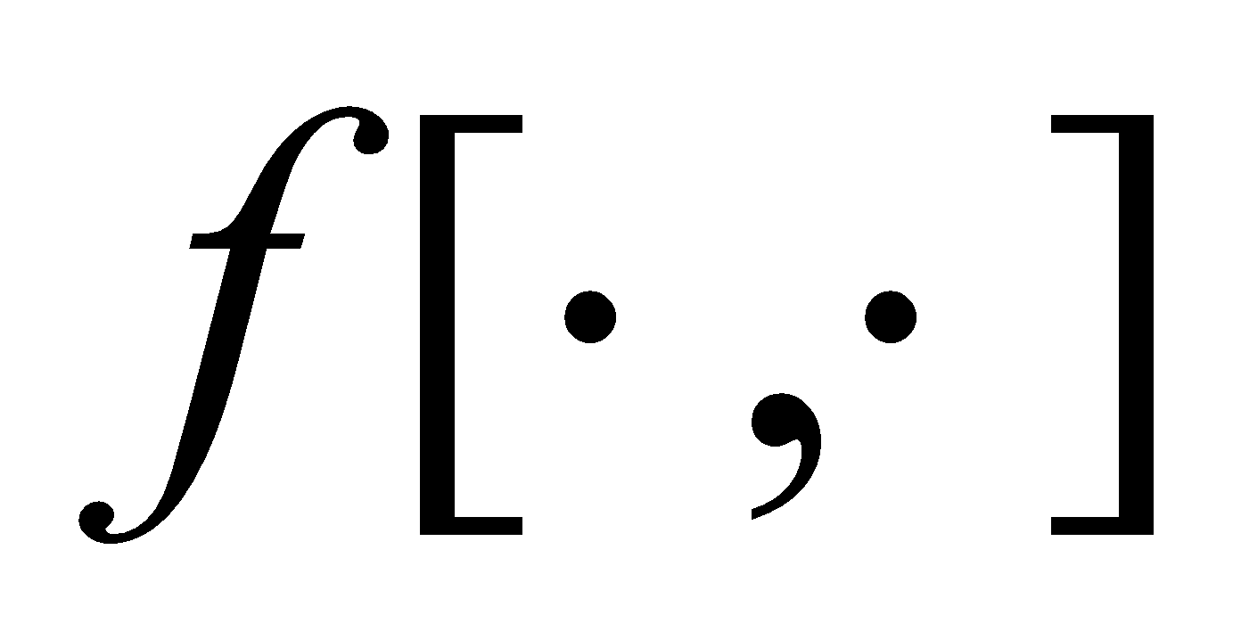
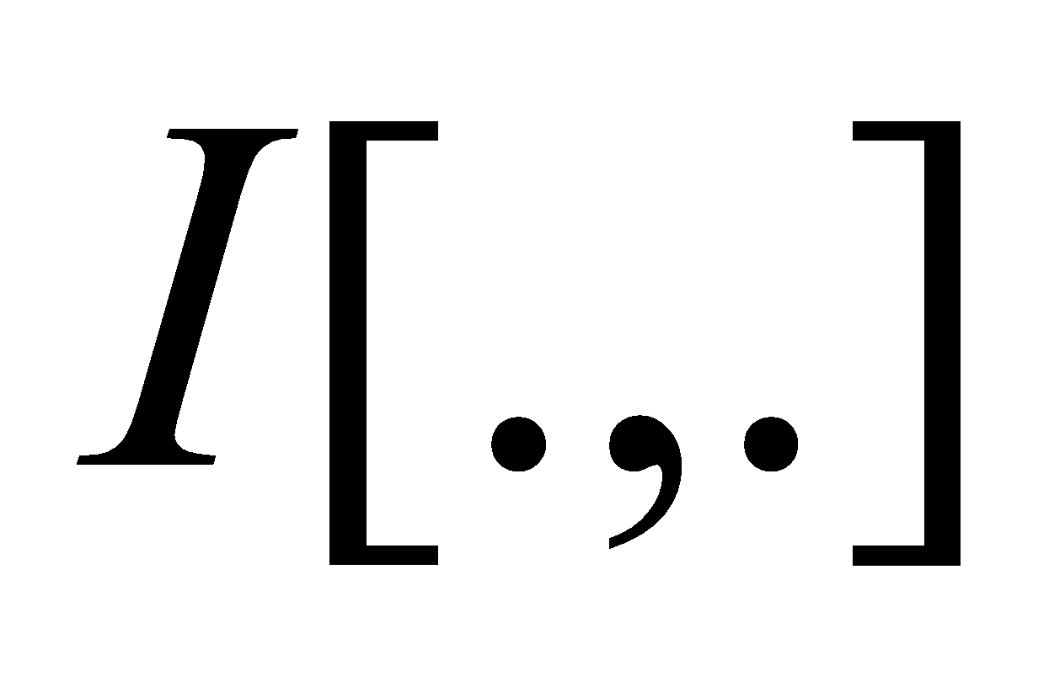
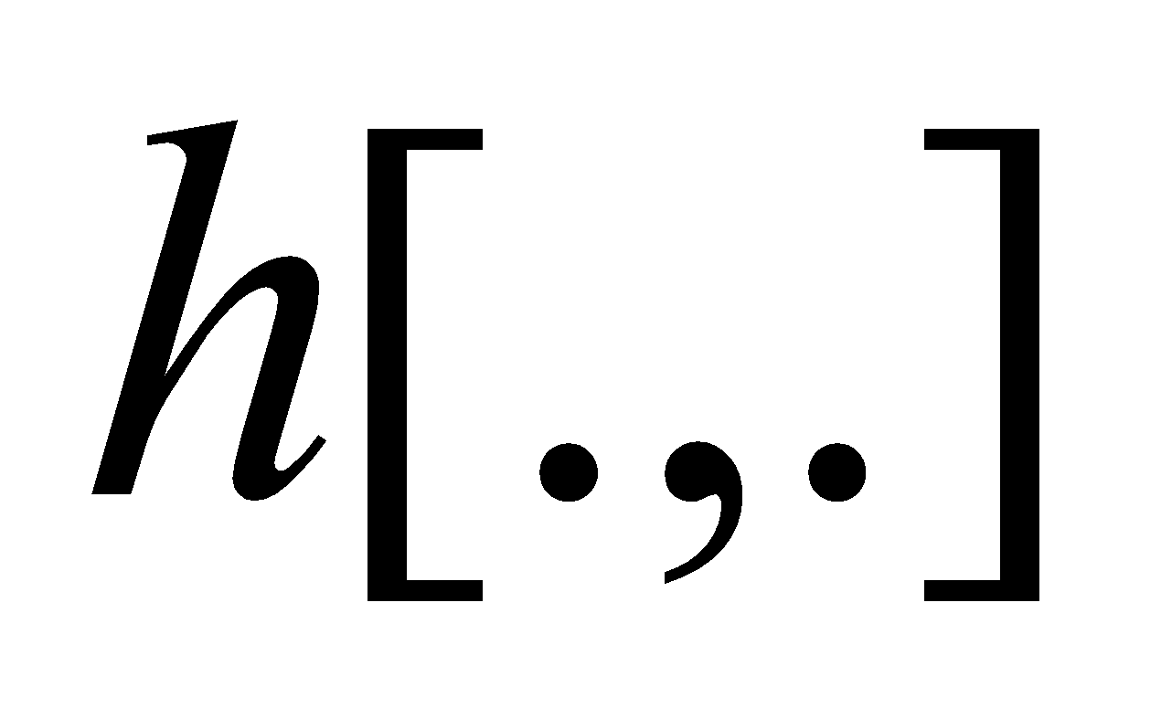
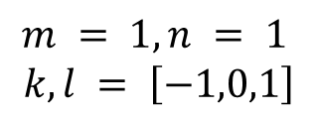
Image Filtering
1
1
1
1
1
1
1
1
1
0 | 0 | 0 | 0 | 0 | 0 | 0 | 0 | 0 | 0
0 | 0 | 0 | 0 | 0 | 0 | 0 | 0 | 0 | 0
0 | 0 | 0 | 90 | 90 | 90 | 90 | 90 | 0 | 0
0 | 0 | 0 | 90 | 90 | 90 | 90 | 90 | 0 | 0
0 | 0 | 0 | 90 | 90 | 90 | 90 | 90 | 0 | 0
0 | 0 | 0 | 90 | 0 | 90 | 90 | 90 | 0 | 0
0 | 0 | 0 | 90 | 90 | 90 | 90 | 90 | 0 | 0
0 | 0 | 0 | 0 | 0 | 0 | 0 | 0 | 0 | 0
0 | 0 | 90 | 0 | 0 | 0 | 0 | 0 | 0 | 0
0 | 0 | 0 | 0 | 0 | 0 | 0 | 0 | 0 | 0
 | 0
0 | 0 | 0 | 0 | 0 | 0 | 0 | 0 | 0 | 0
0 | 0 | 0 | 0 | 0 | 0 | 0 | 0 | 0 | 0
0 | 0 | 0 | 90 | 90 | 90 | 90 | 90 | 0 | 0
0 | 0 | 0 | 90 | 90 | 90 | 90 | 90 | 0 | 0
0 | 0 | 0 | 90 | 90 | 90 | 90 | 90 | 0 | 0
0 | 0 | 0 | 90 | 0 | 90 | 90 | 90 | 0 | 0
0 | 0 | 0 | 90 | 90 | 90 | 90 | 90 | 0 | 0
0 | 0 | 0 | 0 | 0 | 0 | 0 | 0 | 0 | 0
0 | 0 | 90 | 0 | 0 | 0 | 0 | 0 | 0 | 0
0 | 0 | 0 | 0 | 0 | 0 | 0 | 0 | 0 | 0
Steve Seitz
Notes:
To filter the image, we use a sliding 2D window. Starting at the top left pixel of the original image I, we first overlay the filter f to find the current local neighborhood. We then multiply the values of f element-wise
By the values of I in the window and sum up the products. This sum gives us the output value at (m,n) in the output image h.
By convention, we use odd-sized filters because they have an equal number of cells in each direction starting at the center
Notice that the box filter contains a 1/9 multipler; this is to ensure that we do not increase the total light intensity in the image, which would cause things to become brighter.

Slide 22
Image Filtering
1
1
1
1
1
1
1
1
1
0 | 0 | 0 | 0 | 0 | 0 | 0 | 0 | 0 | 0
0 | 0 | 0 | 0 | 0 | 0 | 0 | 0 | 0 | 0
0 | 0 | 0 | 90 | 90 | 90 | 90 | 90 | 0 | 0
0 | 0 | 0 | 90 | 90 | 90 | 90 | 90 | 0 | 0
0 | 0 | 0 | 90 | 90 | 90 | 90 | 90 | 0 | 0
0 | 0 | 0 | 90 | 0 | 90 | 90 | 90 | 0 | 0
0 | 0 | 0 | 90 | 90 | 90 | 90 | 90 | 0 | 0
0 | 0 | 0 | 0 | 0 | 0 | 0 | 0 | 0 | 0
0 | 0 | 90 | 0 | 0 | 0 | 0 | 0 | 0 | 0
0 | 0 | 0 | 0 | 0 | 0 | 0 | 0 | 0 | 0
 | 0
0 | 0 | 0 | 0 | 0 | 0 | 0 | 0 | 0 | 0
0 | 0 | 0 | 0 | 0 | 0 | 0 | 0 | 0 | 0
0 | 0 | 0 | 90 | 90 | 90 | 90 | 90 | 0 | 0
0 | 0 | 0 | 90 | 90 | 90 | 90 | 90 | 0 | 0
0 | 0 | 0 | 90 | 90 | 90 | 90 | 90 | 0 | 0
0 | 0 | 0 | 90 | 0 | 90 | 90 | 90 | 0 | 0
0 | 0 | 0 | 90 | 90 | 90 | 90 | 90 | 0 | 0
0 | 0 | 0 | 0 | 0 | 0 | 0 | 0 | 0 | 0
0 | 0 | 90 | 0 | 0 | 0 | 0 | 0 | 0 | 0
0 | 0 | 0 | 0 | 0 | 0 | 0 | 0 | 0 | 0
Steve Seitz
Notes:
To filter the image, we use a sliding 2D window. Starting at the top left pixel of the original image I, we first overlay the filter f to find the current local neighborhood. We then multiply the values of f element-wise
By the values of I in the window and sum up the products. This sum gives us the output value at (m,n) in the output image h.
By convention, we use odd-sized filters because they have an equal number of cells in each direction starting at the center
Notice that the box filter contains a 1/9 multipler; this is to ensure that we do not increase the total light intensity in the image, which would cause things to become brighter.

Slide 23
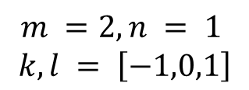
Image Filtering
1
1
1
1
1
1
1
1
1
0 | 0 | 0 | 0 | 0 | 0 | 0 | 0 | 0 | 0
0 | 0 | 0 | 0 | 0 | 0 | 0 | 0 | 0 | 0
0 | 0 | 0 | 90 | 90 | 90 | 90 | 90 | 0 | 0
0 | 0 | 0 | 90 | 90 | 90 | 90 | 90 | 0 | 0
0 | 0 | 0 | 90 | 90 | 90 | 90 | 90 | 0 | 0
0 | 0 | 0 | 90 | 0 | 90 | 90 | 90 | 0 | 0
0 | 0 | 0 | 90 | 90 | 90 | 90 | 90 | 0 | 0
0 | 0 | 0 | 0 | 0 | 0 | 0 | 0 | 0 | 0
0 | 0 | 90 | 0 | 0 | 0 | 0 | 0 | 0 | 0
0 | 0 | 0 | 0 | 0 | 0 | 0 | 0 | 0 | 0
 | 0 | 10
0 | 0 | 0 | 0 | 0 | 0 | 0 | 0 | 0 | 0
0 | 0 | 0 | 0 | 0 | 0 | 0 | 0 | 0 | 0
0 | 0 | 0 | 90 | 90 | 90 | 90 | 90 | 0 | 0
0 | 0 | 0 | 90 | 90 | 90 | 90 | 90 | 0 | 0
0 | 0 | 0 | 90 | 90 | 90 | 90 | 90 | 0 | 0
0 | 0 | 0 | 90 | 0 | 90 | 90 | 90 | 0 | 0
0 | 0 | 0 | 90 | 90 | 90 | 90 | 90 | 0 | 0
0 | 0 | 0 | 0 | 0 | 0 | 0 | 0 | 0 | 0
0 | 0 | 90 | 0 | 0 | 0 | 0 | 0 | 0 | 0
0 | 0 | 0 | 0 | 0 | 0 | 0 | 0 | 0 | 0
Steve Seitz
Notes:
We now slide f, the 2D filter, to the right by one pixel and repeat the same operation.

Slide 24
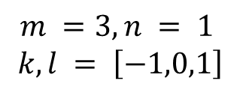
Image Filtering
1
1
1
1
1
1
1
1
1
0 | 0 | 0 | 0 | 0 | 0 | 0 | 0 | 0 | 0
0 | 0 | 0 | 0 | 0 | 0 | 0 | 0 | 0 | 0
0 | 0 | 0 | 90 | 90 | 90 | 90 | 90 | 0 | 0
0 | 0 | 0 | 90 | 90 | 90 | 90 | 90 | 0 | 0
0 | 0 | 0 | 90 | 90 | 90 | 90 | 90 | 0 | 0
0 | 0 | 0 | 90 | 0 | 90 | 90 | 90 | 0 | 0
0 | 0 | 0 | 90 | 90 | 90 | 90 | 90 | 0 | 0
0 | 0 | 0 | 0 | 0 | 0 | 0 | 0 | 0 | 0
0 | 0 | 90 | 0 | 0 | 0 | 0 | 0 | 0 | 0
0 | 0 | 0 | 0 | 0 | 0 | 0 | 0 | 0 | 0
 | 0 | 10 | 20
0 | 0 | 0 | 0 | 0 | 0 | 0 | 0 | 0 | 0
0 | 0 | 0 | 0 | 0 | 0 | 0 | 0 | 0 | 0
0 | 0 | 0 | 90 | 90 | 90 | 90 | 90 | 0 | 0
0 | 0 | 0 | 90 | 90 | 90 | 90 | 90 | 0 | 0
0 | 0 | 0 | 90 | 90 | 90 | 90 | 90 | 0 | 0
0 | 0 | 0 | 90 | 0 | 90 | 90 | 90 | 0 | 0
0 | 0 | 0 | 90 | 90 | 90 | 90 | 90 | 0 | 0
0 | 0 | 0 | 0 | 0 | 0 | 0 | 0 | 0 | 0
0 | 0 | 90 | 0 | 0 | 0 | 0 | 0 | 0 | 0
0 | 0 | 0 | 0 | 0 | 0 | 0 | 0 | 0 | 0
Steve Seitz
Notes:
Etc.

Slide 25
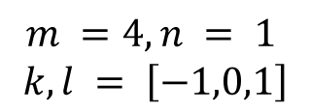
Image Filtering
1
1
1
1
1
1
1
1
1
0 | 0 | 0 | 0 | 0 | 0 | 0 | 0 | 0 | 0
0 | 0 | 0 | 0 | 0 | 0 | 0 | 0 | 0 | 0
0 | 0 | 0 | 90 | 90 | 90 | 90 | 90 | 0 | 0
0 | 0 | 0 | 90 | 90 | 90 | 90 | 90 | 0 | 0
0 | 0 | 0 | 90 | 90 | 90 | 90 | 90 | 0 | 0
0 | 0 | 0 | 90 | 0 | 90 | 90 | 90 | 0 | 0
0 | 0 | 0 | 90 | 90 | 90 | 90 | 90 | 0 | 0
0 | 0 | 0 | 0 | 0 | 0 | 0 | 0 | 0 | 0
0 | 0 | 90 | 0 | 0 | 0 | 0 | 0 | 0 | 0
0 | 0 | 0 | 0 | 0 | 0 | 0 | 0 | 0 | 0
 | 0 | 10 | 20 | 30
0 | 0 | 0 | 0 | 0 | 0 | 0 | 0 | 0 | 0
0 | 0 | 0 | 0 | 0 | 0 | 0 | 0 | 0 | 0
0 | 0 | 0 | 90 | 90 | 90 | 90 | 90 | 0 | 0
0 | 0 | 0 | 90 | 90 | 90 | 90 | 90 | 0 | 0
0 | 0 | 0 | 90 | 90 | 90 | 90 | 90 | 0 | 0
0 | 0 | 0 | 90 | 0 | 90 | 90 | 90 | 0 | 0
0 | 0 | 0 | 90 | 90 | 90 | 90 | 90 | 0 | 0
0 | 0 | 0 | 0 | 0 | 0 | 0 | 0 | 0 | 0
0 | 0 | 90 | 0 | 0 | 0 | 0 | 0 | 0 | 0
0 | 0 | 0 | 0 | 0 | 0 | 0 | 0 | 0 | 0
Steve Seitz
Notes:
We continue this process for all pixels in I

Slide 26
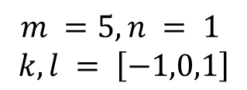
Image Filtering
1
1
1
1
1
1
1
1
1
0 | 0 | 0 | 0 | 0 | 0 | 0 | 0 | 0 | 0
0 | 0 | 0 | 0 | 0 | 0 | 0 | 0 | 0 | 0
0 | 0 | 0 | 90 | 90 | 90 | 90 | 90 | 0 | 0
0 | 0 | 0 | 90 | 90 | 90 | 90 | 90 | 0 | 0
0 | 0 | 0 | 90 | 90 | 90 | 90 | 90 | 0 | 0
0 | 0 | 0 | 90 | 0 | 90 | 90 | 90 | 0 | 0
0 | 0 | 0 | 90 | 90 | 90 | 90 | 90 | 0 | 0
0 | 0 | 0 | 0 | 0 | 0 | 0 | 0 | 0 | 0
0 | 0 | 90 | 0 | 0 | 0 | 0 | 0 | 0 | 0
0 | 0 | 0 | 0 | 0 | 0 | 0 | 0 | 0 | 0
 | 0 | 10 | 20 | 30 | 30
Steve Seitz
Notes:
ones, divide by 9

Slide 27
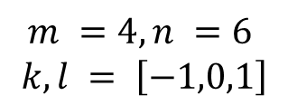
Image Filtering
1
1
1
1
1
1
1
1
1
0 | 0 | 0 | 0 | 0 | 0 | 0 | 0 | 0 | 0
0 | 0 | 0 | 0 | 0 | 0 | 0 | 0 | 0 | 0
0 | 0 | 0 | 90 | 90 | 90 | 90 | 90 | 0 | 0
0 | 0 | 0 | 90 | 90 | 90 | 90 | 90 | 0 | 0
0 | 0 | 0 | 90 | 90 | 90 | 90 | 90 | 0 | 0
0 | 0 | 0 | 90 | 0 | 90 | 90 | 90 | 0 | 0
0 | 0 | 0 | 90 | 90 | 90 | 90 | 90 | 0 | 0
0 | 0 | 0 | 0 | 0 | 0 | 0 | 0 | 0 | 0
0 | 0 | 90 | 0 | 0 | 0 | 0 | 0 | 0 | 0
0 | 0 | 0 | 0 | 0 | 0 | 0 | 0 | 0 | 0
 | 0 | 10 | 20 | 30 | 30
?
Steve Seitz
Notes:
ones, divide by 9. answer is 50

Slide 28
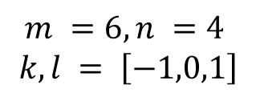
Image Filtering
1
1
1
1
1
1
1
1
1
0 | 0 | 0 | 0 | 0 | 0 | 0 | 0 | 0 | 0
0 | 0 | 0 | 0 | 0 | 0 | 0 | 0 | 0 | 0
0 | 0 | 0 | 90 | 90 | 90 | 90 | 90 | 0 | 0
0 | 0 | 0 | 90 | 90 | 90 | 90 | 90 | 0 | 0
0 | 0 | 0 | 90 | 90 | 90 | 90 | 90 | 0 | 0
0 | 0 | 0 | 90 | 0 | 90 | 90 | 90 | 0 | 0
0 | 0 | 0 | 90 | 90 | 90 | 90 | 90 | 0 | 0
0 | 0 | 0 | 0 | 0 | 0 | 0 | 0 | 0 | 0
0 | 0 | 90 | 0 | 0 | 0 | 0 | 0 | 0 | 0
0 | 0 | 0 | 0 | 0 | 0 | 0 | 0 | 0 | 0
 | 0 | 10 | 20 | 30 | 30
 |  |  |  | 50
?
Steve Seitz
Notes:
ones, divide by 9. answer is 90

Slide 29
Image Filtering
1
1
1
1
1
1
1
1
1
0 | 0 | 0 | 0 | 0 | 0 | 0 | 0 | 0 | 0
0 | 0 | 0 | 0 | 0 | 0 | 0 | 0 | 0 | 0
0 | 0 | 0 | 90 | 90 | 90 | 90 | 90 | 0 | 0
0 | 0 | 0 | 90 | 90 | 90 | 90 | 90 | 0 | 0
0 | 0 | 0 | 90 | 90 | 90 | 90 | 90 | 0 | 0
0 | 0 | 0 | 90 | 0 | 90 | 90 | 90 | 0 | 0
0 | 0 | 0 | 90 | 90 | 90 | 90 | 90 | 0 | 0
0 | 0 | 0 | 0 | 0 | 0 | 0 | 0 | 0 | 0
0 | 0 | 90 | 0 | 0 | 0 | 0 | 0 | 0 | 0
0 | 0 | 0 | 0 | 0 | 0 | 0 | 0 | 0 | 0
 | 0 | 10 | 20 | 30 | 30 | 30 | 20 | 10
 | 0 | 20 | 40 | 60 | 60 | 60 | 40 | 20
 | 0 | 30 | 60 | 90 | 90 | 90 | 60 | 30
 | 0 | 30 | 50 | 80 | 80 | 90 | 60 | 30
 | 0 | 30 | 50 | 80 | 80 | 90 | 60 | 30
 | 0 | 20 | 30 | 50 | 50 | 60 | 40 | 20
 | 10 | 20 | 30 | 30 | 30 | 30 | 20 | 10
 | 10 | 10 | 10 | 0 | 0 | 0 | 0 | 0
Steve Seitz
Notes:
This is the result of applying the filter for the entire image (except the boundary points for now – they’re an edge case we’ll cover soon).

Slide 30
Box Filter
What does it do?
1
1
1
1
1
1
1
1
1
David Lowe
Notes:
The box filter blurs the image because for each pixel, the values of its neighbors is averaged with it, smearing out the intensity values. Certain image filtering operations need to preserve mean image intensity. Box filter, a blurring fitler, does that (reason why it sums to 1). Blurring only makes sense if the mean image intensity is preserved.

Slide 31
Box Filter
What does it do?
Replaces each pixel with an average of its neighborhood
Achieve smoothing effect (remove ‘sharp’ features)
1
1
1
1
1
1
1
1
1
David Lowe
Notes:
The box filter blurs the image because for each pixel, the values of its neighbors is averaged with it, smearing out the intensity values. Certain image filtering operations need to preserve mean image intensity. Box filter, a blurring fitler, does that (reason why it sums to 1). Blurring only makes sense if the mean image intensity is preserved.

Slide 32
Box Filter
What does it do?
Replaces each pixel with an average of its neighborhood
Achieve smoothing effect (remove ‘sharp’ features)
Why does it sum to one?
1
1
1
1
1
1
1
1
1
David Lowe
Notes:
The box filter blurs the image because for each pixel, the values of its neighbors is averaged with it, smearing out the intensity values. Certain image filtering operations need to preserve mean image intensity. Box filter, a blurring fitler, does that (reason why it sums to 1). Blurring only makes sense if the mean image intensity is preserved.

Slide 33
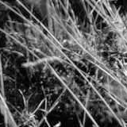
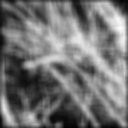
Smoothing with Box Filter
1
1
1
1
1
1
1
1
1
David Lowe
Notes:
Image before and after applying the box filter

Slide 34
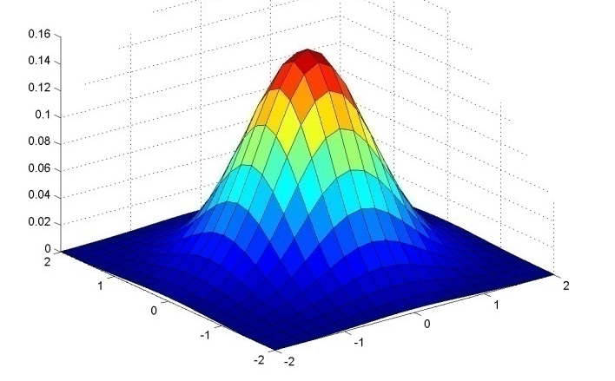
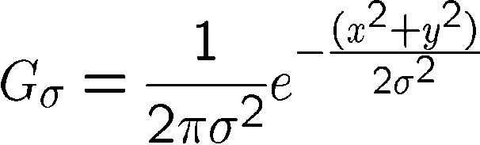
Gaussian Filter
x
0.003 0.013 0.022 0.013 0.003
0.013 0.059 0.097 0.059 0.013
0.022 0.097 0.159 0.097 0.022
0.013 0.059 0.097 0.059 0.013
0.003 0.013 0.022 0.013 0.003
y
x
Kernel size 5 x 5,
Standard deviation σ = 1
y
Viewed from top
y
x
Christopher Rasmussen
Notes:
The filter function/matrix on the top right is constructed by sampling the gaussian function at uniform intervals. Like in the graph, the highest value occurs at the center (mean) of the gaussian.
e^0 = 1, e^-1 = .37, e^-2 = .14, etc.
Point out that x and y span from -2,-1, 0, 1, 2
Gaussian pdfs have infinite extent. Gaussian filters are discrete finite samplings of the Gaussian pdf. What that means is that the filter can be arbitrarily large, and it will never be zero (to numerical precision).

Slide 35

Smoothing with Gaussian Filter
James Hays
Notes:
Unlike box filter, does not result in ‘grid’-like artifacts (see next slide)

Slide 36
Smoothing with Box Filter
1
1
1
1
1
1
1
1
1
David Lowe
Notes:
Image before and after applying the box filter

Slide 37
Image Filtering
  Compute function of local neighborhood
  at each position:
James Hays

Slide 38
Image Filtering
  Compute function of local neighborhood
  at each position:
Really important!
  Enhance images
    Denoise, resize, increase contrast, etc.
James Hays

Slide 39
Image Filtering
  Compute function of local neighborhood
  at each position:
Really important!
  Enhance images
    Denoise, resize, increase contrast, etc.
  Extract information from images
    Texture, edges, distinctive points, etc.
James Hays

Slide 40
Image Filtering
  Compute function of local neighborhood
  at each position:
Really important!
  Enhance images
    Denoise, resize, increase contrast, etc.
  Extract information from images
    Texture, edges, distinctive points, etc.
  Detect patterns
    Template matching
James Hays

Slide 42
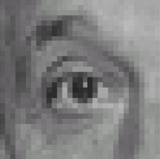

0
0
0
1.
0
1
0
0
0
0
0
0
0
2.
0
0
1
0
0
0
1
0
-1
3.
2
0
-2
1
0
-1
0
0
0
-
1
1
1
4.
0
2
0
1
1
1
0
0
0
1
1
1
David Lowe

Slide 43
1. Practice with linear filters
0
0
0
?
0
1
0
0
0
0
Original
David Lowe

Slide 44
1. Practice with linear filters
0
0
0
0
1
0
0
0
0
Original
Filtered
(no change)
David Lowe
Notes:
Unchanged because at each pixel, we ignore the values of the neighboring pixels and just ‘copy’ the same pixel.

Slide 45
2. Practice with linear filters
0
0
0
?
0
0
1
0
0
0
Original
David Lowe

Slide 46
2. Practice with linear filters
0
0
0
0
0
1
0
0
0
Original
Shifted left
By 1 pixel
David Lowe
Notes:
Shifts to the left because at each input pixel, we copy the value of its right neighbor.

Slide 47
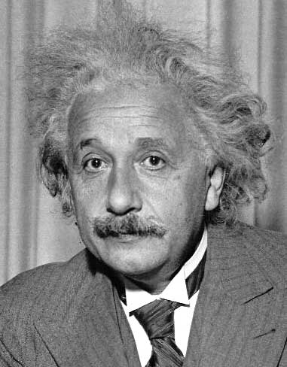
3. Practice with linear filters
1
0
-1
2
0
-2
1
0
-1
David Lowe
Notes:
Notice that this filter sums to 0.

Slide 48
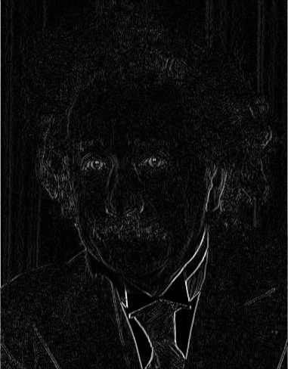
3. Practice with linear filters
1
0
-1
2
0
-2
1
0
-1
Sobel
Vertical Edge
(absolute value)
David Lowe
Notes:
Notice that this filter sums to 0.

Slide 49
3. Practice with linear filters
1
2
1
0
0
0
-1
-2
-1
David Lowe
Notes:
Questions at this point?

Slide 50
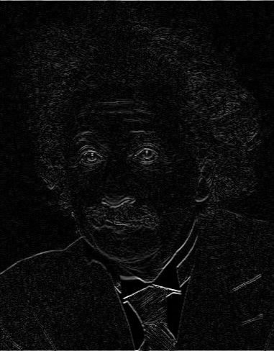
3. Practice with linear filters
1
2
1
0
0
0
-1
-2
-1
Sobel
Horizontal Edge
(absolute value)
David Lowe
Notes:
Questions at this point?

Slide 51
4. Practice with linear filters
0
0
0
-
1
1
1
?
0
2
0
1
1
1
0
0
0
1
1
1
(Note that filter sums to 1)
Original
David Lowe

Slide 52
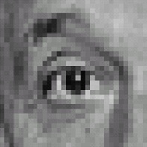
4. Practice with linear filters
0
0
0
-
1
1
1
0
2
0
1
1
1
0
0
0
1
1
1
Original
Sharpening filter
  Accentuates differences with local average
David Lowe

Slide 53
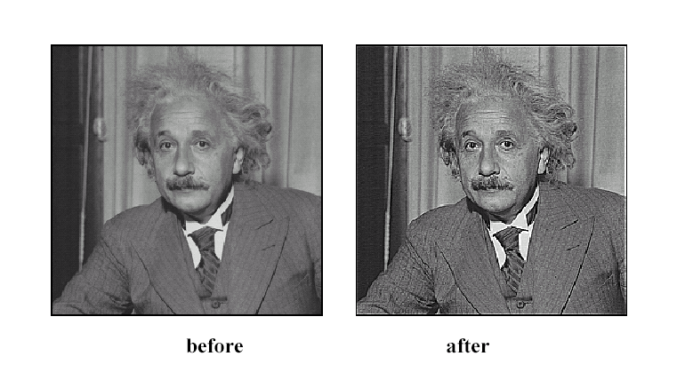
4. Practice with linear filters
David Lowe

Slide 54

Filters in Practice
What about near the edge?
  The filter window falls off the edge of the image
  Need to extrapolate
  methods:
    clip filter (black)
    wrap around
    copy edge
    reflect across edge
S. Marschner
Notes:
Pixels are undefined outside the border of our image, so to apply the filter near the boundary, we nee to extend the image past its boundary using one of many possible methods.
Clip filter: any value outside of the image is set to 0
Wrap around: copy the values near the opposite edge (e.g. copying the bottom portion of the image to the outside of the top boundary)
Copy edge: copy the pixel value of the nearest edge
Reflect across edge: treat out-of-bounds regions as ‘mirrors’ that reflect near-surface image pixels in reverse order

Slide 55

Filters in Practice
What about near the edge?
  The filter window falls off the edge of the image
  Need to extrapolate
  methods:
    clip filter (black)
    wrap around
    copy edge
    reflect across edge
S. Marschner
Notes:
Pixels are undefined outside the border of our image, so to apply the filter near the boundary, we nee to extend the image past its boundary using one of many possible methods.
Clip filter: any value outside of the image is set to 0
Wrap around: copy the values near the opposite edge (e.g. copying the bottom portion of the image to the outside of the top boundary)
Copy edge: copy the pixel value of the nearest edge
Reflect across edge: treat out-of-bounds regions as ‘mirrors’ that reflect near-surface image pixels in reverse order

Slide 56

Filters in Practice
What about near the edge?
  The filter window falls off the edge of the image
  Need to extrapolate
  methods:
    clip filter (black)
    wrap around
    copy edge
    reflect across edge
S. Marschner
Notes:
Pixels are undefined outside the border of our image, so to apply the filter near the boundary, we nee to extend the image past its boundary using one of many possible methods.
Clip filter: any value outside of the image is set to 0
Wrap around: copy the values near the opposite edge (e.g. copying the bottom portion of the image to the outside of the top boundary)
Copy edge: copy the pixel value of the nearest edge
Reflect across edge: treat out-of-bounds regions as ‘mirrors’ that reflect near-surface image pixels in reverse order

Slide 57

Filters in Practice
What about near the edge?
  The filter window falls off the edge of the image
  Need to extrapolate
  methods:
    clip filter (black)
    wrap around
    copy edge
    reflect across edge
S. Marschner
Notes:
Pixels are undefined outside the border of our image, so to apply the filter near the boundary, we nee to extend the image past its boundary using one of many possible methods.
Clip filter: any value outside of the image is set to 0
Wrap around: copy the values near the opposite edge (e.g. copying the bottom portion of the image to the outside of the top boundary)
Copy edge: copy the pixel value of the nearest edge
Reflect across edge: treat out-of-bounds regions as ‘mirrors’ that reflect near-surface image pixels in reverse order

Slide 58

Filters in Practice
What about near the edge?
  The filter window falls off the edge of the image
  Need to extrapolate
  methods:
    clip filter (black)
    wrap around
    copy edge
    reflect across edge
S. Marschner
Notes:
Pixels are undefined outside the border of our image, so to apply the filter near the boundary, we nee to extend the image past its boundary using one of many possible methods.
Clip filter: any value outside of the image is set to 0
Wrap around: copy the values near the opposite edge (e.g. copying the bottom portion of the image to the outside of the top boundary)
Copy edge: copy the pixel value of the nearest edge
Reflect across edge: treat out-of-bounds regions as ‘mirrors’ that reflect near-surface image pixels in reverse order

Slide 59

Filters in Practice
What about near the edge?
  The filter window falls off the edge of the image
  Need to extrapolate
  methods:
    clip filter (black)
    wrap around
    copy edge
    reflect across edge
S. Marschner
Notes:
Pixels are undefined outside the border of our image, so to apply the filter near the boundary, we nee to extend the image past its boundary using one of many possible methods.
Clip filter: any value outside of the image is set to 0
Wrap around: copy the values near the opposite edge (e.g. copying the bottom portion of the image to the outside of the top boundary)
Copy edge: copy the pixel value of the nearest edge
Reflect across edge: treat out-of-bounds regions as ‘mirrors’ that reflect near-surface image pixels in reverse order

Slide 60

Filters in Practice
What about near the edge?
  The filter window falls off the edge of the image
  Need to extrapolate
  methods:
    clip filter (black)
    wrap around
    copy edge
    reflect across edge
S. Marschner
Notes:
Pixels are undefined outside the border of our image, so to apply the filter near the boundary, we nee to extend the image past its boundary using one of many possible methods.
Clip filter: any value outside of the image is set to 0
Wrap around: copy the values near the opposite edge (e.g. copying the bottom portion of the image to the outside of the top boundary)
Copy edge: copy the pixel value of the nearest edge
Reflect across edge: treat out-of-bounds regions as ‘mirrors’ that reflect near-surface image pixels in reverse order

Slide 61

Filters in Practice
What about near the edge?
  The filter window falls off the edge of the image
  Need to extrapolate
  methods:
    clip filter (black)
    wrap around
    copy edge
    reflect across edge
S. Marschner
Notes:
Pixels are undefined outside the border of our image, so to apply the filter near the boundary, we nee to extend the image past its boundary using one of many possible methods.
Clip filter: any value outside of the image is set to 0
Wrap around: copy the values near the opposite edge (e.g. copying the bottom portion of the image to the outside of the top boundary)
Copy edge: copy the pixel value of the nearest edge
Reflect across edge: treat out-of-bounds regions as ‘mirrors’ that reflect near-surface image pixels in reverse order

Slide 62

Filters in Practice
What about near the edge?
  The filter window falls off the edge of the image
  Need to extrapolate
  methods:
    clip filter (black)
    wrap around
    copy edge
    reflect across edge
S. Marschner
Notes:
Pixels are undefined outside the border of our image, so to apply the filter near the boundary, we nee to extend the image past its boundary using one of many possible methods.
Clip filter: any value outside of the image is set to 0
Wrap around: copy the values near the opposite edge (e.g. copying the bottom portion of the image to the outside of the top boundary)
Copy edge: copy the pixel value of the nearest edge
Reflect across edge: treat out-of-bounds regions as ‘mirrors’ that reflect near-surface image pixels in reverse order

Slide 63

Filters in Practice
What about near the edge?
  The filter window falls off the edge of the image
  Need to extrapolate
  methods:
    clip filter (black)
    wrap around
    copy edge
    reflect across edge
S. Marschner
Notes:
Pixels are undefined outside the border of our image, so to apply the filter near the boundary, we nee to extend the image past its boundary using one of many possible methods.
Clip filter: any value outside of the image is set to 0
Wrap around: copy the values near the opposite edge (e.g. copying the bottom portion of the image to the outside of the top boundary)
Copy edge: copy the pixel value of the nearest edge
Reflect across edge: treat out-of-bounds regions as ‘mirrors’ that reflect near-surface image pixels in reverse order

Slide 64

Filters in Practice
What about near the edge?
  The filter window falls off the edge of the image
  Need to extrapolate
  methods:
    clip filter (black)
    wrap around
    copy edge
    reflect across edge
S. Marschner
Notes:
Pixels are undefined outside the border of our image, so to apply the filter near the boundary, we nee to extend the image past its boundary using one of many possible methods.
Clip filter: any value outside of the image is set to 0
Wrap around: copy the values near the opposite edge (e.g. copying the bottom portion of the image to the outside of the top boundary)
Copy edge: copy the pixel value of the nearest edge
Reflect across edge: treat out-of-bounds regions as ‘mirrors’ that reflect near-surface image pixels in reverse order

Slide 65

Filters in Practice
What about near the edge?
  The filter window falls off the edge of the image
  Need to extrapolate
  methods:
    clip filter (black)
    wrap around
    copy edge
    reflect across edge
S. Marschner
Notes:
Pixels are undefined outside the border of our image, so to apply the filter near the boundary, we nee to extend the image past its boundary using one of many possible methods.
Clip filter: any value outside of the image is set to 0
Wrap around: copy the values near the opposite edge (e.g. copying the bottom portion of the image to the outside of the top boundary)
Copy edge: copy the pixel value of the nearest edge
Reflect across edge: treat out-of-bounds regions as ‘mirrors’ that reflect near-surface image pixels in reverse order

Slide 66

Filters in Practice
What about near the edge?
  The filter window falls off the edge of the image
  Need to extrapolate
  methods:
    clip filter (black)
    wrap around
    copy edge
    reflect across edge
S. Marschner
Notes:
Pixels are undefined outside the border of our image, so to apply the filter near the boundary, we nee to extend the image past its boundary using one of many possible methods.
Clip filter: any value outside of the image is set to 0
Wrap around: copy the values near the opposite edge (e.g. copying the bottom portion of the image to the outside of the top boundary)
Copy edge: copy the pixel value of the nearest edge
Reflect across edge: treat out-of-bounds regions as ‘mirrors’ that reflect near-surface image pixels in reverse order

Slide 67
Properties of image filtering methods

Slide 68
Correlation and Convolution
Definition
2D correlation
  e.g., h = scipy.signal.correlate2d(f,I)
James Hays
Notes:
2D correlation is identical to the filtering equation we just saw

Slide 69
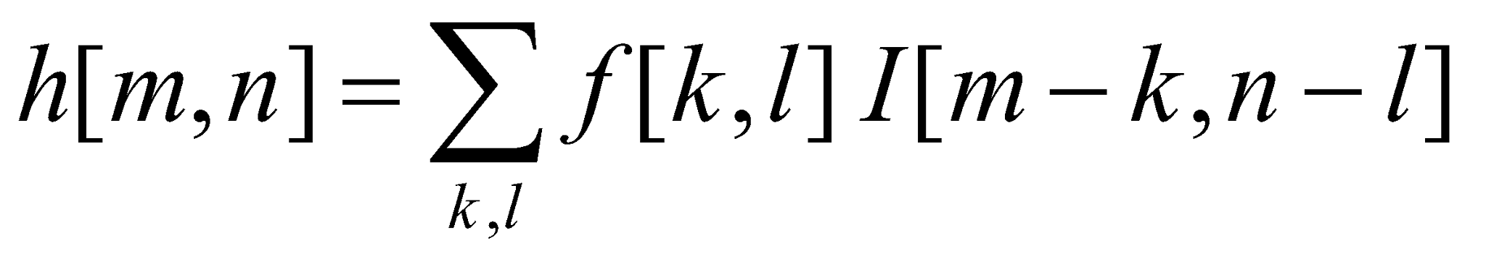
Correlation and Convolution
Definition
2D correlation
2D convolution
  e.g., h = scipy.signal.correlate2d(f,I)
  e.g., h = scipy.signal.convolve2d(f,I)
Convolution is the same as correlation with a 180° rotated filter kernel.
Correlation and convolution are identical when the filter kernel is rotationally symmetric*.
* Symmetric in the geometric sense, not in the matrix linear algebra sense.
James Hays
Notes:
Symmetric in the geometric sense, not in the linear algebra/matrix sense.
Symmetric in the matrix sense: a symmetric matrix is a square matrix that is equal to its transpose. A = A^T
I.E., matrix can be reflected along its diagonal and it is equal to itself
However, to rotate the matrix by 180 degrees and still have the same matrix, we need the matrix to also have the same values elsewhere, e.g., at the top left and bottom right.
From George Chu (2020 student):
image matrix I: 1 2
3 4
symmetric filter: 1 2 <- this matrix is equal to its transpose, but is not rotationally symmetric
2 4
Correlation computation: 1*1+2*2+3*2+4*4 = 27
Convolution computation: 1*4+2*2+3*2+4*1 = 18 <- correlation and convolution produce different answers
Rotationally symmetric: 1 2
2 1 <- this produces the same values with either correlation or convolution

Slide 70
Linear Filter Properties
Svetlana Lazebnik
Notes:
To be linear, filters must satisfy these two properties. Linearity means that filtering an image with two (different) filters f1 and f2 results in the same output as filtering the images separately first before summing the intermediate outputs.
Translation invariance means that shifting the original image before filtering results in the same output as filtering then shifting.

Slide 71
Linear Filter Properties
Linearity:
imfilter(I, f₁ + f₂) =
imfilter(I,f₁) + imfilter(I,f₂)
Svetlana Lazebnik
Notes:
To be linear, filters must satisfy these two properties. Linearity means that filtering an image with two (different) filters f1 and f2 results in the same output as filtering the images separately first before summing the intermediate outputs.
Translation invariance means that shifting the original image before filtering results in the same output as filtering then shifting.

Slide 72
Linear Filter Properties
Linearity:
imfilter(I, f₁ + f₂) =
imfilter(I,f₁) + imfilter(I,f₂)
Shift/translation invariance:
Same behavior given intensities regardless of pixel location m,n
imfilter(I,shift(f)) = shift(imfilter(I,f))
Svetlana Lazebnik
Notes:
To be linear, filters must satisfy these two properties. Linearity means that filtering an image with two (different) filters f1 and f2 results in the same output as filtering the images separately first before summing the intermediate outputs.
Translation invariance means that shifting the original image before filtering results in the same output as filtering then shifting.

Slide 73
Convolution Properties
Commutative: a * b = b * a
  Conceptually no difference between filter and signal
  But filtering implementations might break this equality, e.g., image edges
  Correlation is _not_ commutative (rotation effect) – produces rotated version of output.
Associative: a * (b * c) = (a * b) * c
  Often apply several filters one after another: (((a * b₁) * b₂) * b₃)
  This is equivalent to applying one filter: a * (b₁ * b₂ * b₃) -> computationally faster
  Correlation is _not_ associative (rotation effect)
Distributes over addition: a * (b + c) = (a * b) + (a * c)
Scalars factor out: ka * b = a * kb = k (a * b)
Identity: a * e = a when e = [0, 0, 1, 0, 0],
Svetlana Lazebnik
Notes:
Convolution is additionally commutative and associative, but correlation is not.
David Jacobs @ UMD - http://www.cs.umd.edu/~djacobs/CMSC426/Convolution.pdf
The key difference between the two is that convolution is associative. That is, if F and G are filters, then F*(G*I) = (F*G)*I. If you don’t believe this, try a simple example, using F=G=(-1 0 1), for example. It is very convenient to have convolution be associative. Suppose, for example, we want to smooth an image and then take its derivative. We could do this by convolving the image with a Gaussian filter, and then convolving it with a derivative filter. But we could alternatively convolve the derivative filter with the Gaussian to produce a filter called a Difference of Gaussian (DOG), and then convolve this with our image. The nice thing about this is that the DOG filter can be precomputed, and we only have to convolve one filter with our image.
In general, people use convolution for image processing operations such as smoothing, and they use correlation to match a template to an image. Then, we don’t mind that correlation isn’t associative, because it doesn’t really make sense to combine two templates into one with correlation, whereas we might often want to combine two filter together for convolution. When discussing the Fourier series as a way of understanding filtering, we will use convolution, so that we can introduce the famous convolution theorem.
For more information on _why_ there are differences between correlation and convolution even though “it’s just a minus sign”, please read Tomasi.
Note that this is not a short explanation.
Carlo Tomasi @ Duke - https://courses.cs.duke.edu/fall15/compsci527/notes/convolution-filtering.pdf

Slide 74
Convolution in Convolutional Neural Networks
Convolution is the basic operation in CNNs
Learning convolution kernels allows us to learn which `features’ provide useful information in images.

Slide 75
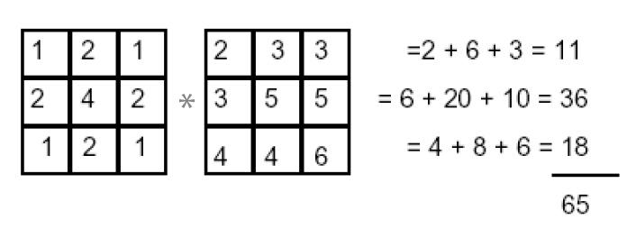
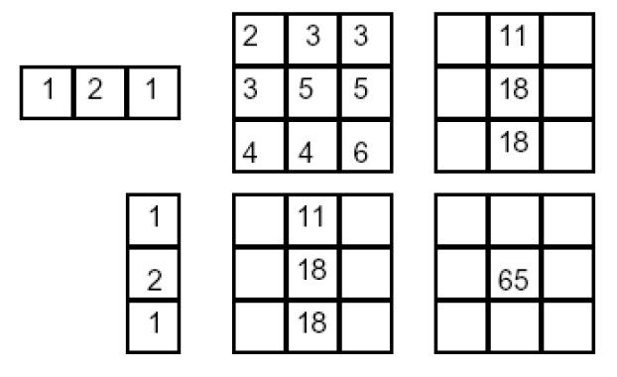
Separability: 2x 1D convolution = 2D convolution
2D convolution
(center location only)
=
Kristen Grauman
Notes:
We can use an outer product to decompose the 2D filter into two 1D filters, where one is represented as a row column and the other a row vector.
Convolution vs filtering doesn’t matter here because the filter is symmetric
9 multiply-add operations at the top for 2D convolution
~11 multiply-add operations at the bottom for the separable 2D convolution

Slide 76
Separability Example
2D convolution
(center location only)
=
Kristen Grauman
Notes:
We can use an outer product to decompose the 2D filter into two 1D filters, where one is represented as a row column and the other a row vector.
Convolution vs filtering doesn’t matter here because the filter is symmetric
9 multiply-add operations at the top for 2D convolution
~11 multiply-add operations at the bottom for the separable 2D convolution

Slide 77
Separability Example
2D convolution
(center location only)
=
The filter factors
into a product of 1D
filters:
Kristen Grauman
Notes:
We can use an outer product to decompose the 2D filter into two 1D filters, where one is represented as a row column and the other a row vector.
Convolution vs filtering doesn’t matter here because the filter is symmetric
9 multiply-add operations at the top for 2D convolution
~11 multiply-add operations at the bottom for the separable 2D convolution

Slide 78
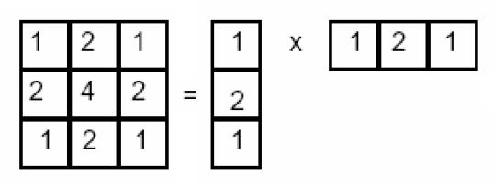
Separability Example
2D convolution
(center location only)
=
The filter factors
into a product of 1D
filters:
Kristen Grauman
Notes:
We can use an outer product to decompose the 2D filter into two 1D filters, where one is represented as a row column and the other a row vector.
Convolution vs filtering doesn’t matter here because the filter is symmetric
9 multiply-add operations at the top for 2D convolution
~11 multiply-add operations at the bottom for the separable 2D convolution

Slide 79
Separability Example
2D convolution
(center location only)
=
The filter factors
into a product of 1D
filters:
Perform convolution
along rows:
Kristen Grauman
Notes:
We can use an outer product to decompose the 2D filter into two 1D filters, where one is represented as a row column and the other a row vector.
Convolution vs filtering doesn’t matter here because the filter is symmetric
9 multiply-add operations at the top for 2D convolution
~11 multiply-add operations at the bottom for the separable 2D convolution

Slide 80
Separability Example
2D convolution
(center location only)
=
The filter factors
into a product of 1D
filters:
Perform convolution
along rows:
*
=
*
=
Kristen Grauman
Notes:
We can use an outer product to decompose the 2D filter into two 1D filters, where one is represented as a row column and the other a row vector.
Convolution vs filtering doesn’t matter here because the filter is symmetric
9 multiply-add operations at the top for 2D convolution
~11 multiply-add operations at the bottom for the separable 2D convolution

Slide 81
Separability Example
2D convolution
(center location only)
=
The filter factors
into a product of 1D
filters:
Perform convolution
along rows:
*
=
Followed by convolution
along the remaining column:
*
=
Kristen Grauman
Notes:
We can use an outer product to decompose the 2D filter into two 1D filters, where one is represented as a row column and the other a row vector.
Convolution vs filtering doesn’t matter here because the filter is symmetric
9 multiply-add operations at the top for 2D convolution
~11 multiply-add operations at the bottom for the separable 2D convolution

Slide 82
Separability Example
2D convolution
(center location only)
=
The filter factors
into a product of 1D
filters:
Perform convolution
along rows:
*
=
Followed by convolution
along the remaining column:
*
=
Kristen Grauman
Notes:
We can use an outer product to decompose the 2D filter into two 1D filters, where one is represented as a row column and the other a row vector.
Convolution vs filtering doesn’t matter here because the filter is symmetric
9 multiply-add operations at the top for 2D convolution
~11 multiply-add operations at the bottom for the separable 2D convolution

Slide 83
Separability Use
MxN image, PxQ filter
2D convolution: ~MNPQ multiply-adds
Separable 2D: ~MN(P+Q) multiply-adds
Notes:
https://blogs.mathworks.com/steve/2006/10/04/separable-convolution/

Slide 84
Separability Use
MxN image, PxQ filter
2D convolution: ~MNPQ multiply-adds
Separable 2D: ~MN(P+Q) multiply-adds
Speed up = PQ/(P+Q)
9x9 filter = ~4.5x faster
Notes:
https://blogs.mathworks.com/steve/2006/10/04/separable-convolution/

Slide 85
Gaussian Filter
x
0.003 0.013 0.022 0.013 0.003
0.013 0.059 0.097 0.059 0.013
0.022 0.097 0.159 0.097 0.022
0.013 0.059 0.097 0.059 0.013
0.003 0.013 0.022 0.013 0.003
y
x
Kernel size 5 x 5,
Standard deviation σ = 1
y
Viewed from top
y
x
Christopher Rasmussen
Notes:
e^0 = 1, e^-1 = .37, e^-2 = .14, etc.
Point out that x and y span from -2,-1, 0, 1, 2
Gaussian pdfs have infinite extent. Gaussian filters are discrete finite samplings of the Gaussian pdf. What that means is that the filter can be arbitrarily large, and it will never be zero (to numerical precision).

Slide 86
Gaussian Filter Properties
Gaussian convolved with Gaussian…
…is another Gaussian
  So can smooth with small-width kernel, repeat, and get same result as larger-width kernel
  Convolving twice with Gaussian kernel of width σ is same as convolving once with kernel of width σ√2
Separable kernel
  Factors into product of two 1D Gaussians
Kristen Grauman
Notes:
Kernel is another name for a filter.
Gaussians remove “high-frequency” components from the image (low-pass filter)
But we need to talk about image frequency first…

Slide 87
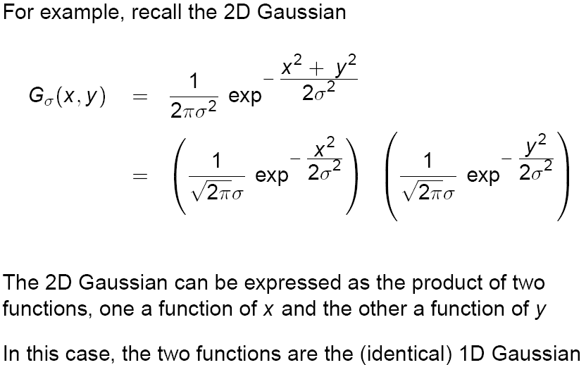
Separability of the Gaussian Filter
David Lowe

Slide 88
Practical matters
How big should the Gaussian filter be?
Values at edges should be near zero
Gaussians have infinite extent…
Rule of thumb for Gaussian: set filter half-width to about 3 σ
How big should the Gaussian filter be?
Values at edges should be near zero
Gaussians have infinite extent…
Rule of thumb for Gaussian: set filter half-width to about 3 σ
James Hays

Slide 90
Dall-E Time!
Give me 3 prompts each class…

Slide 91
Ben Thomas
Notes:
http://benthomas.net.au/cityshrinker/eilz24txaul9s1hx5prqr0ta5y8nvl

Slide 92
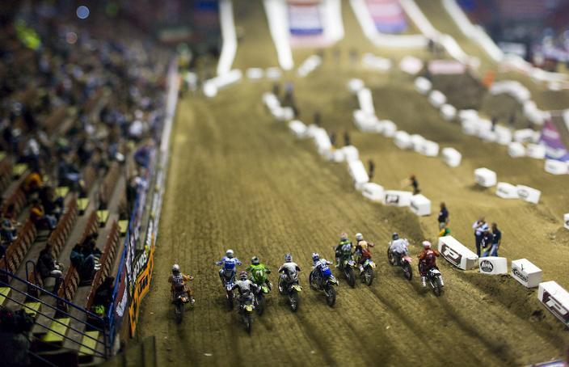

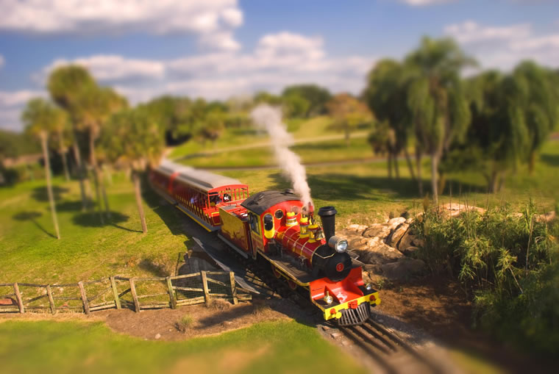
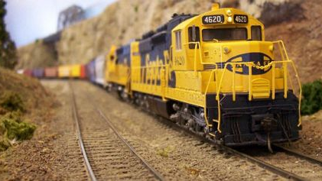
Tilt-shift photography
Notes:
http://twistedsifter.com/2009/11/what-is-tilt-shift-photography/
https://www.google.com/url?sa=i&rct=j&q=&esrc=s&source=images&cd=&cad=rja&uact=8&ved=0ahUKEwjh0vHWnOrRAhXHNiYKHU9_C8MQjB0IBg&url=http%3A%2F%2Fwww.tiltshiftphotography.net%2Ftilt-shift-photography-examples%2F&bvm=bv.145822982,d.amc&psig=AFQjCNHwu3AEwcnsTWQDqGS8vA2-H9QSEw&ust=1485877855629030
“All of these are real scenes shot in a ‘tilt-shift style’”
Fourth one is actually a toy
Point out the fact that there is a very thin region of the world that is in focus, that the top and bottom are blurred.

Slide 93
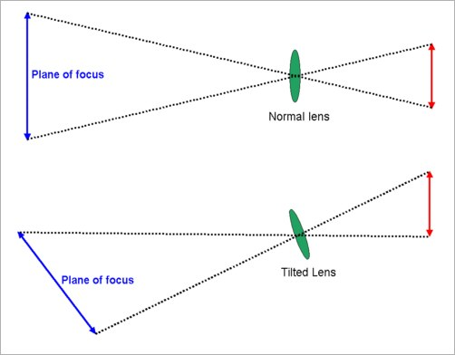
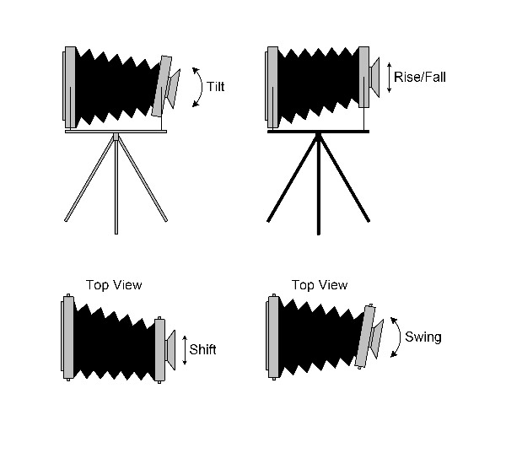
Tilt shift camera
Sensor
Shift
Tilt
Sensor
Notes:
http://www.bobatkins.com/photography/reviews/macro_tilt_adapter/tilt.jpg

Slide 94
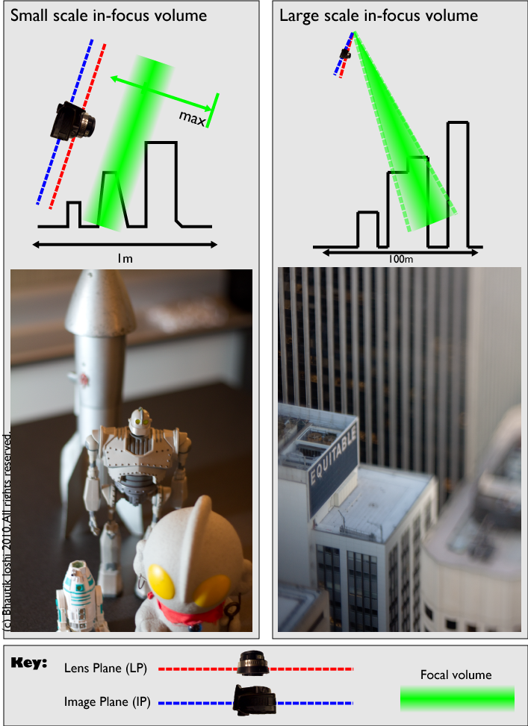
Macro photography
Notes:
http://cow.mooh.org/projects/tiltshift/howdoesitwork.html#miniaturisationeffectfig

Slide 95
Can we fake tilt shift?
We need to blur the image
  OK, now we know how to do that.

Slide 96
Can we fake tilt shift?
We need to blur the image
  OK, now we know how to do that.
We need to blur progressively more away from our ‘fake’ focal plane

Slide 97
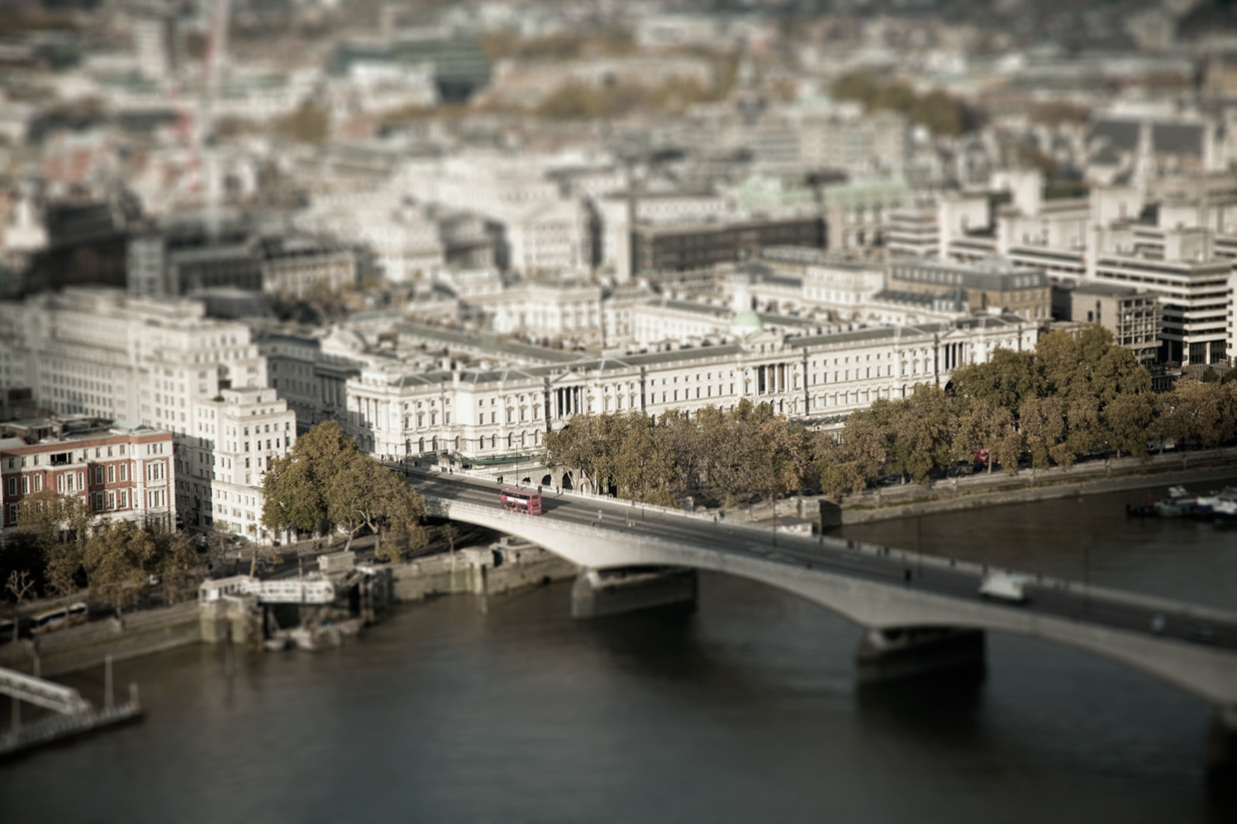
But can I make it look more like a toy?
Boost saturation – toys are very colorful
We’ll learn how to do this when we discuss color
Notes:
For now: transform to Hue, Saturation, Value instead of RGB
Ray optics: https://www.youtube.com/watch?v=Ex2rd6IBy7k&list=PLMXAf0aPgIuVcelVL2B-u1yjU4cS643ak&pp=0gcJCf4COCosWNin
Optical Instruments: https://www.youtube.com/watch?v=fMza3UdGfEk&list=PLMXAf0aPgIuWB9FSyXmZ5SqPruhwIoqX2

Slide 98
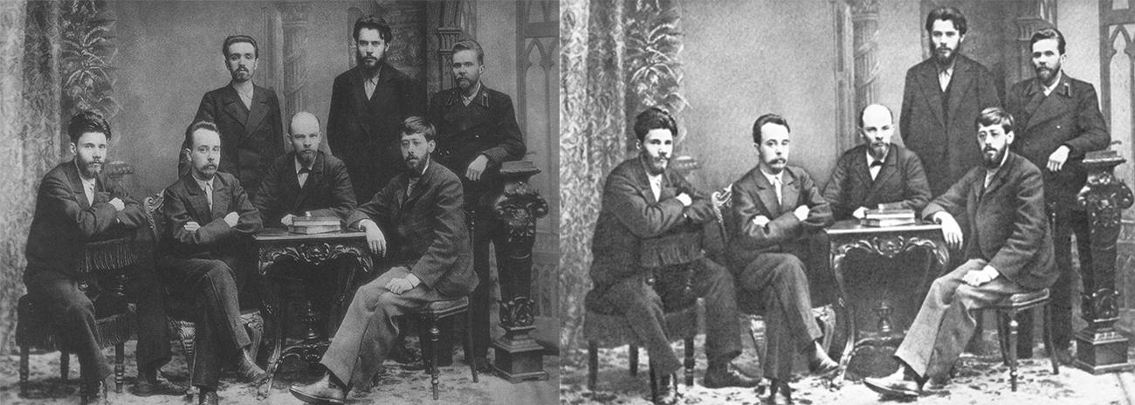
Trust in Images
Left: Alexander Malchenko, P. Zaporozhets, and Anatoly Vaneyev (standing); Victor V. Starkov, Gleb Krzhizhanovsky, Vladimir Lenin, and Julius Martov (sitting). Right: manipulated image with Malchenko removed. [source]
Notes:
Images have been historically manipulated for different purposes.
We can hide or implant information by editing an image
We can edit images based on our aesthetic judgement
Alexander Malchenko is seen removed from an official picture after being condemned as an anti-revolutionary and executed.

Slide 99

Trust in Images
What technical and legal means can we develop and use to preserve civil trust on images that are publicly distributed?
What solutions have been proposed and what are potential pitfalls they might have?
“In Event of Moon Disaster”
An MIT art installation to educate the public about deepfakes.
Notes:
Citizens of modern western states heavily rely on visual media to navigate society.
The selection of what visual media is made publicly accessible has ethical and political implications.
The ability to “perfectly” manipulate images can reshape relations between citizens and non-citizens established by the distribution of images by the state or large media monopolies. Novel technologies make this easier.
What are technical and legal means we can develop and use to preserve civil trust on images that are publicly distributed. What has been proposed and what potential pitfalls might these “solutions” have?

Slide 100
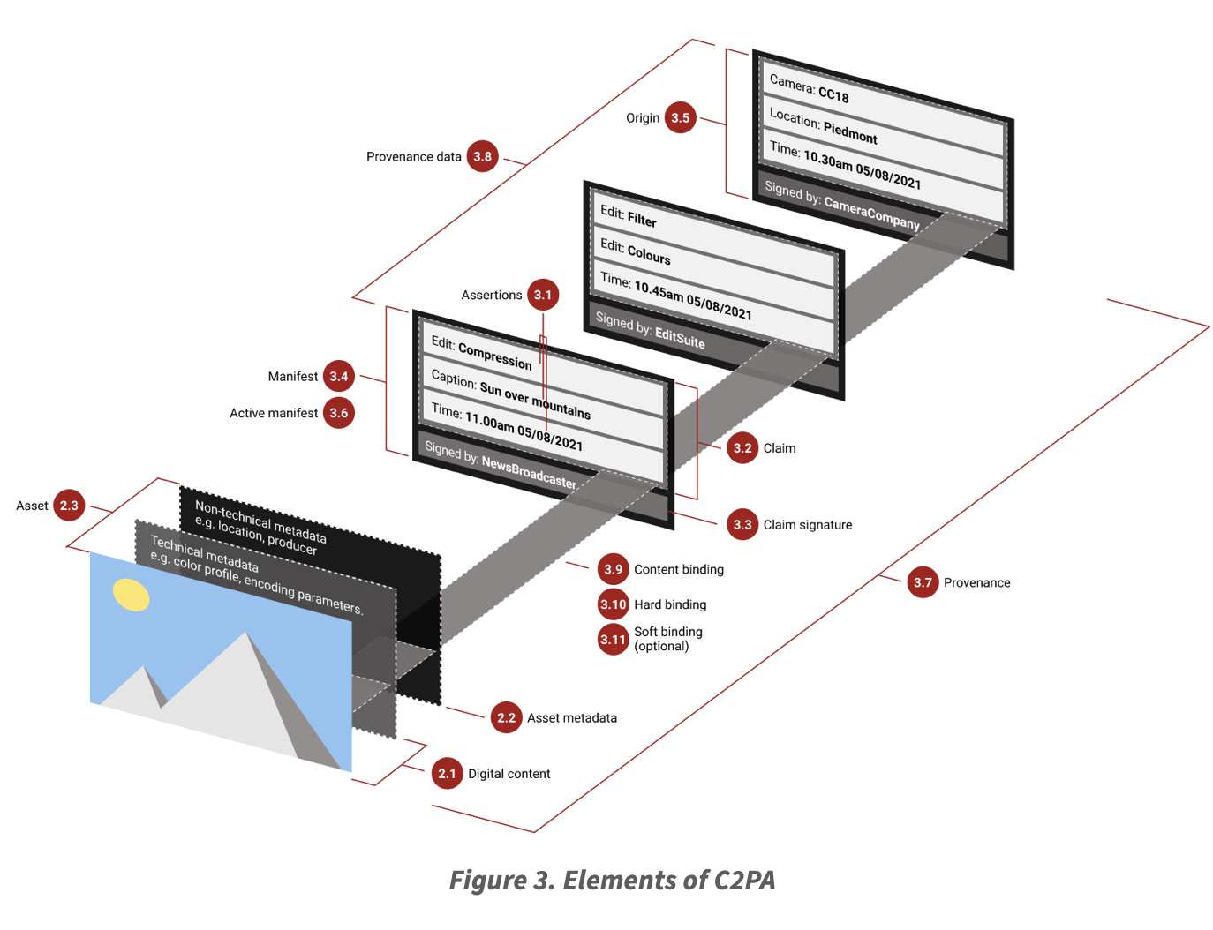
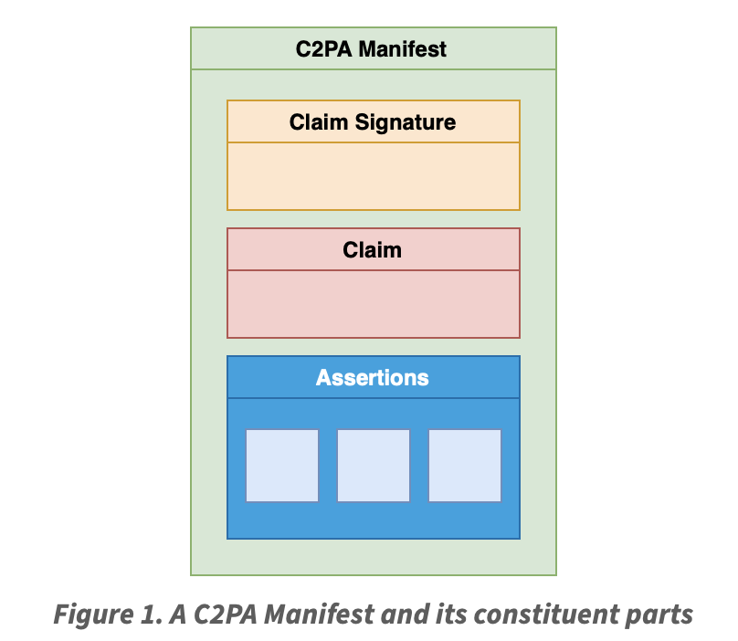

Technical Solutions
Coalition for Content Provenance
and Authenticity (C2PA)
Alliance between Adobe, ARM, BBC, Intel, Microsoft, Truepic and Twitter to address the prevalence of mis-leading information online through the development of technical stan-dards for certifying the source and history of media content. [source]
C2PA technical specifications
Notes:
Coalition for Content Provenance and Authenticity (C2PA): Track changes done to an image by trusted software through encrypted metadata.
Alliance between Adobe, arm, BBC, intel, Microsoft, Truepic and Twitter to “address the prevalence of misleading information online through the development of technical standards for certifying the source and history of media content.” (link)

Slide 101

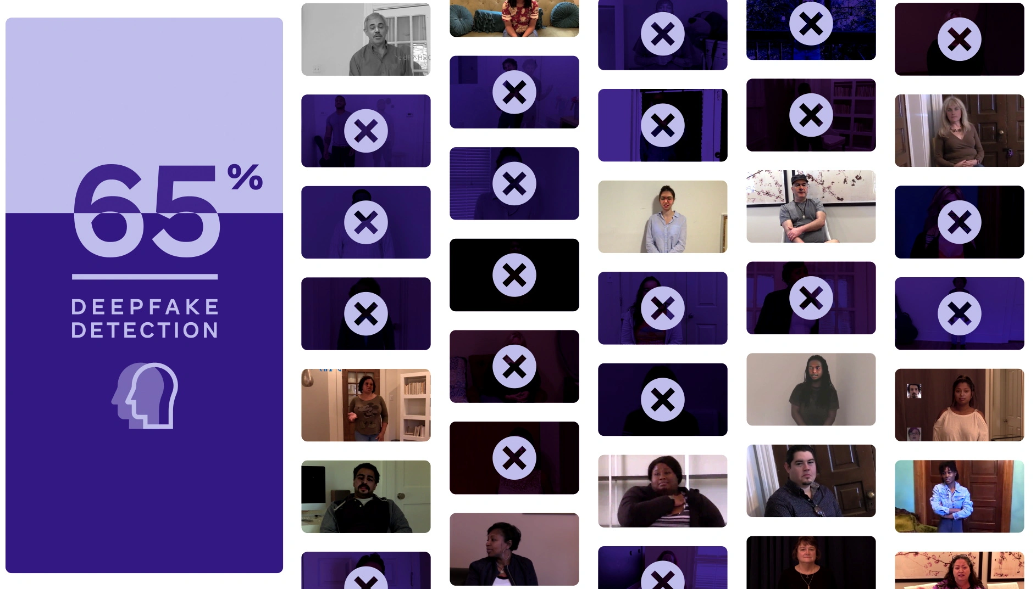
Technical Solutions
Deepfake Detection Challenge (DFDC)
Facebook invested $10m on deepfake detection technology in order to remove any media generated with artificial technology that represent misleading information. [source]
2,000 deepfake detection models submitted
Top model achieved 65.18% accuracy on dataset with real life examples.
Notes:
Deepfake Detection Challenge (DFDC)
Facebook invested $10m on Deepfake detection technology in order to remove any media generated with artificial technology that represent misleading information.
2,000 participants submitted deepfake detection models trained on a dataset created for the challenge. Top model achieved 65.18% accuracy tested on blackbox dataset with real life examples.

Slide 102

Monopolies of Knowledge / Technology
“Monopolies of knowledge arise when the ruling class maintains political power through control of key communications technologies.” [source]
Ensuring image truth through technology that only works when verified by large trusted parties (commercial or political) can consolidate power.
Notes:
The technical solutions presented do not challenge the political status quo, but rather conform to it.
Consider who is able to participate C2PA, who are the agents that will primarily benefit from this technology.
Although the technology can be seen as a way to combat misinformation, it is also a way in which it is rescuing the monopoly companies with enough financial power can have over the distribution of media content.
Legal solutions operates on a more case by case basis, but there is overwhelming precedent of it protecting the interests of powerful institutions and states rather than the individual citizen.
How can the CV specialist play an informed role in this political stage?

Slide 103


Legal Solutions: Individualist and Collectivist
An individual could:
  Sue under defamation if reputation is tarnished due to image manipulation.
  Sue under false light accusation if depicted in a misleading manner.
  Sue under the The Trademark Act if there is a case of infringement.
Legislation against deepfakes is challenged by freedom of speech.
Act according to an assumed collective interest:
Pass legislation against deepfakes because they could be used to “disrupt social order and violate people’s interests, creating political risks and bringing a negative impact to national security and social stability.” [source]
e.g., U.S. Legal System
e.g., Cyberspace
Administration of China
November 2019 legislation
Notes:
https://www.reuters.com/article/us-china-technology/china-seeks-to-root-out-fake-news-and-deepfakes-with-new-online-content-rules-idUSKBN1Y30VU

Slide 104
Civil Trust • Image Manipulation
Individualist • Collectivist
Monopoly of Knowledge
Questions and Key Concepts
Does the development of C2PA and DFDC shift the control of key communications technologies from the current ruling class to anyone else?
How do these technical solutions disrupt of preserve the knowledge monopolies that exist today?
How can the CV specialist play an informed and intentional role in developing technology that is not just a means towards profit for the ruling class, but responds to human needs and demands?

Slide 105
Sobel Filter
1
2
1
0
0
0
-1
-2
-1
What is the 1 2 1 pattern?
  Binomial distribution or “triangle filter”
  Discrete approximate to Gaussian; fast for integer mathematics
  Smooths along edge
Sobel
Notes:
- Look at a second filter which is an ‘edge detection’ filter
Negative numbers
Oh. Well, let’s take the absolute value (the magnitude)
Add the mean

Slide 106
Sobel Filter
1
2
1
0
0
0
-1
-2
-1
What is the 1 2 1 pattern?
  Binomial distribution or “triangle filter”
  Discrete approximate to Gaussian; fast for integer mathematics
  Smooths along edge
What happens to negative numbers?
For visualization:
  Shift image + 0.5
  If gradients are small, scale edge response
Sobel
Notes:
- Look at a second filter which is an ‘edge detection’ filter
Negative numbers
Oh. Well, let’s take the absolute value (the magnitude)
Add the mean

Slide 107

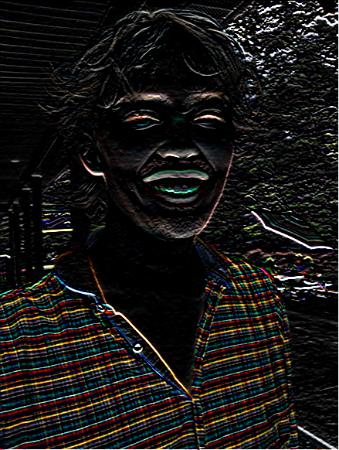
1
2
1
0
0
0
-1
-2
-1
>> I = img_to_float32( io.imread( ‘luke.jpg’ ) )
>> h = convolve2d( I, sobelKernel )
Sobel
>> plt.imshow( h )
Notes:
Picture is of Luke Murray, another former TA.

Slide 108
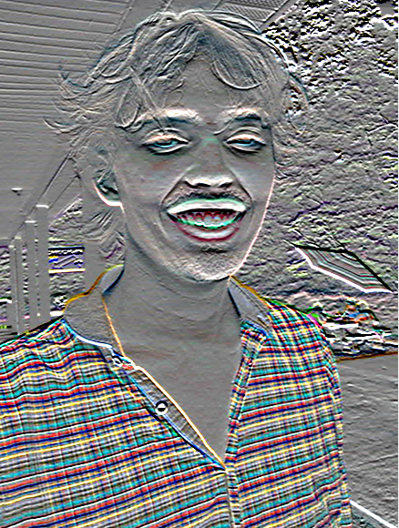
1
2
1
0
0
0
-1
-2
-1
>> I = img_to_float32( io.imread( ‘luke.jpg’ ) )
>> h = convolve2d( I, sobelKernel )
Sobel
>> plt.imshow( h )
>> plt.imshow( h + 0.5 )
Notes:
To recover the detail from the negative outputs, we increase the intensity of all pixels by adding a 0.5 offset
Picture is of Luke Murray, another former TA (now an MIT PhD)

Slide 109


h(:,:,1) < 0
h(:,:,1) > 0
Notes:
There are as many negative output intensities as there are positive ones!

Slide 110









Think-Pair-Share
1) _ = D * B
2) A = _ * _
3) F = D * _
4) _ = D * D
D
H
* = Convolution operator
F
I
A
B
C
G
E
Derek Hoiem
Notes:
1) G = D * B
2) A = B * C
3) F = D * E
4) I = D * D

Slide 111
Think-Pair-Share
1) G = D * B
2) A = _ * _
3) F = D * _
4) _ = D * D
D
H
* = Convolution operator
F
I
A
B
C
G
E
Derek Hoiem
Notes:
1) G = D * B
2) A = B * C
3) F = D * E
4) I = D * D

Slide 112
Think-Pair-Share
1) G = D * B
2) A = B * C
3) F = D * _
4) _ = D * D
D
H
* = Convolution operator
F
I
A
B
C
G
E
Derek Hoiem
Notes:
1) G = D * B
2) A = B * C
3) F = D * E
4) I = D * D

Slide 113
Think-Pair-Share
1) G = D * B
2) A = B * C
3) F = D * E
4) _ = D * D
D
H
* = Convolution operator
F
I
A
B
C
G
E
Derek Hoiem
Notes:
1) G = D * B
2) A = B * C
3) F = D * E
4) I = D * D

Slide 114
Think-Pair-Share
1) G = D * B
2) A = B * C
3) F = D * E
4) I = D * D
D
H
* = Convolution operator
F
I
A
B
C
G
E
Derek Hoiem
Notes:
1) G = D * B
2) A = B * C
3) F = D * E
4) I = D * D

Slide 115
I = D * D
D (275 x 175 pixels)
I (from slide – 275 x 175)

Slide 116
I = D * D
D (275 x 175 pixels)
I (from slide – 275 x 175)
“…something to do with lack of content (black) at edges…”

Slide 117
I = D * D
D (275 x 175 pixels)
I (from slide – 275 x 175)
>> D = img_to_float32( io.imread( ‘convexample.png’ ) )
>> I = convolve2d( D, D )
>> np.max(I)
1.1021e+04
# Normalize for visualization
>> I_norm = (I – np.min(I)) / (np.max(I) – np.min(I))
>> plt.imshow( I_norm )

Slide 118

I = D * D
D (275 x 175 pixels)
I (from slide – 275 x 175)
>> D = img_to_float32( io.imread( ‘convexample.png’ ) )
>> I = convolve2d( D, D )
>> np.max(I)
1.1021e+04
# Normalize for visualization
>> I_norm = (I – np.min(I)) / (np.max(I) – np.min(I))
>> plt.imshow( I_norm )
I_norm

Slide 119

I = D * D
D (275 x 175 pixels)
I (from slide – 275 x 175)
(275-1)/2
I_norm
275

Slide 120
I = D * D
D (275 x 175 pixels)
I (from slide – 275 x 175)
(275-1)/2
(275-1)/2
I_norm
275

Slide 121
I = D * D
D (275 x 175 pixels)
I (from slide – 275 x 175)
(275-1)/2
(275-1)/2
I_norm
275
For x: 275 + (275-1)/2 + (275-1)/2
= 549

Slide 122
I = D * D
D (275 x 175 pixels)
I (from slide – 275 x 175)
(275-1)/2
(275-1)/2
(549 x 349 pixels)
I_norm
275
For x: 275 + (275-1)/2 + (275-1)/2
= 549

Slide 123
I = D * D
D (275 x 175 pixels)
I (from slide – 275 x 175)
>> I = convolve2d( D, D, mode=‘full’ )
(Default; pad with zeros)
>> I = convolve2d( D, D, mode=‘same’ )
(Return same size as D)
>> I = convolve2d( D, D, mode=‘valid’ )
(No padding)
549 x 349
275 x 175
Value = 10528.3
1x1

Slide 124
A = B * C
A
B
C
When the filter ‘looks like’ the image = ‘template matching’

Slide 125
A = B * C
A
B
C
C is a Gaussian kernel and we know that it ‘blurs’.
When the filter ‘looks like’ the image = ‘template matching’

Slide 126
A = B * C
A
B
C
C is a Gaussian kernel and we know that it ‘blurs’.
When the filter ‘looks like’ the image = ‘template matching’
Filtering viewed as comparing an image of
what you want to find against all image regions.

Slide 127
A = B * C
A
B
C
C is a Gaussian kernel and we know that it ‘blurs’.
When the filter ‘looks like’ the image = ‘template matching’
Filtering viewed as comparing an image of
what you want to find against all image regions.
For symmetric filters: use either convolution or correlation.
For nonsymmetric filters: correlation is template matching.

Slide 128
D (275 x 175 pixels)
Let’s see if we can use correlation to ‘find’ the parts of the image that look like the kernel.
Robert Collins
Notes:
If we slice out the center region of our image I to be the filter, we expect the correlated output to have a peak response at the same location, but that doesn’t seem to be the case…

Slide 129
D (275 x 175 pixels)
Let’s see if we can use correlation to ‘find’ the parts of the image that look like the kernel.
>> f = D[ 57:117, 107:167 ]
Robert Collins
Notes:
If we slice out the center region of our image I to be the filter, we expect the correlated output to have a peak response at the same location, but that doesn’t seem to be the case…

Slide 130

D (275 x 175 pixels)
Let’s see if we can use correlation to ‘find’ the parts of the image that look like the kernel.
>> f = D[ 57:117, 107:167 ]
f
61 x 61
Robert Collins
Notes:
If we slice out the center region of our image I to be the filter, we expect the correlated output to have a peak response at the same location, but that doesn’t seem to be the case…

Slide 131
D (275 x 175 pixels)
Let’s see if we can use correlation to ‘find’ the parts of the image that look like the kernel.
>> f = D[ 57:117, 107:167 ]
Expect response ‘peak’ in middle of I
f
61 x 61
Robert Collins
Notes:
If we slice out the center region of our image I to be the filter, we expect the correlated output to have a peak response at the same location, but that doesn’t seem to be the case…

Slide 132
D (275 x 175 pixels)
Let’s see if we can use correlation to ‘find’ the parts of the image that look like the kernel.
>> f = D[ 57:117, 107:167 ]
Expect response ‘peak’ in middle of I
>> I = correlate2d( D, f, ‘same’ )
f
61 x 61
Robert Collins
Notes:
If we slice out the center region of our image I to be the filter, we expect the correlated output to have a peak response at the same location, but that doesn’t seem to be the case…

Slide 133

D (275 x 175 pixels)
Let’s see if we can use correlation to ‘find’ the parts of the image that look like the kernel.
>> f = D[ 57:117, 107:167 ]
Expect response ‘peak’ in middle of I
>> I = correlate2d( D, f, ‘same’ )
f
61 x 61
I
Robert Collins
Notes:
If we slice out the center region of our image I to be the filter, we expect the correlated output to have a peak response at the same location, but that doesn’t seem to be the case…

Slide 134
D (275 x 175 pixels)
Let’s see if we can use correlation to ‘find’ the parts of the image that look like the kernel.
>> f = D[ 57:117, 107:167 ]
Expect response ‘peak’ in middle of I
>> I = correlate2d( D, f, ‘same’ )
f
61 x 61
I
Correct location
+
Robert Collins
Notes:
If we slice out the center region of our image I to be the filter, we expect the correlated output to have a peak response at the same location, but that doesn’t seem to be the case…

Slide 135
D (275 x 175 pixels)
Let’s see if we can use correlation to ‘find’ the parts of the image that look like the kernel.
>> f = D[ 57:117, 107:167 ]
Expect response ‘peak’ in middle of I
>> I = correlate2d( D, f, ‘same’ )
f
61 x 61
I
Correct location
+
Response peak
Robert Collins
Notes:
If we slice out the center region of our image I to be the filter, we expect the correlated output to have a peak response at the same location, but that doesn’t seem to be the case…

Slide 136
D (275 x 175 pixels)
Let’s see if we can use correlation to ‘find’ the parts of the image that look like the kernel.
>> f = D[ 57:117, 107:167 ]
Expect response ‘peak’ in middle of I
>> I = correlate2d( D, f, ‘same’ )
f
61 x 61
I
Correct location
Hmm…
That didn’t work – why not?
+
Response peak
Robert Collins
Notes:
If we slice out the center region of our image I to be the filter, we expect the correlated output to have a peak response at the same location, but that doesn’t seem to be the case…

Slide 137
Correlation
  e.g., h = scipy.signal.correlate2d(f,I)
Notes:
Intuitively, we want to reduce the overall brightness of the image to avoid this behavior

Slide 138
Correlation
  e.g., h = scipy.signal.correlate2d(f,I)
As brightness in I increases, the response in h will increase, as long as f is positive.
  Overall brighter regions will give higher correlation response -> not useful!
Notes:
Intuitively, we want to reduce the overall brightness of the image to avoid this behavior

Slide 139
OK, so let’s subtract the mean
Notes:
We can do that by subtracting the mean from the filter and image before correlating. This now gives us a peak response at the correct position where the filter aligns with the image content. In other words, we have working template matching!

Slide 140
OK, so let’s subtract the mean
>> f = D[ 57:117, 107:167 ]
Notes:
We can do that by subtracting the mean from the filter and image before correlating. This now gives us a peak response at the correct position where the filter aligns with the image content. In other words, we have working template matching!

Slide 141
OK, so let’s subtract the mean
>> f = D[ 57:117, 107:167 ]
>> f2 = f – np.mean(f)
Notes:
We can do that by subtracting the mean from the filter and image before correlating. This now gives us a peak response at the correct position where the filter aligns with the image content. In other words, we have working template matching!

Slide 142

OK, so let’s subtract the mean
>> f = D[ 57:117, 107:167 ]
>> f2 = f – np.mean(f)
f2
61 x 61
Notes:
We can do that by subtracting the mean from the filter and image before correlating. This now gives us a peak response at the correct position where the filter aligns with the image content. In other words, we have working template matching!

Slide 143
OK, so let’s subtract the mean
>> f = D[ 57:117, 107:167 ]
>> f2 = f – np.mean(f)
>> D2 = D – np.mean(D)
f2
61 x 61
Notes:
We can do that by subtracting the mean from the filter and image before correlating. This now gives us a peak response at the correct position where the filter aligns with the image content. In other words, we have working template matching!

Slide 144

D2 (275 x 175 pixels)
OK, so let’s subtract the mean
>> f = D[ 57:117, 107:167 ]
>> f2 = f – np.mean(f)
>> D2 = D – np.mean(D)
f2
61 x 61
Notes:
We can do that by subtracting the mean from the filter and image before correlating. This now gives us a peak response at the correct position where the filter aligns with the image content. In other words, we have working template matching!

Slide 145
D2 (275 x 175 pixels)
OK, so let’s subtract the mean
>> f = D[ 57:117, 107:167 ]
>> f2 = f – np.mean(f)
>> D2 = D – np.mean(D)
Now zero centered.
Score is higher only when dark parts
match and when light parts match.
f2
61 x 61
Notes:
We can do that by subtracting the mean from the filter and image before correlating. This now gives us a peak response at the correct position where the filter aligns with the image content. In other words, we have working template matching!

Slide 146
D2 (275 x 175 pixels)
OK, so let’s subtract the mean
>> f = D[ 57:117, 107:167 ]
>> f2 = f – np.mean(f)
>> D2 = D – np.mean(D)
Now zero centered.
Score is higher only when dark parts
match and when light parts match.
>> I2 = correlate2d( D2, f2, ‘same’ )
f2
61 x 61
Notes:
We can do that by subtracting the mean from the filter and image before correlating. This now gives us a peak response at the correct position where the filter aligns with the image content. In other words, we have working template matching!

Slide 147

D2 (275 x 175 pixels)
OK, so let’s subtract the mean
>> f = D[ 57:117, 107:167 ]
>> f2 = f – np.mean(f)
>> D2 = D – np.mean(D)
Now zero centered.
Score is higher only when dark parts
match and when light parts match.
>> I2 = correlate2d( D2, f2, ‘same’ )
f2
61 x 61
I2
Notes:
We can do that by subtracting the mean from the filter and image before correlating. This now gives us a peak response at the correct position where the filter aligns with the image content. In other words, we have working template matching!

Slide 148
D2 (275 x 175 pixels)
OK, so let’s subtract the mean
>> f = D[ 57:117, 107:167 ]
>> f2 = f – np.mean(f)
>> D2 = D – np.mean(D)
Now zero centered.
Score is higher only when dark parts
match and when light parts match.
>> I2 = correlate2d( D2, f2, ‘same’ )
Remember – float data type– goes negative!
f2
61 x 61
I2
Notes:
We can do that by subtracting the mean from the filter and image before correlating. This now gives us a peak response at the correct position where the filter aligns with the image content. In other words, we have working template matching!

Slide 149
>> I3 = correlate2d( D2, D2, ‘full’ )
Or our original example: D2 correlated with itself

Slide 150

>> I3 = correlate2d( D2, D2, ‘full’ )
I3
Or our original example: D2 correlated with itself

Slide 151
D2 (275 x 175 pixels)
>> I3 = correlate2d( D2, D2, ‘full’ )
I3
Or our original example: D2 correlated with itself

Slide 152
What happens with convolution?
Notes:
We get a completely different output when we apply convolution instead of correlation. We want to stick with correlation for template matching.

Slide 153
What happens with convolution?
>> f = D[ 57:117, 107:167 ]
Notes:
We get a completely different output when we apply convolution instead of correlation. We want to stick with correlation for template matching.

Slide 154
What happens with convolution?
>> f = D[ 57:117, 107:167 ]
>> f2 = f – np.mean(f)
Notes:
We get a completely different output when we apply convolution instead of correlation. We want to stick with correlation for template matching.

Slide 155
What happens with convolution?
>> f = D[ 57:117, 107:167 ]
>> f2 = f – np.mean(f)
f2
61 x 61
Notes:
We get a completely different output when we apply convolution instead of correlation. We want to stick with correlation for template matching.

Slide 156
What happens with convolution?
>> f = D[ 57:117, 107:167 ]
>> f2 = f – np.mean(f)
>> D2 = D – np.mean(D)
f2
61 x 61
Notes:
We get a completely different output when we apply convolution instead of correlation. We want to stick with correlation for template matching.

Slide 157
D2 (275 x 175 pixels)
What happens with convolution?
>> f = D[ 57:117, 107:167 ]
>> f2 = f – np.mean(f)
>> D2 = D – np.mean(D)
f2
61 x 61
Notes:
We get a completely different output when we apply convolution instead of correlation. We want to stick with correlation for template matching.

Slide 158
D2 (275 x 175 pixels)
What happens with convolution?
>> f = D[ 57:117, 107:167 ]
>> f2 = f – np.mean(f)
>> D2 = D – np.mean(D)
>> I2 = convolve2d( D2, f2, ‘same’ )
f2
61 x 61
Notes:
We get a completely different output when we apply convolution instead of correlation. We want to stick with correlation for template matching.

Slide 159

D2 (275 x 175 pixels)
What happens with convolution?
>> f = D[ 57:117, 107:167 ]
>> f2 = f – np.mean(f)
>> D2 = D – np.mean(D)
>> I2 = convolve2d( D2, f2, ‘same’ )
f2
61 x 61
I2
Notes:
We get a completely different output when we apply convolution instead of correlation. We want to stick with correlation for template matching.

Slide 160
Non-linear Filters

Slide 161

Non-Linear Filter: Median Filter
Operates over a window by selecting the median intensity in the window.
‘Rank’ filter as based on ordering of gray levels
  E.G., min, max, range filters
Steve Seitz, Steve Marschner
Notes:
Non-linear filters do not satisfy the linearity and/or shift invariance properties of linear filters
Better at removing salt’n’pepper noise

Slide 162
Median Filter
0 | 0 | 0 | 0 | 0 | 0 | 0 | 0 | 0 | 0
0 | 0 | 0 | 0 | 0 | 0 | 0 | 0 | 0 | 0
0 | 0 | 0 | 90 | 90 | 90 | 90 | 90 | 0 | 0
0 | 0 | 0 | 90 | 90 | 90 | 90 | 90 | 0 | 0
0 | 0 | 0 | 90 | 90 | 90 | 90 | 90 | 0 | 0
0 | 0 | 0 | 90 | 0 | 90 | 90 | 90 | 0 | 0
0 | 0 | 0 | 90 | 90 | 90 | 90 | 90 | 0 | 0
0 | 0 | 0 | 0 | 0 | 0 | 0 | 0 | 0 | 0
0 | 0 | 90 | 0 | 0 | 0 | 0 | 0 | 0 | 0
0 | 0 | 0 | 0 | 0 | 0 | 0 | 0 | 0 | 0
 |  |  |  | ?
Steve Seitz
Notes:
Answer is 90.

Slide 163

Salt and Pepper Noise

Slide 164

3 x 3 Mean Filter

Slide 165

11 x 11 Mean Filter

Slide 166
Salt and Pepper Noise

Slide 167

3 x 3 Median Filter

Slide 168

11 x 11 Median Filter

Slide 169
Median filters
Operates over a window by selecting the median intensity in the window.
What advantage does a median filter have over a mean filter?
Is a median filter a kind of convolution?
Interpretation: Median filtering is sorting.
Notes:
Answer: Not convolution: try a region with 1’s and a 2, and then 1’s and a 3
Detailed explanation for median filtering as sorting: http://arxiv.org/abs/1406.1717 by Jukka Suomela

Slide 170
Sampling
Notes:
Sampling refers to turning a continuous signal into a discrete signal

Slide 171


Why does a lower resolution image still make sense to us? What information do we lose?
Slide: Derek Hoiem, Image: http://www.flickr.com/photos/igorms/136916757/
Notes:
Downsampling is useful when we need to reduce storage space

Slide 172

Making lower resolution images:
Subsampling by a factor of 2
Throw away every other row and column to create a 1/2 size image
Notes:
The higher the subsampling factor, the more pixels are skipped, resulting in smaller images

Slide 173
Making lower resolution images:
Subsampling by a factor of 2
Throw away every other row and column to create a 1/2 size image
Notes:
The higher the subsampling factor, the more pixels are skipped, resulting in smaller images

Slide 174


Image Pyramid
David Forsyth
Notes:
Downsampling repeatedly results in an ‘image pyramid’

Slide 175
Downsampling
Start with image of w x h
Sample every other pixel
im_small = image[ ::w, ::w ]
To build a pyramid,
repeat Steps 1 & 2
until im_small is 1 pixel large.
James Hays

Slide 176
Downsampling
Start with image of w x h
Sample every other pixel
im_small = image[ ::w, ::w ]
To build a pyramid,
repeat Steps 1 & 2
until im_small is 1 pixel large.
NumPy Syntax
w = 2
::2 -> start at 0,
end at ‘end’,
increase every 2, until the end.
e.g.,
0,2,4,6,…,w
(if w is not even, then this goes to w-1)
James Hays

Slide 177



Image Subsampling
1/8
1/4
Throw away every other row and column to create a 1/2 size image.
Steve Seitz

Slide 178


Subsampling without Filtering
1/2
1/4 (2x subsample)
1/8 (4x subsample)
Steve Seitz
Notes:
Issue with naïve downsampling: we start to see artifacts (e.g. white pixels not present in original image, jagged edges)

Slide 179

Aliasing
S. Marschner
Notes:
Aliasing occurs when we sample a signal at a frequency that is too low such that we can’t properly reconstruct the original signal (more in a few slides).
If we reconstructed the signal using just the sampled points (black dots above), we’d get a completely different-looking reconstruction than the original signal (see next slide).
Intuitively, we don’t have enough information about the signal because we sampled it too infrequently.

Slide 180

Aliasing
S. Marschner

Slide 181

What’s happening?
Input signal:

Slide 182

What’s happening?
Input signal:
Plot as image:
x = 0:.05:5; plt.imshow(sin((2.^x).*x))

Slide 183
What’s happening?
Aliasing!
Not enough samples
Input signal:
Plot as image:
x = 0:.05:5; plt.imshow(sin((2.^x).*x))

Slide 184
What’s happening?
Aliasing!
Not enough samples
Input signal:
Plot as image:
x = 0:.05:5; plt.imshow(sin((2.^x).*x))
Aliasing:
When two signals become indistinguishable from one another due to sampling.
They are ‘aliases’ of one another.

Slide 185

Sampling and aliasing

Slide 186

Aliasing in Graphics
A. Efros

Slide 187
Temporal Aliasing in Videos
[YouTube; JoinBuzzirk; phrancque]
Notes:
https://www.youtube.com/watch?v=Y1yHMy0-4TM
https://www.youtube.com/watch?v=jQDjJRYmeWg

Slide 188

Temporal Aliasing in Videos
[YouTube; JoinBuzzirk; phrancque]
Notes:
https://www.youtube.com/watch?v=Y1yHMy0-4TM
https://www.youtube.com/watch?v=jQDjJRYmeWg

Slide 189

Temporal Aliasing in Videos
[YouTube; JoinBuzzirk; phrancque]
Notes:
https://www.youtube.com/watch?v=Y1yHMy0-4TM
https://www.youtube.com/watch?v=jQDjJRYmeWg

Slide 190

Aliasing in video
Steve Seitz

Slide 191
Nyquist-Shannon Sampling Theorem
When sampling a signal at discrete intervals, the sampling frequency must be ≥ 2 × f_{max}
f_{max} = max frequency of the input signal
This allows us to reconstruct the original perfectly from the sampled version
v
v
v
good
bad
Notes:
The Nyquist-Shannon sampling theorem tells us how frequently we need to sample the continuous signal so that we are guaranteed a perfect reconstruction

Slide 192
Anti-aliasing
Solutions:
Sample more often
Remove all frequencies that are greater than half the new sampling frequency
  Will lose information
  But it’s better than aliasing
  How?
Hays

Slide 193

Anti-aliasing
Forsyth and Ponce 2002

Slide 194
Subsampling without Filtering
1/2
1/4 (2x subsample)
1/8 (4x subsample)
Steve Seitz

Slide 195



Subsampling with Gaussian Pre-filtering
Gaussian 1/2
G 1/4
G 1/8
Gaussian Pyramid. Burt and Adelson, 1983

Slide 196

Hybrid Images
Hybrid Images. A. Oliva, A. Torralba, P.G. Schyns

Slide 197
Frequency Domain
Hybrid Images
Fourier Transforms
FT as filtering

