Slide 1
What is Computer Vision and why?
What is Image Processing and why?
Image
Digital image representation
Pixels and pixel manipulation
Images in practice
Modified by Hong Xu, mostly taken from slides by Betsy Sanders, in turn modified from James Tompkin’s class.
Image credit: Pixar animation studios

Slide 2
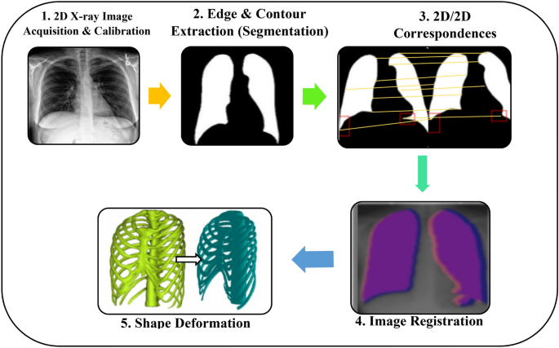
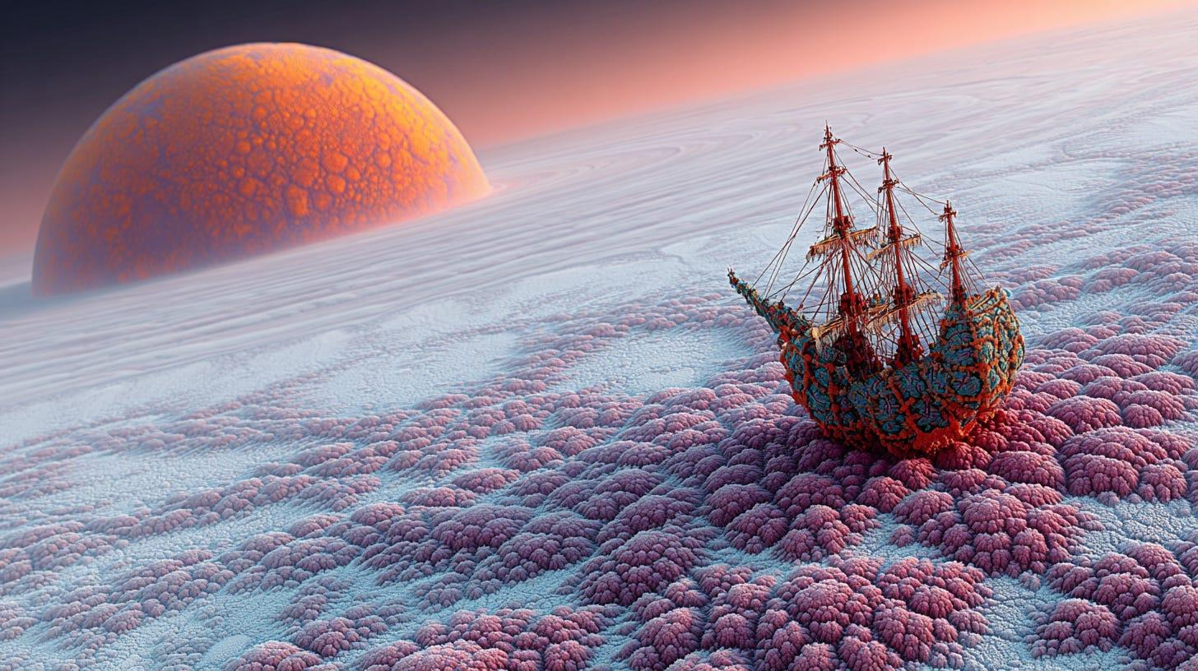
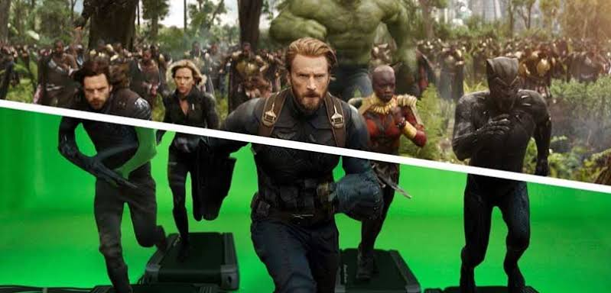
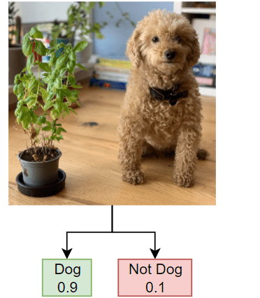

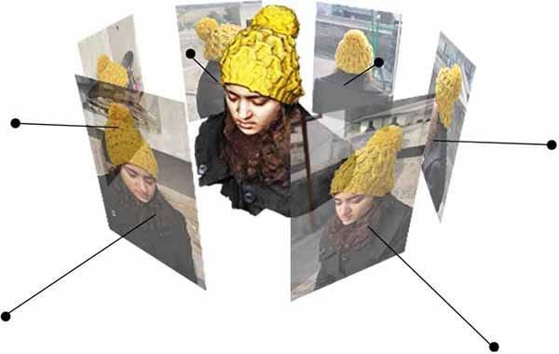
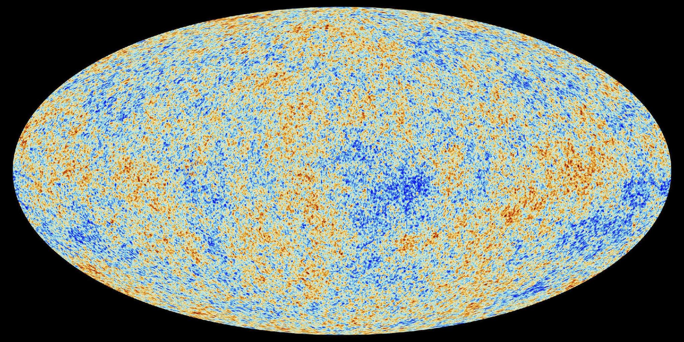
What is IP and why?
Lots more!

Slide 3
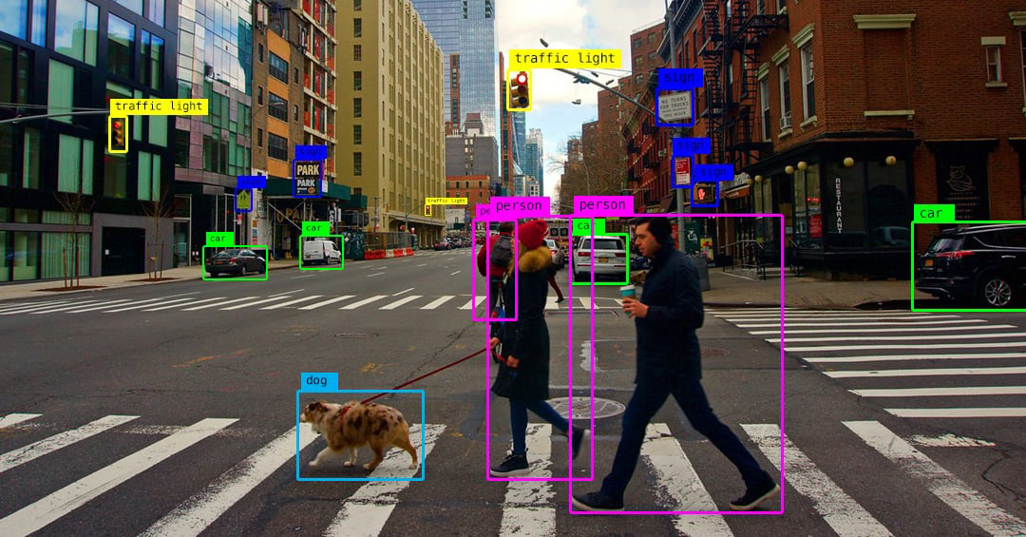
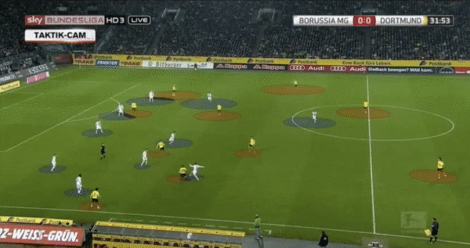
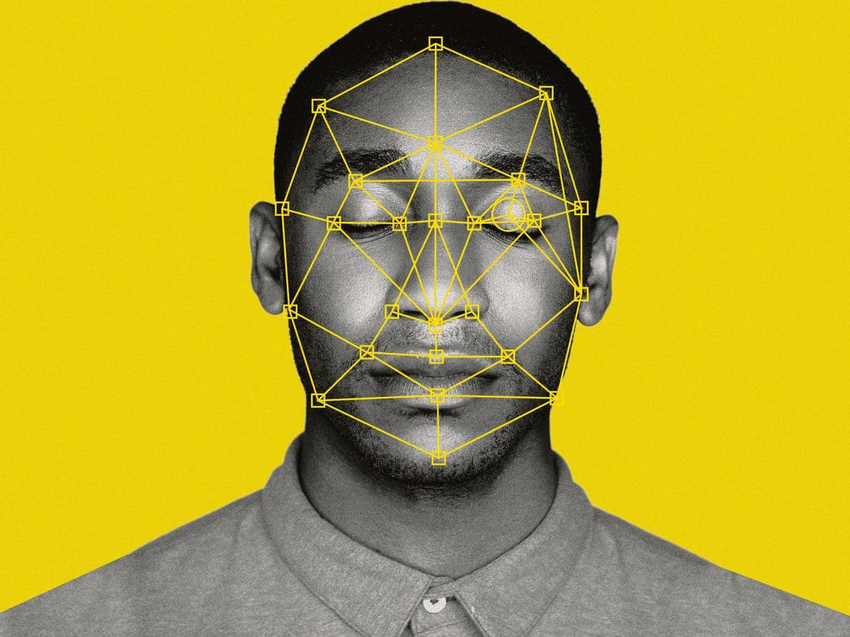
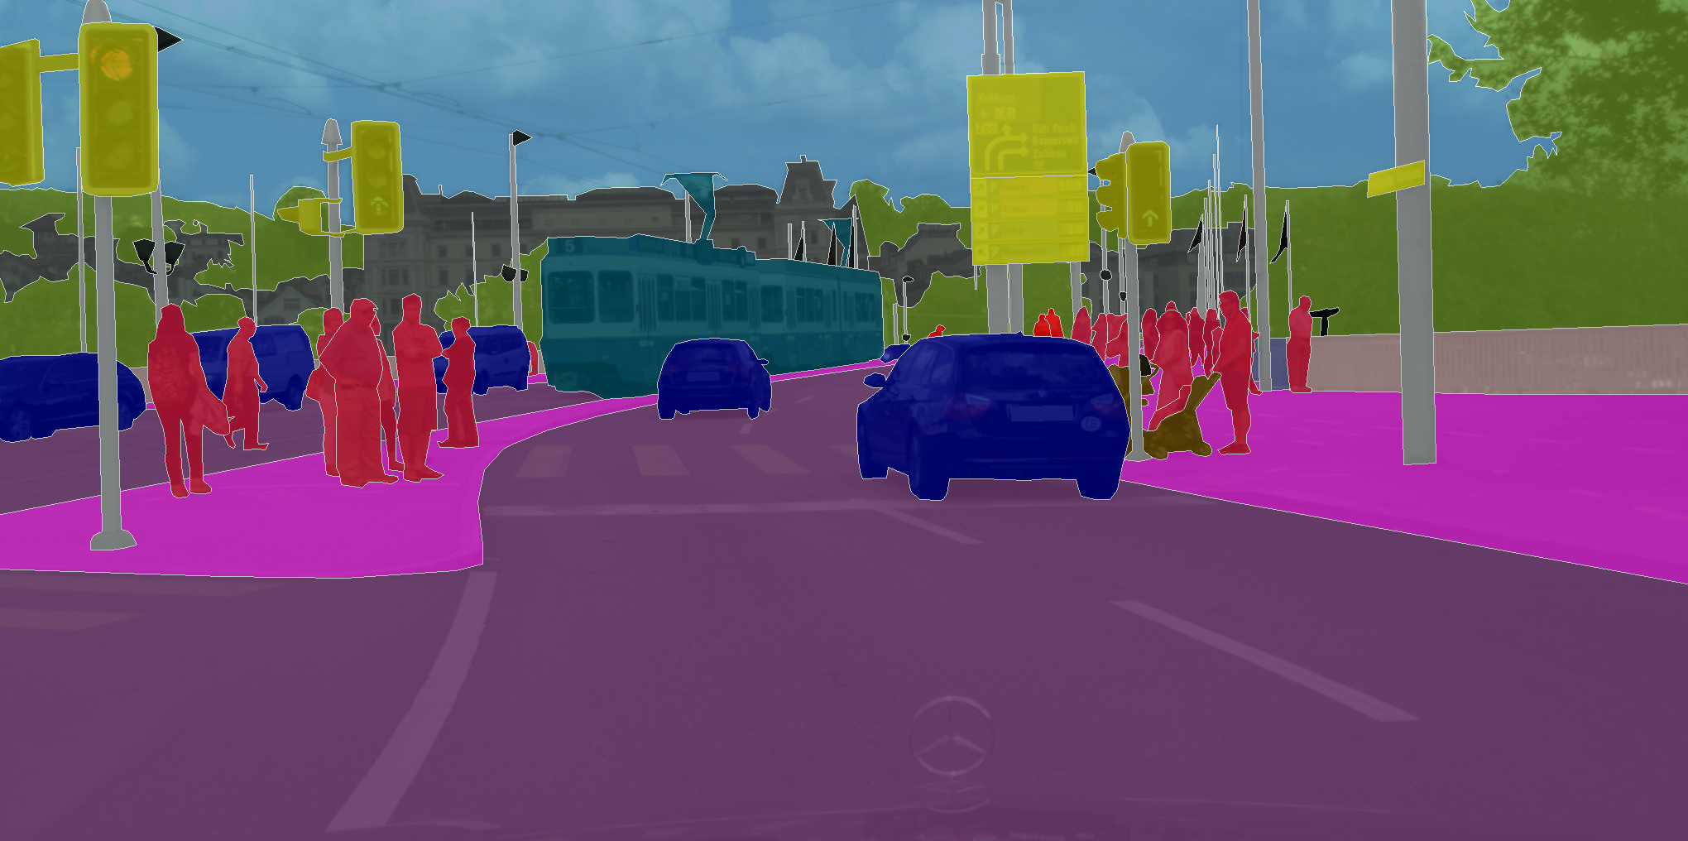
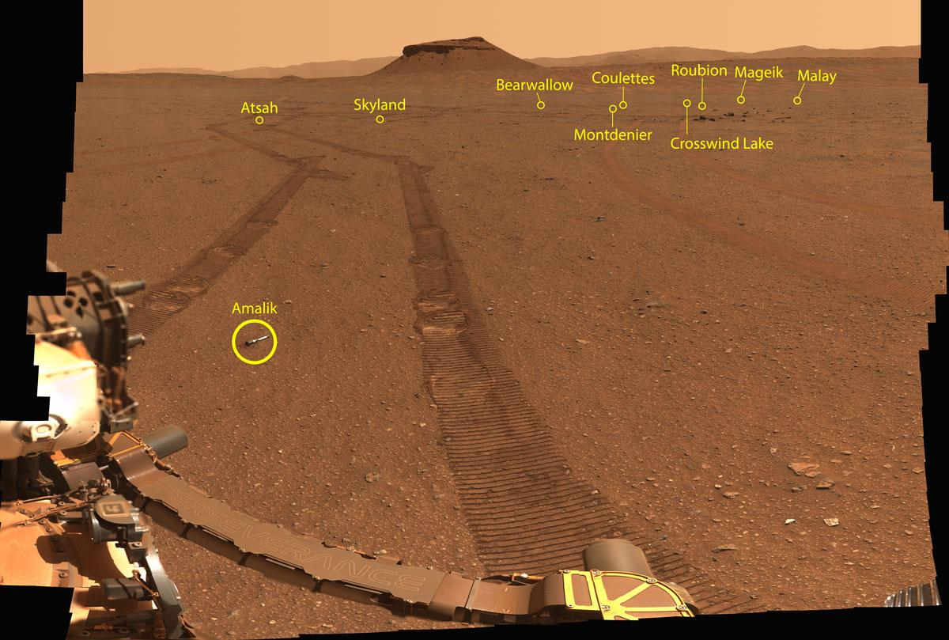
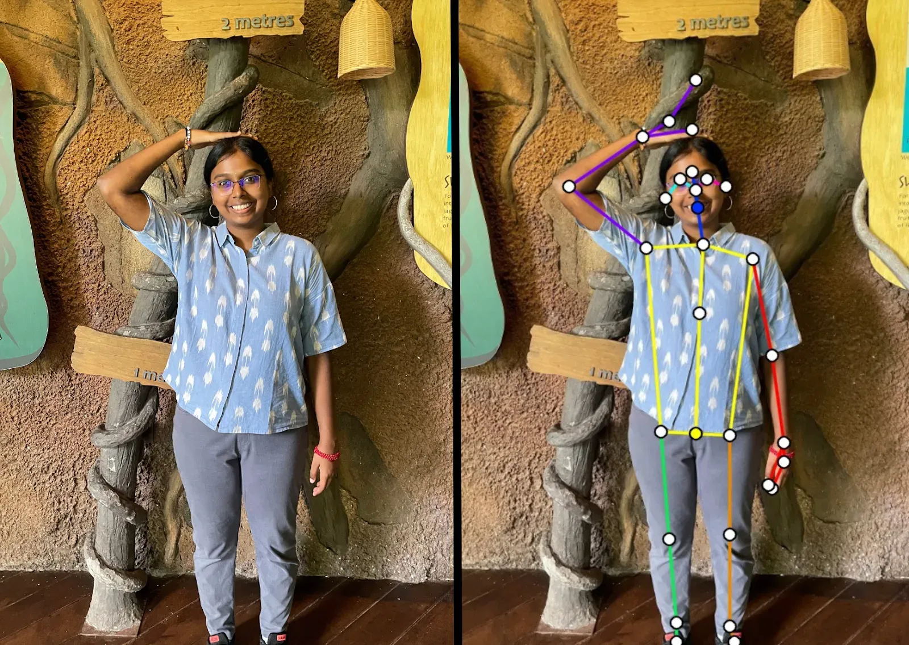
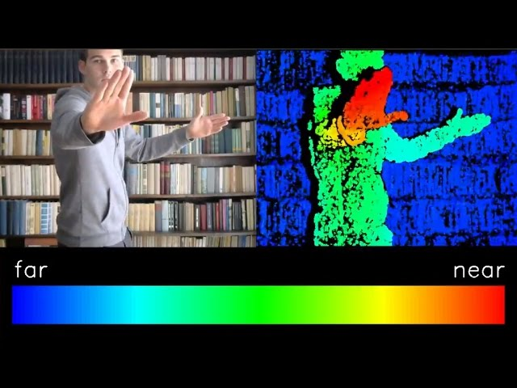
What is CV and why?
Lots more!
Notes:
What is computer vision and why is it important.
Lots more is up to them to figure out. Microscopic probes, nano machinery, full self-driving anything, automating all human tasks and labor, scientific image analysis, etc.

Slide 4
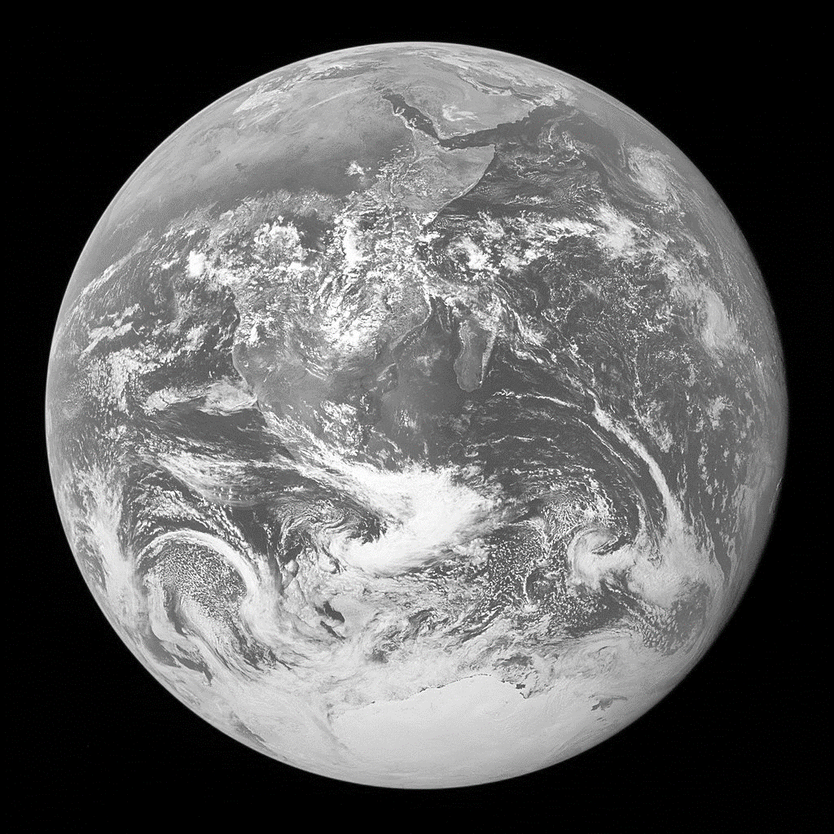
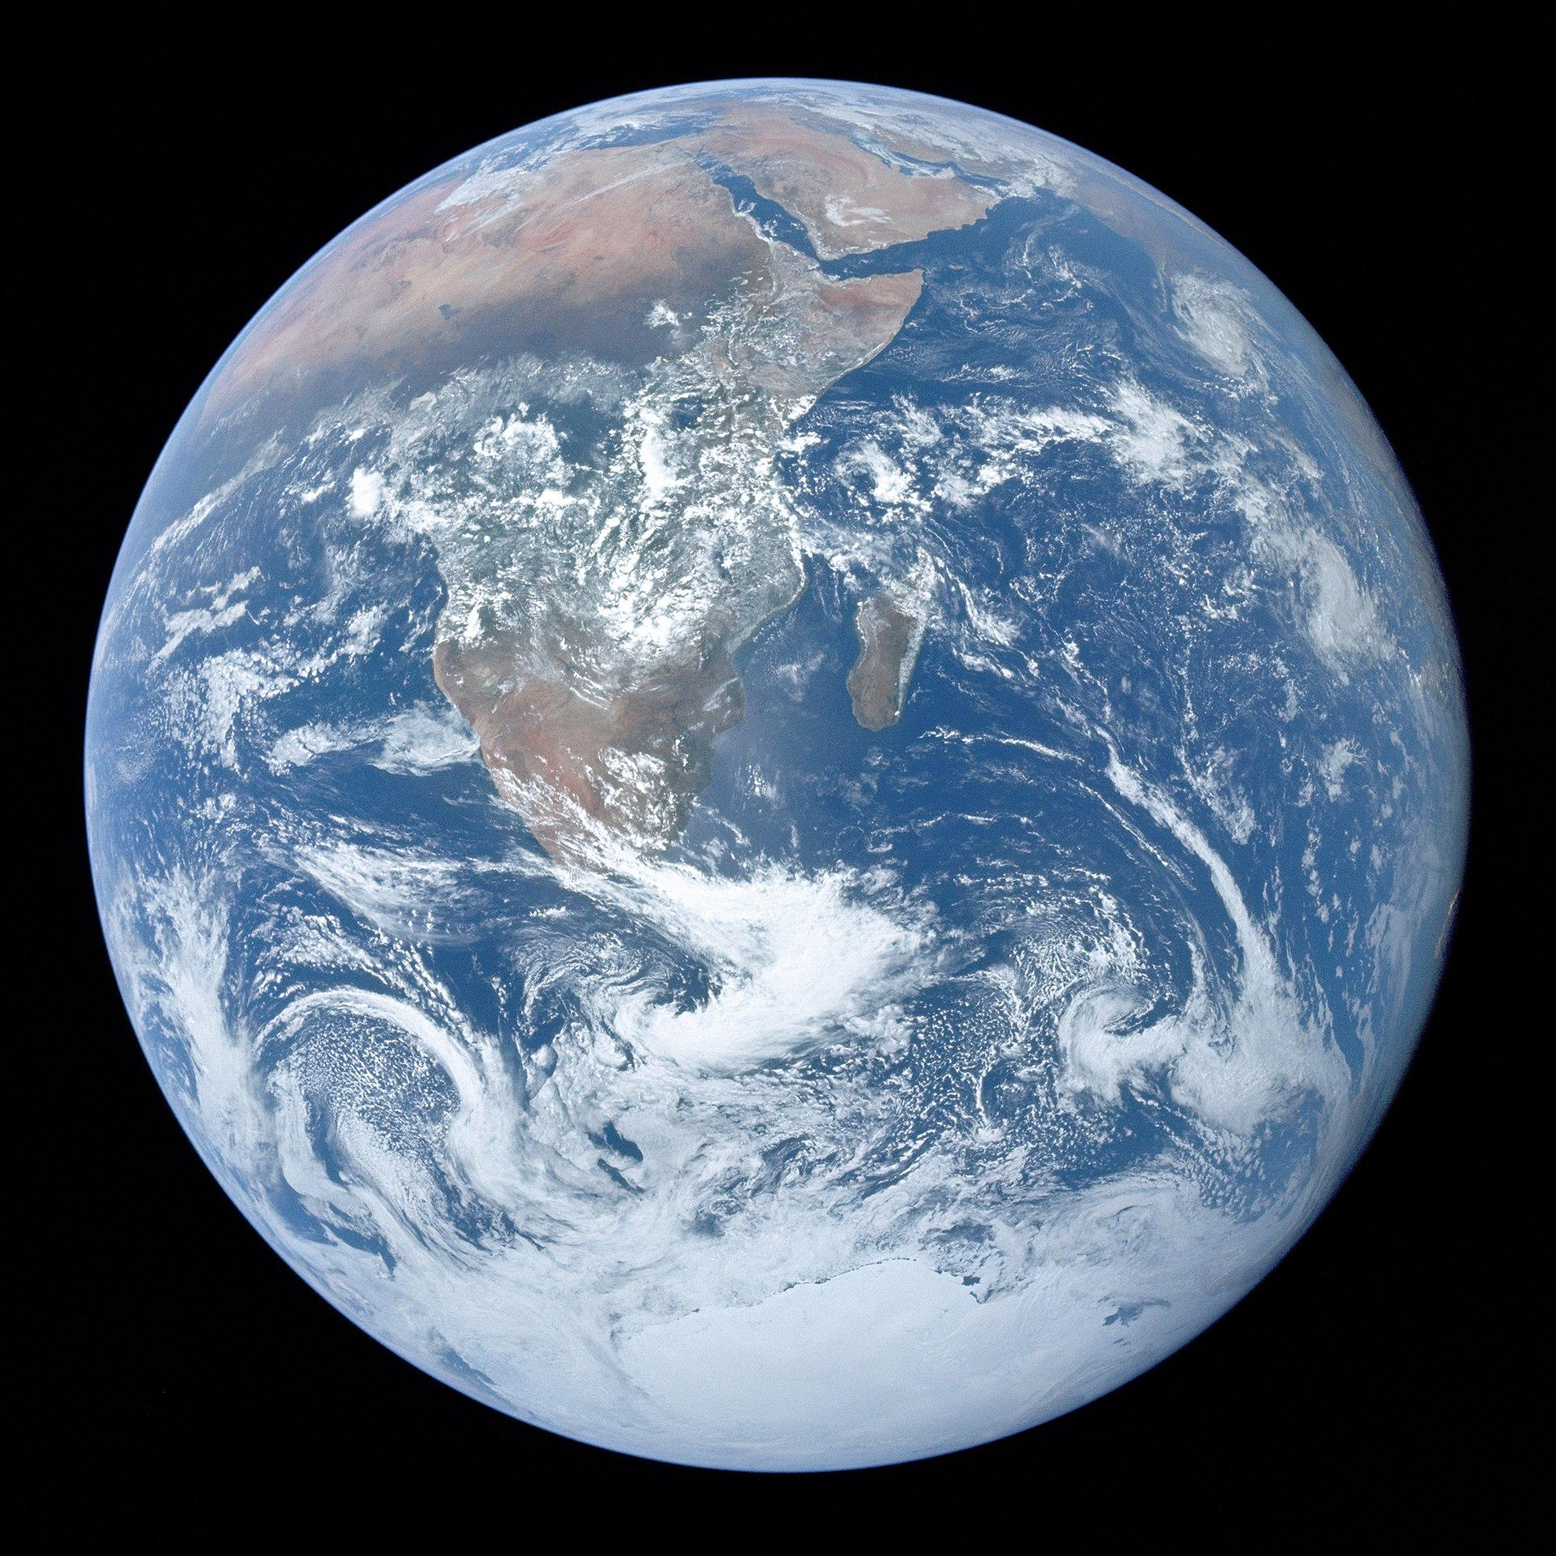
Blue Marble. NASA | Apollo 17
Notes:
This is the famous Blue Marble image from Apollo 17

Slide 5
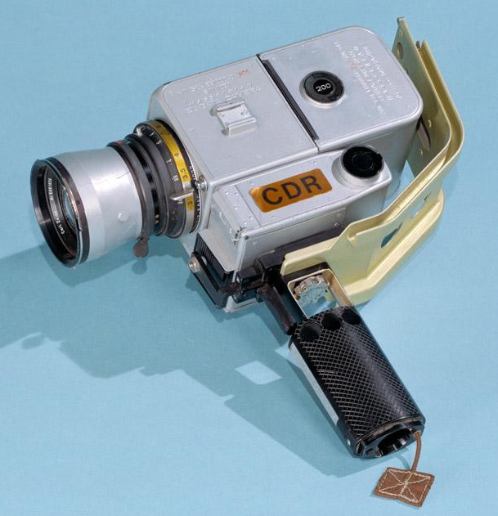
Light received by camera
[Hasselblad 500 EL - NASA variant – ‘Data Camera’ (HDC)]
Blue Marble. NASA | Apollo 17
Notes:
Light from the Earth creates a continuous signal that is measured by cameras.
Camera: Hasselblad (Swedish company)
https://www.hasselblad.com/about/history/hasselblad-in-space/
NASA Space Shuttle – Astronaut’s Photography Manual
https://ia802801.us.archive.org/8/items/pdfy-CrPzRQE7YadZxwnF/astronauts_manual_singlepage_lr.pdf

Slide 6
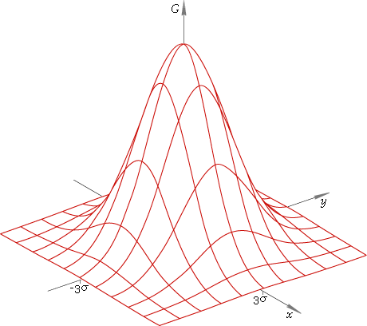
Approximate figurative distribution of light
Light received by camera
Amount of light
Spatial dimension 1
Spatial dimension 2
Blue Marble. NASA | Apollo 17
Notes:
Light from the Earth creates a continuous signal that is measured by cameras.

Slide 7
Signal
A (multi-dimensional) function that contains information about a phenomenon.
Notes:
Natural signals are continuous, but our measurements of them are discrete.
Signals can be any phenomena – light, heat, gravity, population distribution, etc.

Slide 8
Signal
A (multi-dimensional) function that contains information about a phenomenon.
Signals can be
  Continuous: light
  Discrete: measurement of a light
  Sampling: reduction of continuous signal to a discrete signal
Notes:
Natural signals are continuous, but our measurements of them are discrete.
Signals can be any phenomena – light, heat, gravity, population distribution, etc.

Slide 9
Signal
A (multi-dimensional) function that contains information about a phenomenon.
Signals can be
  Continuous: light
  Discrete: measurement of a light
  Sampling: reduction of continuous signal to a discrete signal
Any phenomenon
  Light
  Heat
  Gravity
Notes:
Natural signals are continuous, but our measurements of them are discrete.
Signals can be any phenomena – light, heat, gravity, population distribution, etc.

Slide 10
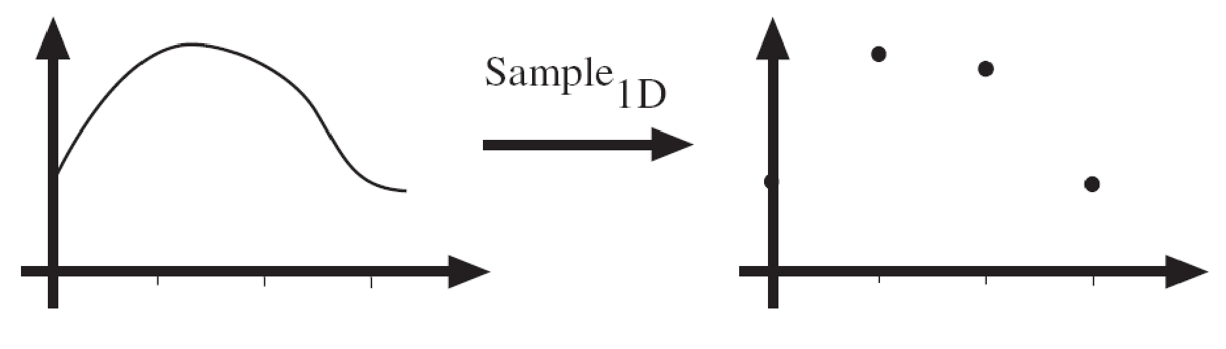
Sampling
Sampling in 1D takes a function and returns a vector whose elements are values of that function at the sample points.
f(x)
[2,6,5,2]
x
x
Danny Alexander
Notes:
Sampling is the process of converting a continuous signal into a discrete signal.

Slide 11
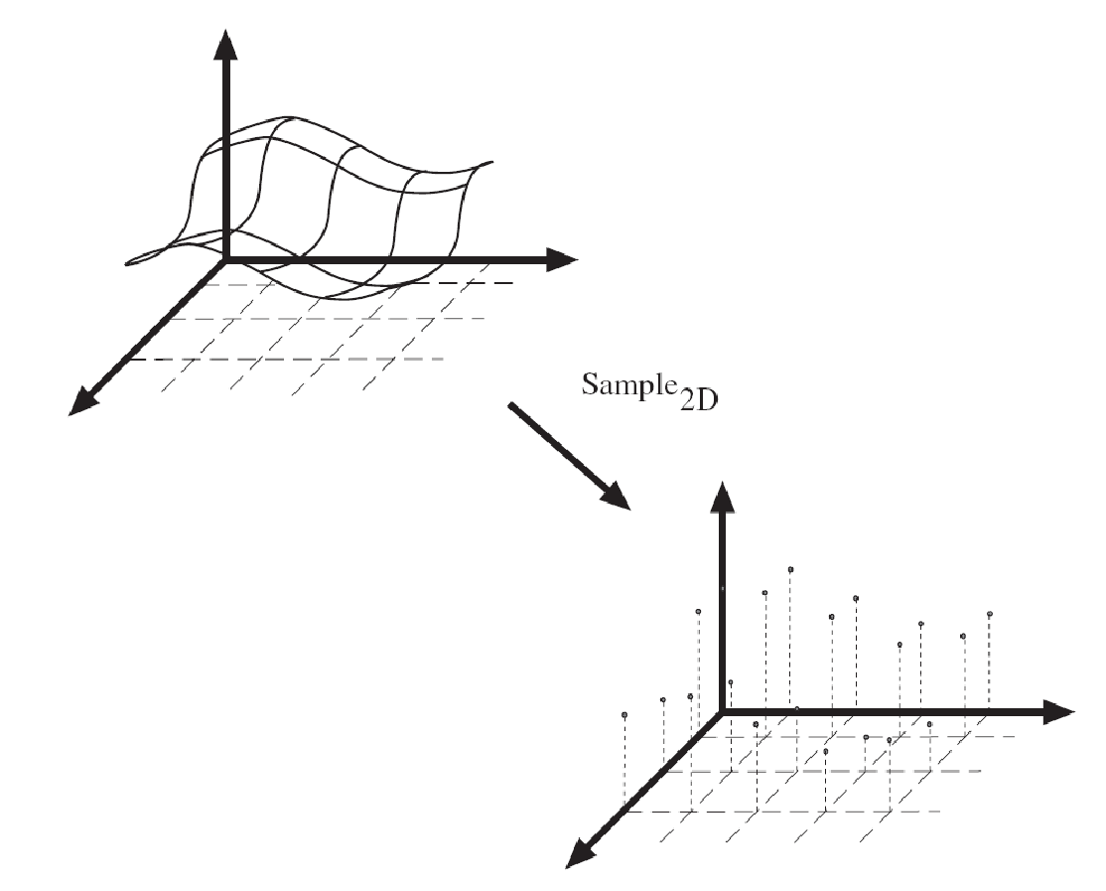
Sampling
f(x)
x
y
Sampling in 2D takes a function and returns a matrix.
x
y
Danny Alexander
Notes:
We can sample signals in 1D or 2D or higher dimensions.

Slide 12
2D Image
A sampling of a function that contains information about a 2D* signal.
* or a 2D projection of a multi-dimensional signal
Notes:
A 2D image is a sampling of a 2D signal. Note that the 2D signal can also be a projection (or slice) of a higher-dimensional signal like in MRI or CT scans.

Slide 13
2D Image
A sampling of a function that contains information about a 2D* signal.
Image stores intensity or ‘brightness’
* or a 2D projection of a multi-dimensional signal
Notes:
A 2D image is a sampling of a 2D signal. Note that the 2D signal can also be a projection (or slice) of a higher-dimensional signal like in MRI or CT scans.

Slide 14
2D Image
A sampling of a function that contains information about a 2D* signal.
Image stores intensity or ‘brightness’
2D signals are special for us
  Brightness along x and y dimensions
* or a 2D projection of a multi-dimensional signal
Notes:
A 2D image is a sampling of a 2D signal. Note that the 2D signal can also be a projection (or slice) of a higher-dimensional signal like in MRI or CT scans.

Slide 15
2D Image
A sampling of a function that contains information about a 2D* signal.
Image stores intensity or ‘brightness’
2D signals are special for us
  Brightness along x and y dimensions
Video: xy-coordinates + time
  Time-varying 2D signal
* or a 2D projection of a multi-dimensional signal
Notes:
A 2D image is a sampling of a 2D signal. Note that the 2D signal can also be a projection (or slice) of a higher-dimensional signal like in MRI or CT scans.

Slide 16
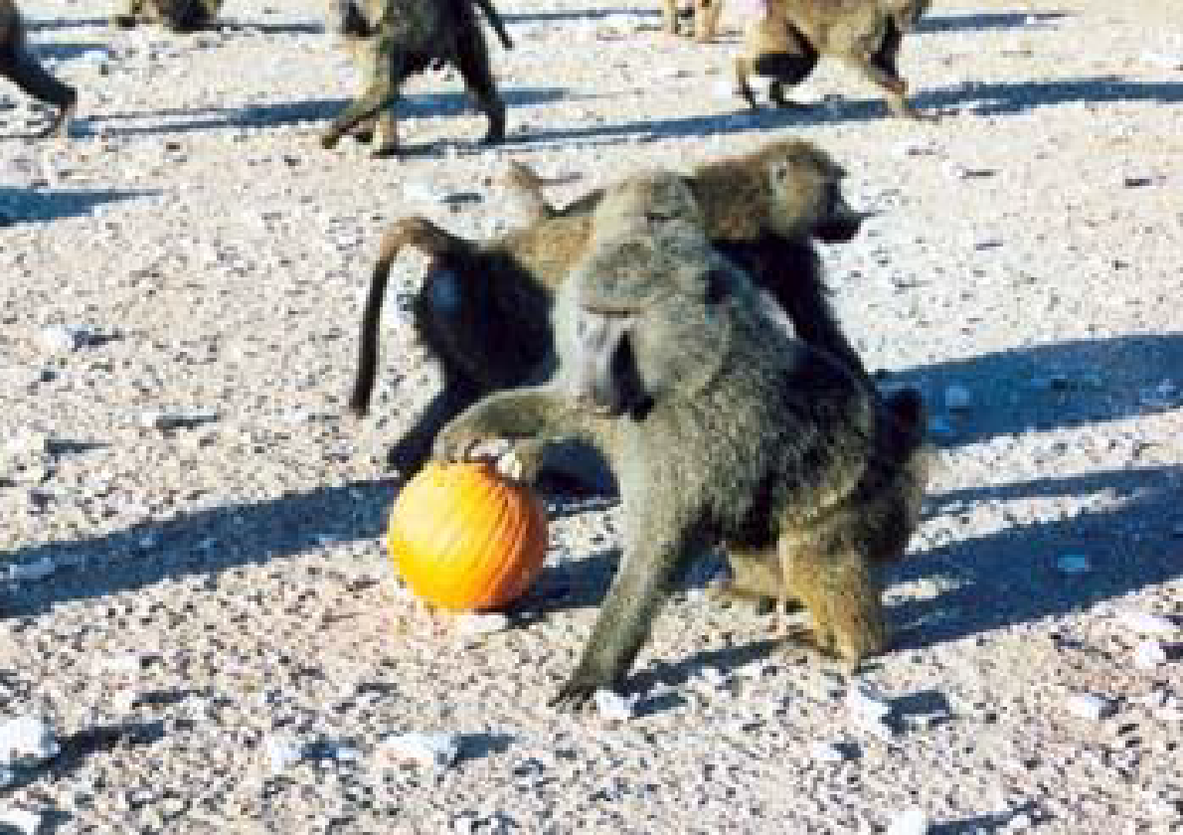
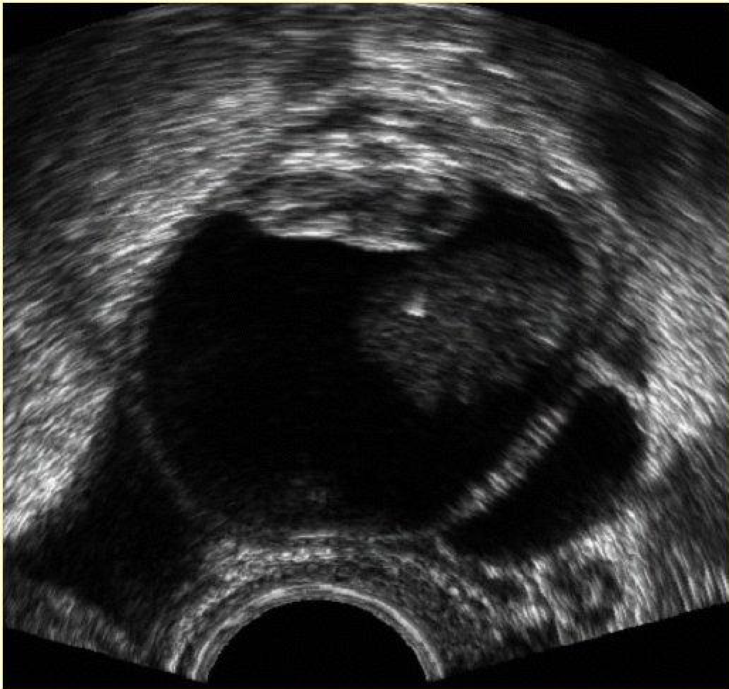
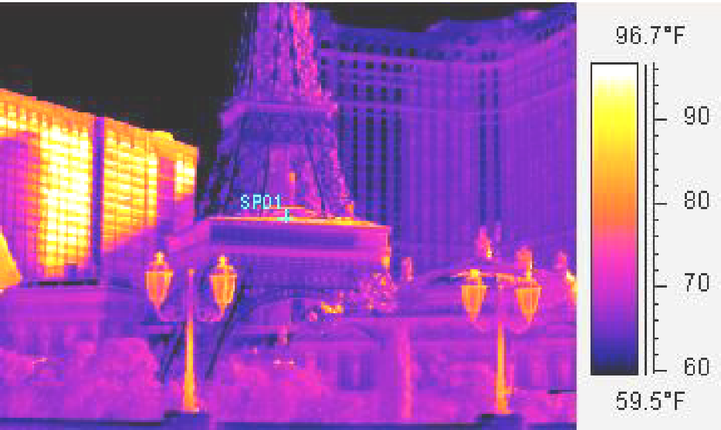
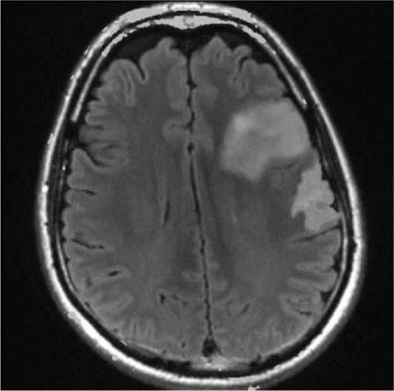
Example 2D Images
http://radiologykey.com/wp-content/uploads/2016/01/9781604063325_c014_f004.jpg
Notes:
Top left: Visible light image
Top right: Ultrasound
Bottom left: Thermal/infrared
Bottom right: fMRI - fMRI - changes in blood flow in the brain associated with neural activity
Img src: http://radiologykey.com/wp-content/uploads/2016/01/9781604063325_c014_f004.jpg

Slide 17
Sampling in Practice
Notes:
Does anyone know what Kodak 400 is anymore?

Slide 18
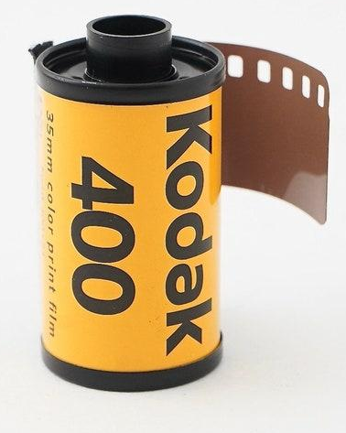
Sampling in Practice
Notes:
Does anyone know what Kodak 400 is anymore?

Slide 19
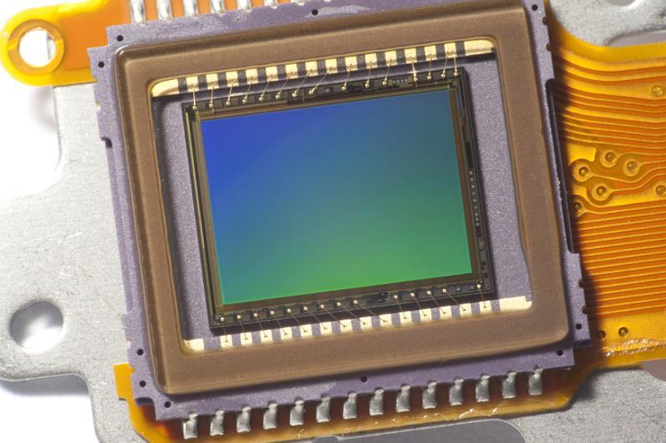
Sampling in Practice: Digital Image
CMOS / CCD
Notes:
These days, we use CMOS (complementary metal-oxide semiconductor) or CCD (charge coupled device) are semiconductor devices that are sensitive to light. When photons impinge on them, they emit electrons.
An image that we obtain using such sensors is called a digital image. We will primarily deal with digital images this class.

Slide 20
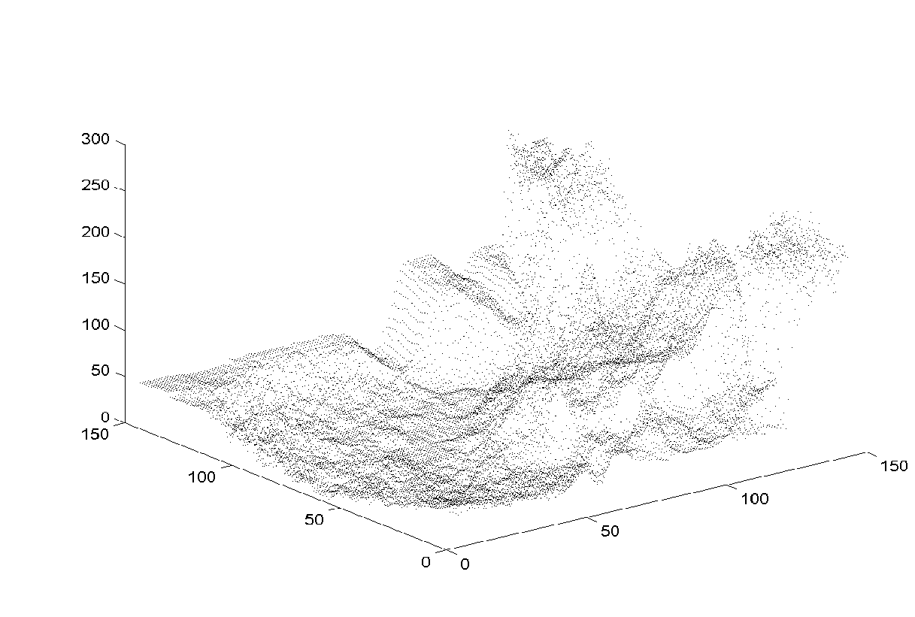
Digital Image as ‘Height Map’
Brightness
or intensity
x
y
Notes:
We can visualize digital images as a height map.

Slide 21
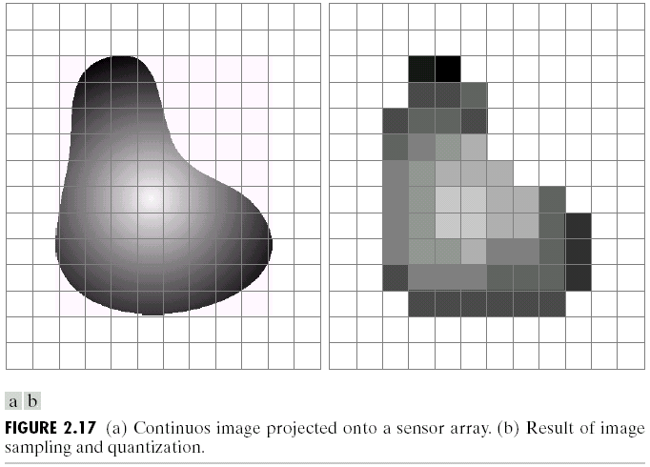
Sensor Array
CMOS sensor
James Hays
Notes:
https://www.freeimages.co.uk/galleries/transtech/audiovideo/slides/CMOS_sensor.htm
Hidden question: Why does it have this blue/green tint on the sensor?

Slide 22
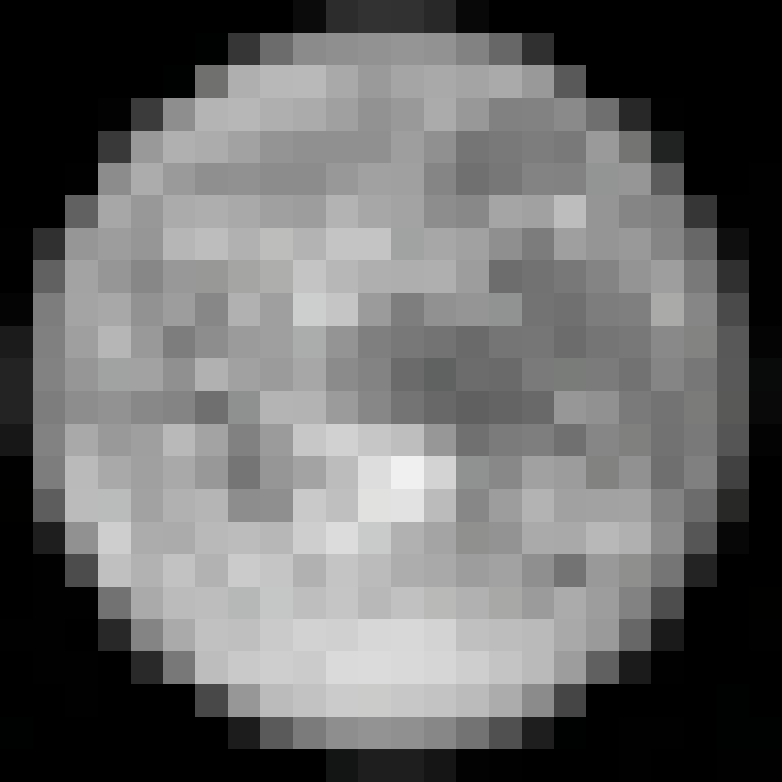
Elements of a Digital Image
Pixel: picture element
‘101’
y
I(x,y)
x
Notes:
A pixel is a picture element. It’s the basic component of a digital image.

Slide 23
Elements of a Digital Image
Pixel: picture element
‘101’
y
I(x,y)
‘191’
I(x,y)
x
Notes:
Pixels have values – a number associated with each one.

Slide 24
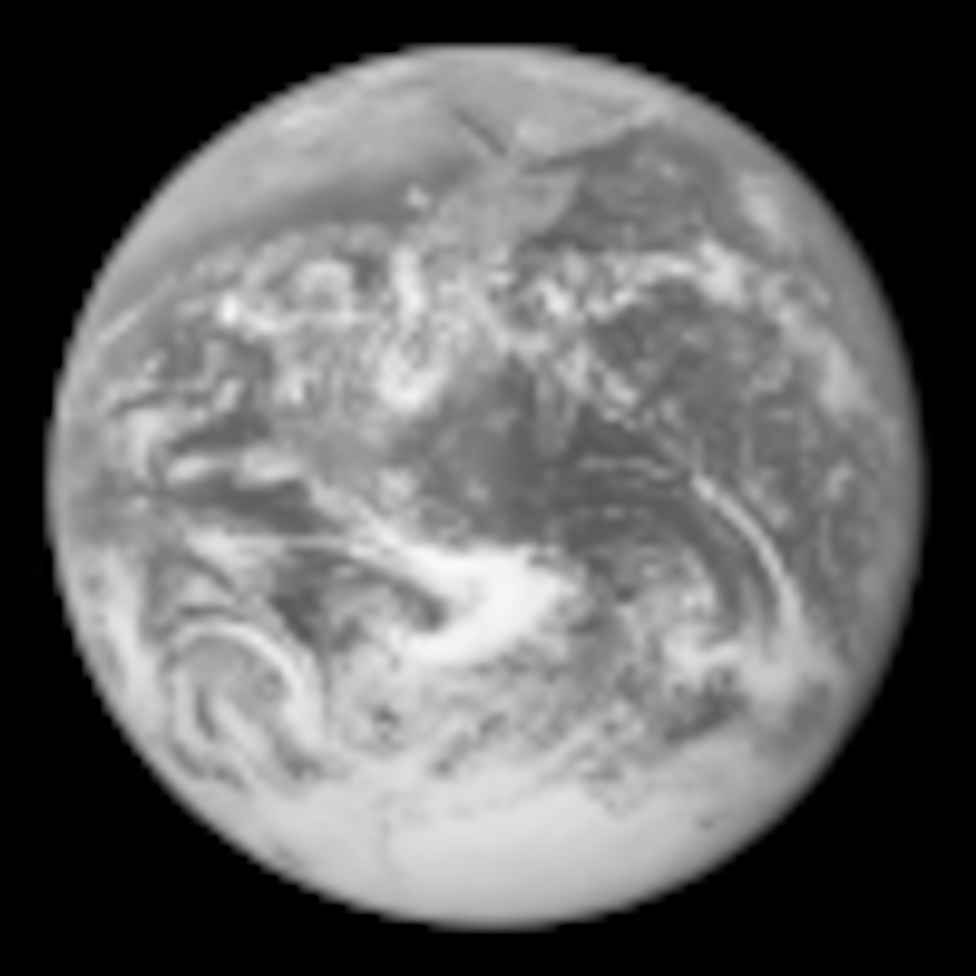
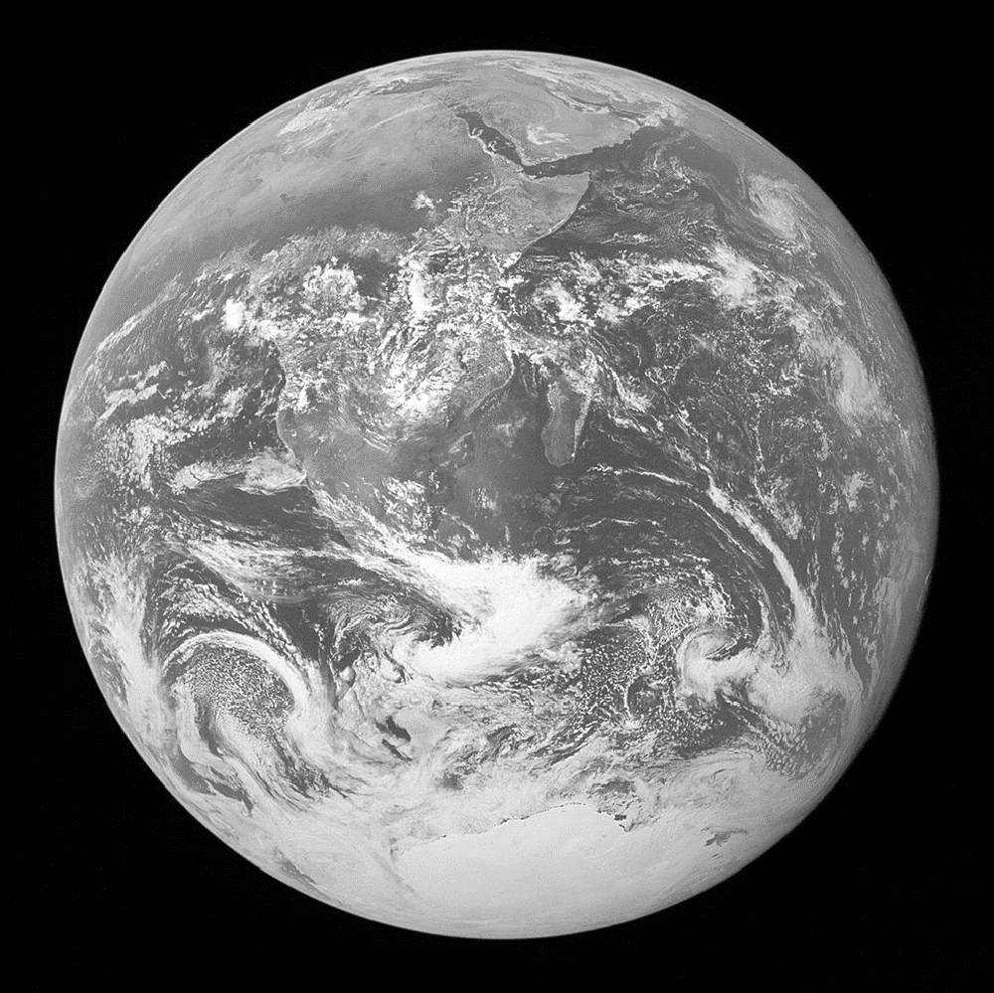
Resolution: geometric vs. spatial
Both images are 1000x1000 pixels
Notes:
Resolution is the number of pixels that an image contains.
Difference between geometric resolution and spatial resolution. Spatial resolution is the size of an image pixel or the smallest distinct object an imaging system can show. Geometric resolution (or sharpness) is how clearly structural edges and lines are rendered, which is determined by physical layout factors like source distance, focus size, and motion blur
The images are the same size, but they contain different amounts of detail.

Slide 25
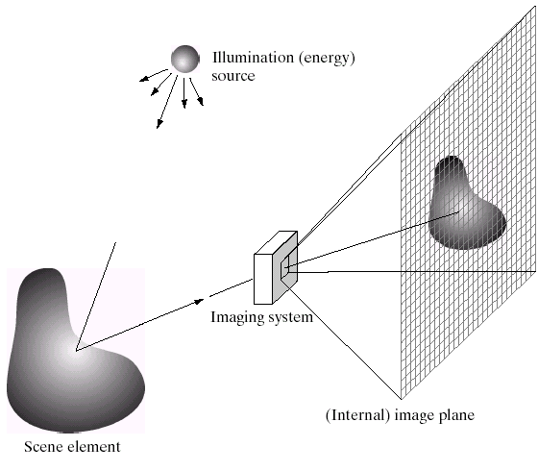
Light Integration Over the Frustum
Output Image
Camera Sensor
Notes:
We can approximate a pixel as a square frustum: https://en.wikipedia.org/wiki/Frustum
Sometimes we approximate it as a solid angle:
https://en.wikipedia.org/wiki/Solid_angle
Note: This diagram arguably has an error (for convenience). The scene element should be flipped as projection onto the camera plane typically turns the image upside down.

Slide 26
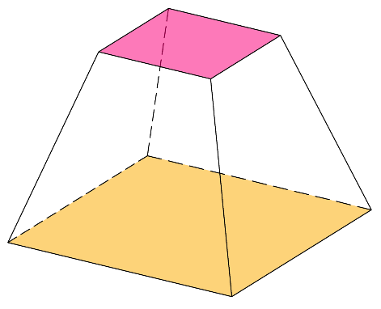
Light Integration Over the Frustum
Image
Output Image
Pixel
Camera Sensor
A frustum approximates the ray space that a pixel samples
James Hays
Notes:
We can approximate a pixel as a square frustum: https://en.wikipedia.org/wiki/Frustum
Sometimes we approximate it as a solid angle:
https://en.wikipedia.org/wiki/Solid_angle
Note: This diagram arguably has an error (for convenience). The scene element should be flipped as projection onto the camera plane typically turns the image upside down.
Q to class: Why is the the projection onto the camera upside down?
----
For an amusing diatribe on what a pixel is or is not:
“A Pixel Is Not A Little Square,
A Pixel Is Not A Little Square,
A Pixel Is Not A Little Square!
(And a Voxel is Not a Little Cube)”
Alvy Ray Smith,
MS Tech Memo 6, 1995.
http://alvyray.com/Memos/CG/Microsoft/6_pixel.pdf

Slide 27
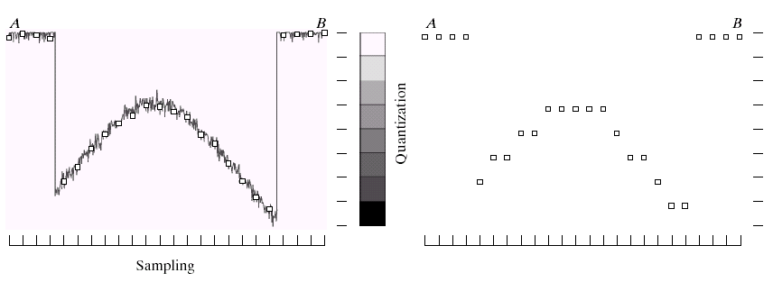
Quantization
Signals from the digital world need to to translated to digital. The image must be digitized spatially AND in amplitude.
Two STEPS to Digitizing:
1. Sampling
2. Quantization: digitizing the amplitude value
Underlying analog charge signal
Quantized values
Notes:
Real valued function will get digital values – integer values
• Quantization is lossy.
– After quantization, the original signal cannot be reconstructed anymore
• This is in contrast to sampling, as a sampled but not quantized signal can be reconstructed.
• Simple quantization uses equally spaced levels with k intervals
Figure 2.16 from Szeliski textbook.
In Digital Image Processing, signals captured from the physical world need to be translated into digital form by “Digitization” Process. In order to become suitable for digital processing, an image function f(x,y) must be digitized both spatially and in amplitude. This digitization process involves two main processes called
Sampling: Digitizing the co-ordinate value is called sampling.
Quantization: Digitizing the amplitude value is called quantization
Typically, a frame grabber or digitizer is used to sample and quantize the analogue video signal.

Slide 28
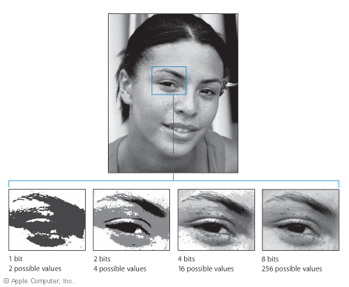
Quantization Effects – Radiometric Resolution
We often call this bit depth.
For photography, this is also related to dynamic range.
Notes:
Dynamic range: The minimum and maximum range of light intensity that can be measured/perceived/represented/displayed.

Slide 29
Dimensionality of an Image
An image of size 1000x1000 with 8-bit quantization per pixel
  = 256 values ^ (1000 x 1000)
Notes:
Zoran and Weiss: “In the context of this work, a natural image would be the result of taking an ordinary digital camera, pointing it somewhere in the world and pressing the shutter button.“
Let’s think about how many possible pixel value combinations for just 256 grayscale images…

Slide 30
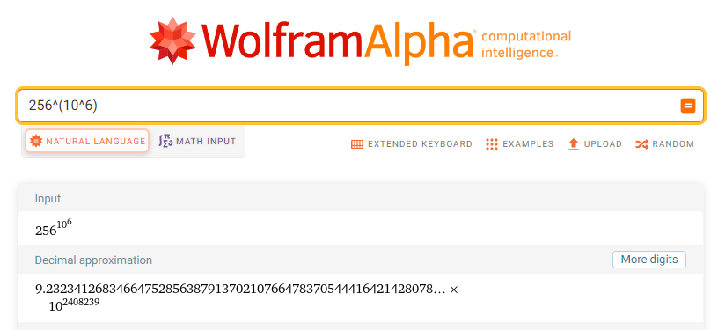
Dimensionality of an Image
An image of size 1000x1000 with 8-bit quantization per pixel
  = 256 values ^ (1000 x 1000)
All scenes ever depicted
Notes:
Zoran and Weiss: “In the context of this work, a natural image would be the result of taking an ordinary digital camera, pointing it somewhere in the world and pressing the shutter button.“

Slide 31
Dimensionality of an Image
An image of size 1000x1000 with 8-bit quantization per pixel
  = 256 values ^ (1000 x 1000)
All scenes ever depicted
  In size 1000x1000
Notes:
Zoran and Weiss: “In the context of this work, a natural image would be the result of taking an ordinary digital camera, pointing it somewhere in the world and pressing the shutter button.“

Slide 32
Dimensionality of an Image
An image of size 1000x1000 with 8-bit quantization per pixel
  = 256 values ^ (1000 x 1000)
All scenes ever depicted
  In size 1000x1000
Computer vision as making sense of high-dimensional data.
  ‘Natural’ images are a subspace
  CV as deriving low-dimensional, explainable models.
Notes:
Zoran and Weiss: “In the context of this work, a natural image would be the result of taking an ordinary digital camera, pointing it somewhere in the world and pressing the shutter button.“

Slide 33
Images in Python (import numpy)
N x M grayscale image “im” (N is number of rows and M is number of columns)
  im[0,0] = top-left pixel value
  im[row,col] = row pixels down, col pixels to right
  im[N-1,M-1] = bottom-right pixel
Column
Row
0.92 | 0.93 | 0.94 | 0.97 | 0.62 | 0.37 | 0.85 | 0.97 | 0.93 | 0.92 | 0.99
0.95 | 0.89 | 0.82 | 0.89 | 0.56 | 0.31 | 0.75 | 0.92 | 0.81 | 0.95 | 0.91
0.89 | 0.72 | 0.51 | 0.55 | 0.51 | 0.42 | 0.57 | 0.41 | 0.49 | 0.91 | 0.92
0.96 | 0.95 | 0.88 | 0.94 | 0.56 | 0.46 | 0.91 | 0.87 | 0.90 | 0.97 | 0.95
0.71 | 0.81 | 0.81 | 0.87 | 0.57 | 0.37 | 0.80 | 0.88 | 0.89 | 0.79 | 0.85
0.49 | 0.62 | 0.60 | 0.58 | 0.50 | 0.60 | 0.58 | 0.50 | 0.61 | 0.45 | 0.33
0.86 | 0.84 | 0.74 | 0.58 | 0.51 | 0.39 | 0.73 | 0.92 | 0.91 | 0.49 | 0.74
0.96 | 0.67 | 0.54 | 0.85 | 0.48 | 0.37 | 0.88 | 0.90 | 0.94 | 0.82 | 0.93
0.69 | 0.49 | 0.56 | 0.66 | 0.43 | 0.42 | 0.77 | 0.73 | 0.71 | 0.90 | 0.99
0.79 | 0.73 | 0.90 | 0.67 | 0.33 | 0.61 | 0.69 | 0.79 | 0.73 | 0.93 | 0.97
0.91 | 0.94 | 0.89 | 0.49 | 0.41 | 0.78 | 0.78 | 0.77 | 0.89 | 0.99 | 0.93
Notes:
Practical matters when dealing with images in python.

Slide 34
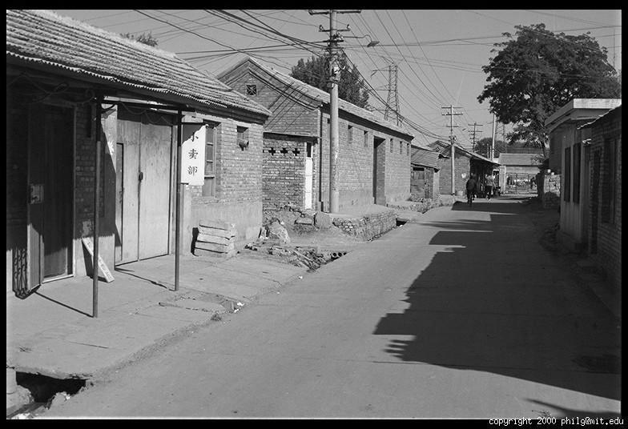
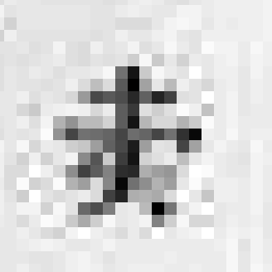
Grayscale Intensity
0.92 | 0.93 | 0.94 | 0.97 | 0.62 | 0.37 | 0.85 | 0.97 | 0.93 | 0.92 | 0.99
0.95 | 0.89 | 0.82 | 0.89 | 0.56 | 0.31 | 0.75 | 0.92 | 0.81 | 0.95 | 0.91
0.89 | 0.72 | 0.51 | 0.55 | 0.51 | 0.42 | 0.57 | 0.41 | 0.49 | 0.91 | 0.92
0.96 | 0.95 | 0.88 | 0.94 | 0.56 | 0.46 | 0.91 | 0.87 | 0.90 | 0.97 | 0.95
0.71 | 0.81 | 0.81 | 0.87 | 0.57 | 0.37 | 0.80 | 0.88 | 0.89 | 0.79 | 0.85
0.49 | 0.62 | 0.60 | 0.58 | 0.50 | 0.60 | 0.58 | 0.50 | 0.61 | 0.45 | 0.33
0.86 | 0.84 | 0.74 | 0.58 | 0.51 | 0.39 | 0.73 | 0.92 | 0.91 | 0.49 | 0.74
0.96 | 0.67 | 0.54 | 0.85 | 0.48 | 0.37 | 0.88 | 0.90 | 0.94 | 0.82 | 0.93
0.69 | 0.49 | 0.56 | 0.66 | 0.43 | 0.42 | 0.77 | 0.73 | 0.71 | 0.90 | 0.99
0.79 | 0.73 | 0.90 | 0.67 | 0.33 | 0.61 | 0.69 | 0.79 | 0.73 | 0.93 | 0.97
0.91 | 0.94 | 0.89 | 0.49 | 0.41 | 0.78 | 0.78 | 0.77 | 0.89 | 0.99 | 0.93
Notes:
Actual pixel values from a natural image.

Slide 35
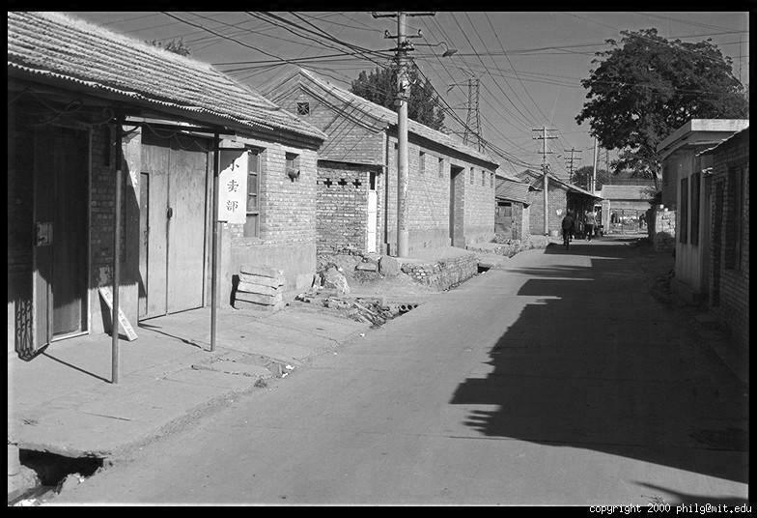
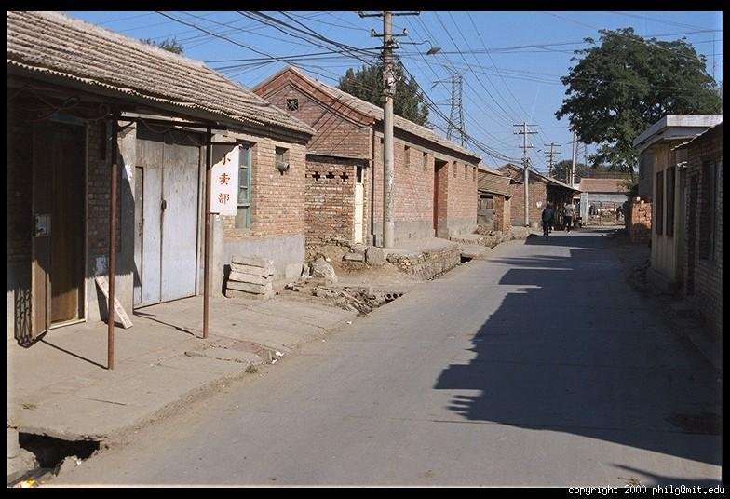
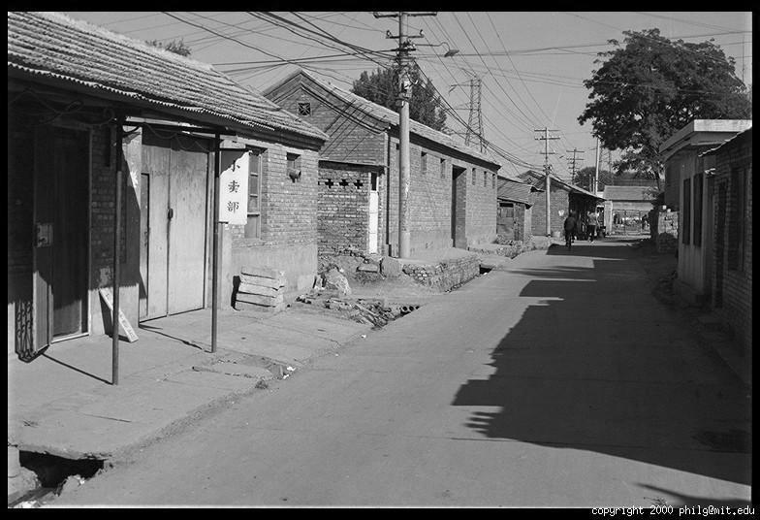
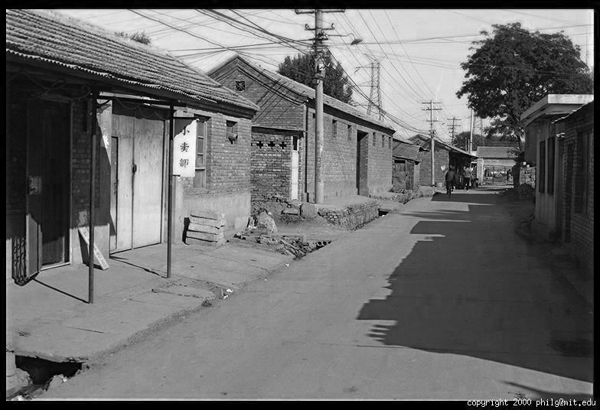
Color
Red intensity
Green
Blue
Notes:
We handle color by having three arrays, one for each of red, green or blue color channels. Combining the channels gives a color image.

Slide 36
Images in Python (import numpy)
N x M grayscale image “im”
  im[0,0,0] = top-left pixel value, red channel
  im[y,x,1] = y pixels down, x pixels to right, green channel
  im[N-1,M-1,2] = bottom-right pixel, blue channel
Column
Row
R
0.92 | 0.93 | 0.94 | 0.97 | 0.62 | 0.37 | 0.85 | 0.97 | 0.93 | 0.92 | 0.99
0.95 | 0.89 | 0.82 | 0.89 | 0.56 | 0.31 | 0.75 | 0.92 | 0.81 | 0.95 | 0.91
0.89 | 0.72 | 0.51 | 0.55 | 0.51 | 0.42 | 0.57 | 0.41 | 0.49 | 0.91 | 0.92
0.96 | 0.95 | 0.88 | 0.94 | 0.56 | 0.46 | 0.91 | 0.87 | 0.90 | 0.97 | 0.95
0.71 | 0.81 | 0.81 | 0.87 | 0.57 | 0.37 | 0.80 | 0.88 | 0.89 | 0.79 | 0.85
0.49 | 0.62 | 0.60 | 0.58 | 0.50 | 0.60 | 0.58 | 0.50 | 0.61 | 0.45 | 0.33
0.86 | 0.84 | 0.74 | 0.58 | 0.51 | 0.39 | 0.73 | 0.92 | 0.91 | 0.49 | 0.74
0.96 | 0.67 | 0.54 | 0.85 | 0.48 | 0.37 | 0.88 | 0.90 | 0.94 | 0.82 | 0.93
0.69 | 0.49 | 0.56 | 0.66 | 0.43 | 0.42 | 0.77 | 0.73 | 0.71 | 0.90 | 0.99
0.79 | 0.73 | 0.90 | 0.67 | 0.33 | 0.61 | 0.69 | 0.79 | 0.73 | 0.93 | 0.97
0.91 | 0.94 | 0.89 | 0.49 | 0.41 | 0.78 | 0.78 | 0.77 | 0.89 | 0.99 | 0.93
G
0.92 | 0.93 | 0.94 | 0.97 | 0.62 | 0.37 | 0.85 | 0.97 | 0.93 | 0.92 | 0.99
0.95 | 0.89 | 0.82 | 0.89 | 0.56 | 0.31 | 0.75 | 0.92 | 0.81 | 0.95 | 0.91
0.89 | 0.72 | 0.51 | 0.55 | 0.51 | 0.42 | 0.57 | 0.41 | 0.49 | 0.91 | 0.92
0.96 | 0.95 | 0.88 | 0.94 | 0.56 | 0.46 | 0.91 | 0.87 | 0.90 | 0.97 | 0.95
0.71 | 0.81 | 0.81 | 0.87 | 0.57 | 0.37 | 0.80 | 0.88 | 0.89 | 0.79 | 0.85
0.49 | 0.62 | 0.60 | 0.58 | 0.50 | 0.60 | 0.58 | 0.50 | 0.61 | 0.45 | 0.33
0.86 | 0.84 | 0.74 | 0.58 | 0.51 | 0.39 | 0.73 | 0.92 | 0.91 | 0.49 | 0.74
0.96 | 0.67 | 0.54 | 0.85 | 0.48 | 0.37 | 0.88 | 0.90 | 0.94 | 0.82 | 0.93
0.69 | 0.49 | 0.56 | 0.66 | 0.43 | 0.42 | 0.77 | 0.73 | 0.71 | 0.90 | 0.99
0.79 | 0.73 | 0.90 | 0.67 | 0.33 | 0.61 | 0.69 | 0.79 | 0.73 | 0.93 | 0.97
0.91 | 0.94 | 0.89 | 0.49 | 0.41 | 0.78 | 0.78 | 0.77 | 0.89 | 0.99 | 0.93
B
0.92 | 0.93 | 0.94 | 0.97 | 0.62 | 0.37 | 0.85 | 0.97 | 0.93 | 0.92 | 0.99
0.95 | 0.89 | 0.82 | 0.89 | 0.56 | 0.31 | 0.75 | 0.92 | 0.81 | 0.95 | 0.91
0.89 | 0.72 | 0.51 | 0.55 | 0.51 | 0.42 | 0.57 | 0.41 | 0.49 | 0.91 | 0.92
0.96 | 0.95 | 0.88 | 0.94 | 0.56 | 0.46 | 0.91 | 0.87 | 0.90 | 0.97 | 0.95
0.71 | 0.81 | 0.81 | 0.87 | 0.57 | 0.37 | 0.80 | 0.88 | 0.89 | 0.79 | 0.85
0.49 | 0.62 | 0.60 | 0.58 | 0.50 | 0.60 | 0.58 | 0.50 | 0.61 | 0.45 | 0.33
0.86 | 0.84 | 0.74 | 0.58 | 0.51 | 0.39 | 0.73 | 0.92 | 0.91 | 0.49 | 0.74
0.96 | 0.67 | 0.54 | 0.85 | 0.48 | 0.37 | 0.88 | 0.90 | 0.94 | 0.82 | 0.93
0.69 | 0.49 | 0.56 | 0.66 | 0.43 | 0.42 | 0.77 | 0.73 | 0.71 | 0.90 | 0.99
0.79 | 0.73 | 0.90 | 0.67 | 0.33 | 0.61 | 0.69 | 0.79 | 0.73 | 0.93 | 0.97
0.91 | 0.94 | 0.89 | 0.49 | 0.41 | 0.78 | 0.78 | 0.77 | 0.89 | 0.99 | 0.93
Notes:
Practical matters when dealing with images in python. We deal with color as an additional dimension in our arrays.

Slide 37
Images in Python (import numpy,scikit)
Take care of types!
- uint8 (values 0 to 255) – io.imread(“file.jpg”)
- float32 (values 0 to 255) – io.imread(“file.jpg”).astype(np.float32)
- float32 (values 0 to 1) – img_as_float32(io.imread(“file.jpg”))
Column
Row
0.92 | 0.93 | 0.94 | 0.97 | 0.62 | 0.37 | 0.85 | 0.97 | 0.93 | 0.92 | 0.99
0.95 | 0.89 | 0.82 | 0.89 | 0.56 | 0.31 | 0.75 | 0.92 | 0.81 | 0.95 | 0.91
0.89 | 0.72 | 0.51 | 0.55 | 0.51 | 0.42 | 0.57 | 0.41 | 0.49 | 0.91 | 0.92
0.96 | 0.95 | 0.88 | 0.94 | 0.56 | 0.46 | 0.91 | 0.87 | 0.90 | 0.97 | 0.95
0.71 | 0.81 | 0.81 | 0.87 | 0.57 | 0.37 | 0.80 | 0.88 | 0.89 | 0.79 | 0.85
0.49 | 0.62 | 0.60 | 0.58 | 0.50 | 0.60 | 0.58 | 0.50 | 0.61 | 0.45 | 0.33
0.86 | 0.84 | 0.74 | 0.58 | 0.51 | 0.39 | 0.73 | 0.92 | 0.91 | 0.49 | 0.74
0.96 | 0.67 | 0.54 | 0.85 | 0.48 | 0.37 | 0.88 | 0.90 | 0.94 | 0.82 | 0.93
0.69 | 0.49 | 0.56 | 0.66 | 0.43 | 0.42 | 0.77 | 0.73 | 0.71 | 0.90 | 0.99
0.79 | 0.73 | 0.90 | 0.67 | 0.33 | 0.61 | 0.69 | 0.79 | 0.73 | 0.93 | 0.97
0.91 | 0.94 | 0.89 | 0.49 | 0.41 | 0.78 | 0.78 | 0.77 | 0.89 | 0.99 | 0.93
Notes:
Be careful with data types. They can be tricky.

Slide 38
Think-Pair-Share
>>> from numpy import random as r
>>> I = r.rand(256,256)
What is this? What does it look like?
Which values does it have?
How many are there?
Notes:
Think about how this random array would look like.

Slide 39
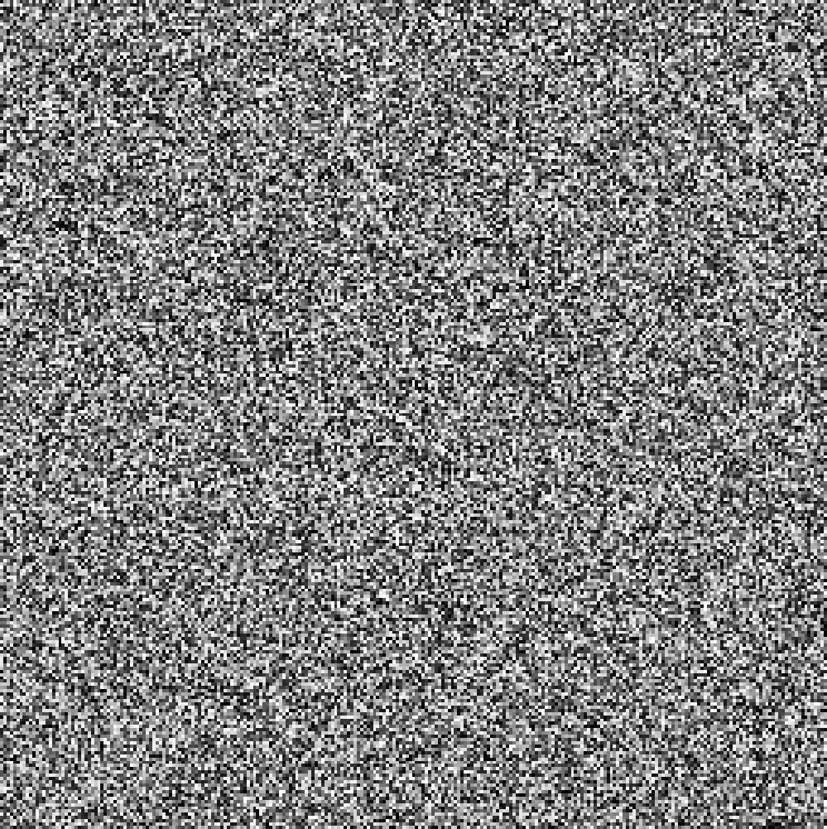
>>> from matplotlib import pyplot as p
>>> I = r.rand(256,256)
>>> p.imshow(I, cmap=‘gray’)
>>> p.show()

Slide 40
>>> from matplotlib import pyplot as p
>>> I = r.rand(256,256) * 0.5
>>> p.imshow(I, cmap=‘gray’,
vmin=0.0, vmax=1.0)
>>> p.show()
NOTE:
On imshow(), matplotlib will normalize the input e.g., map the lowest value to 0 and highest to 1.
Even though we multiplied by 0.5, the overall brightness will be the same.
To fix, add vmin and vmax bounds to imshow().

Slide 41
>>> from matplotlib import pyplot as p
>>> I = r.rand(256,256)
>>> p.imshow(I, cmap=‘gray’)
>>> p.show()
Is it an image?
Notes:
Yep, static.

Slide 42
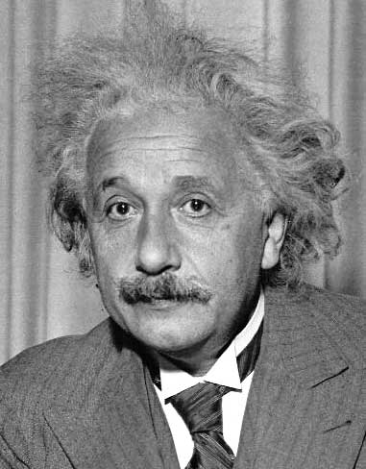
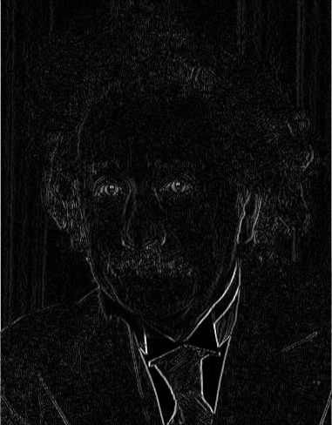
Matrix Operations
Image filtering

